Slide 1
Tragedy in Pakistan
Sermon Delivered by Hadhrat Mirza Masroor Ahmad (aba); Head of the Ahmadiyya Muslim Community
relayed live all across the globe
19 December 2014

Slide 2
Summary
Today Huzoor observed that these days many incidents of barbarity and brutality are carried out in Muslim countries.
Recent atrocity in Pakistan was the worst example of brutality and viciousness. Our hearts are filled with compassion and we feel distress for the families .
The Holy Prophet (peace and blessings of Allah be on him) had strictly forbidden to use force against women and children of even non-Muslims during battle!
God enjoins that even enmity should not incline you to be unfair
Those who die in suicide attacks or while fighting and think they will gain pleasure of God after death are certainly wrong.
The Imam of the age taught us the ability to have sympathy and love for those who are associated with our master
Three Funeral Prayer in absentia
19 December2014

Slide 3
Brutality in Muslim countries
Peshawar Incident
The True teaching
Sympathy and Compassion
Promised Messiah as says
Prayers and funerals
The religion of Islam teaches love and brotherhood, completely contrary to its teachings numerous organisations have been formed in the name of implementing Shariah and they are perpetrating such viciousness that one is left aghast whether these are actions of humans or creatures worse than animals in the guise of humans
The developed world
Such episodes do not take place or at least they do not occur with the same frequency
Muslim countries
Many incidents of barbarity and brutality are carried out
Muslim governments and organisations formed in the name of Islam perpetrate cruelty
raises strong protests against such incidents whether the perpetrators are government workers or any groups or individuals e.g. recent protests in USA
for personal interests or in the name of peace and in the name of Islam!
19 December2014

Slide 4
Brutality in Muslim countries
Peshawar Incident
The True teaching
Sympathy and Compassion
Promised Messiah as says
Prayers and funerals
Recent atrocity in Pakistan was the worst example of brutality and viciousness
Our grief at the time and the cruelty perpetrated against us was neither deemed worthy of attention, compassion and condolence by the government [of Pakistan] nor the public, perhaps due to fear of the maulawis.
However, Ahmadis have compassion for mankind and we are moved to see humanity in distress.
Mankind cried out against this injustice and cruelty towards over 100 innocent children
Such Brutality was also seen four and half years ago in our mosques in Lahore. Our mosque attacks were reported by BBC among the worst incidents in Pakistan in the last five years
19 December2014

Slide 5
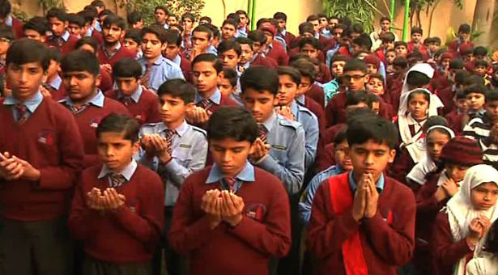
Brutality in Muslim countries
Peshawar Incident
The True teaching
Sympathy and Compassion
Promised Messiah as says
Prayers and funerals
The large majority of victims martyred were innocent children some aged five, six and seven years and others ten, eleven and thirteen years
May God wrap all of them in His cover of mercy and forgiveness and may He also grant patience and steadfastness to their parents.
These children were targeted because the so-called implementers of Shariah wanted to avenge Pakistani army.
This incident exceeded all manner of barbarity
Our hearts are filled with compassion and we feel distress for the families and have great sympathy for them.
19 December2014

Slide 6
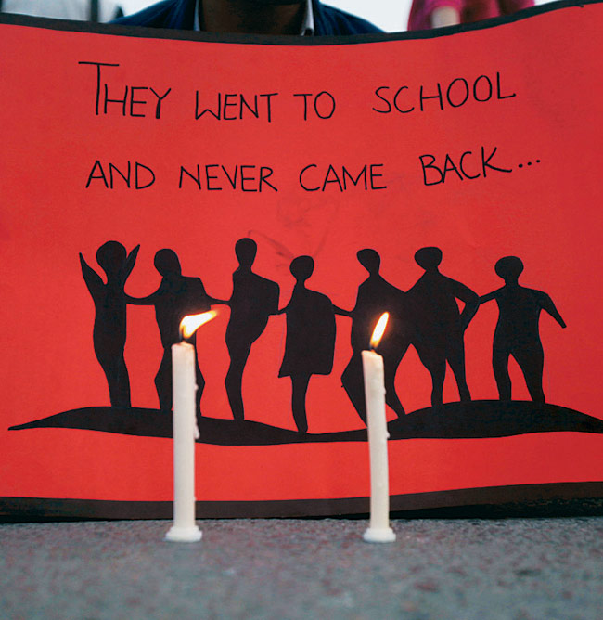
Brutality in Muslim countries
Peshawar Incident
The True teaching
Sympathy and Compassion
Promised Messiah as says
Prayers and funerals
Everyone felt horror and pain regardless of their faith. At the occasion of the first woman Church of England bishop appointment, sentiments of grief were expressed, a minute’s silence was observed and prayers offered.
Once He questioned a Companion who had killed a Jew child in action, the Companion replied, O Prophet of God, he was only a Jew child killed by mistake, what does it matter? The Holy Prophet (peace and blessings of Allah be on him) replied was he not an innocent child of man?
Such was the standard of sanctity of humanity demonstrated to us by the blessed model of the Holy Prophet (peace and blessings of Allah be on him) And these brutal actions are perpetrated in the name of Islam now!
The Holy Prophet (peace and blessings of Allah be on him) had strictly forbidden to use force against women and children of even non-Muslims during battle!
We observed that anyone with decency expressed pain and condolence, whereas those who are called Muslims proudly took responsibility of the atrocity and showed no remorse!
19 December2014

Slide 7
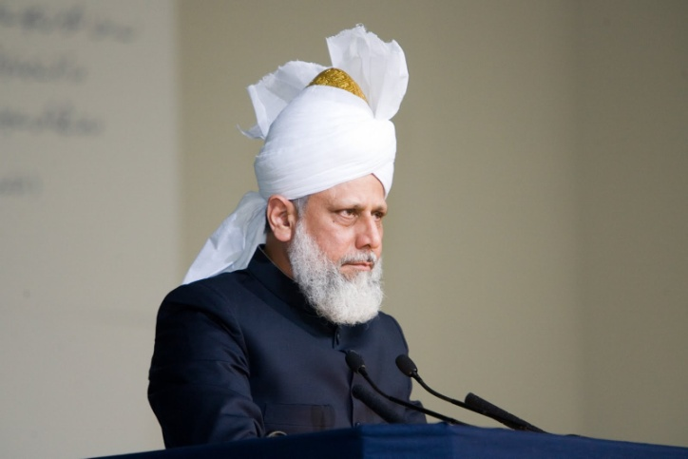
Brutality in Muslim countries
Peshawar Incident
The True teaching
Sympathy and Compassion
Promised Messiah as says
Prayers and funerals
The incident had a great impact on Hazrat Khalifatul Masih throughout the day
Many letters were received by Hazrat Khalifatul Masih expressing pain and distress.
Seeing these incidents one is reminded of the oppressions committed against Ahmadis but one also empathise with the loss of innocent lives.
And in such a situation one prays for the destruction of the cruel.
May God soon rid the country of these vicious and wicked people, and rid all Muslim countries of them.
19 December2014

Slide 8
Extremism and cruelty is a tragedy of almost every Muslim country, e.g Iraq, Syria and Libya
In the anti-government disturbances in Syria about 130,000 people have died, 6600 of which were children and about one-third were civilians
ISIS has killed thousands and hundreds of women and girls have been lined up and executed because they refused to marry ISIS men
According to another source the number of victims of this oppression and destruction is far greater.
Brutality in Muslim countries
Peshawar Incident
The True teaching
Sympathy and Compassion
Promised Messiah as says
Prayers and funerals
One who knows the reality of Islam is befuddled that this is being done in the name of the God Who is Most Gracious, Compassionate and Ever Merciful! In the name of the Prophet who was given the title of mercy for all the worlds/mankind! In the name of the Shariah which teaches to be fair to even one’s enemy!
19 December2014

Slide 9
Brutality in Muslim countries
Peshawar Incident
The True teaching
Sympathy and Compassion
Promised Messiah as says
Prayers and funerals
God enjoins that even enmity should not incline you to be unfair and your models of fairness and justice should become witness to the teaching of Islam.
Until they accept what God states, until they extend fairness even to the enemy, until they give security to those who greet them with peace, until they establish standards of brotherhood, until governments look after public, until public is complaint to governments and until fear of God is instilled in hearts, such atrocities will continue to take place!
‘O ye who believe! be steadfast in the cause of Allah, bearing witness in equity; and let not a people’s enmity incite you to act otherwise than with justice. Be always just, that is nearer to righteousness. And fear Allah. Surely, Allah is aware of what you do.’ (5:9)
Here God elevates the level of the faith of a true believer and if this element of justice is missing then faith is not complete.
If only those who are known as Muslims self-reflect and see if their acts draw non-Muslims to them or not! Their acts are even pushing Muslims away!
19 December2014

Slide 10
Brutality in Muslim countries
Peshawar Incident
The True teaching
Sympathy and Compassion
Promised Messiah as says
Prayers and funerals
Not only are these people perpetrating evident murder and mayhem they are also distancing the next generation from Islam.
Would the children who saw their friends targeted by the vicious barbarity ever consider the perpetrators as Muslims?
And if they did, question will arise in their minds about Islam
If only those known as Islamic religious leaders, who have created these extremist terror organisations in the name of Jihad and sectarianism corrected their faith and gave the next generation the correct teaching of Islam
This can only be achieved if they accepted what the Imam of the age taught and practiced true Islam themselves
19 December2014

Slide 11
Brutality in Muslim countries
Peshawar Incident
The True teaching
Sympathy and Compassion
Promised Messiah as says
Prayers and funerals
The true and ardent devotee of the Holy Prophet (peace and blessings of Allah be on him) wrote
‘The Maulawis will do Islam a great favour if they can unite to dispel this notion from the minds of ignorant Muslims. In so doing, they will not only help to reveal the excellences and beauties of Islam, but will also remove the aversion which religious opponents have for it on account of their misconceptions…’ (How to be Free from Sin, p. 13)
Such was the compassion the Promised Messiah (on whom be peace) had to spread the true teachings of Islam, if only they listened!
The objectives of these so-called Maulawis are not to establish sanctity of Islam. Rather they pursue personal and vested interests. There has not even been any strong condemnation of this incident by the religious scholars.
19 December2014

Slide 12
Brutality in Muslim countries
Peshawar Incident
The True teaching
Sympathy and Compassion
Promised Messiah as says
Prayers and funerals
God states about those who profess the Kalima that they are: ‘…tender amongst themselves…’ (48:30).
‘And whoso kills a believer intentionally, his reward shall be Hell wherein he shall abide. And Allah will be wroth with him and will curse him and will prepare for him a great punishment.’ (4:94)
And God further states as to who a true believer is: ‘…and say not to anyone who greets you with the greeting of peace, ‘Thou art not a believer.’ (4:95)
Today they kill hundreds of thousands of their own and they martyr their own children! Do they think they will escape chastisement! Never!
It should be remembered that God states: ‘…And fear Allah…’ and God is not simply aware of everything just for awareness rather, every action of man decides his fate. And those who perpetrate cruelty certainly have a bad ending.
19 December2014

Slide 13
Brutality in Muslim countries
Peshawar Incident
The True teaching
Sympathy and Compassion
Promised Messiah as says
Prayers and funerals
Those who die in suicide attacks or while fighting and think they will gain pleasure of God after death are certainly wrong.
They have no right to kill one who wishes them peace as a true believer
What on earth was the fault of the innocent children they killed!
Those children were seeking knowledge to become useful part of society, to be assets of the country and to spread peace
It is astonishing to listen to the so-called religious leaders who teach extremism in spite of the beautiful teaching of Islam
Maybe they consider Hell something out of fables or maybe they do not have faith in the Word of God and belief in the Hereafter for they continue to kill each other
Islam has established sanctity of brotherhood and if anyone tramples upon it and kills one who professes the Kalima then most certainly he will go to Hell and he will always be under God’s curse.
19 December2014

Slide 14
Brutality in Muslim countries
Peshawar Incident
The True teaching
Sympathy and Compassion
Promised Messiah as says
Prayers and funerals
Due to fighting and numerous terrorist organisations most muslim countries are like battlegrounds
God has also stated about the results; of harming the sanctity of brotherhood; that one sees in this world: ‘And obey Allah and His Messenger and dispute not with one another, lest you falter and your power depart from you. And be steadfast; surely, Allah is with the steadfast.’ (8:47)
Today this is exactly what the condition of the Muslim world appears to be, their power is diminishing
They do not have each other’s confidence which could facilitate peace and they also have no standing before other countries
Their concept of God is all but void and they consider worldly people the source of their permanence
19 December2014

Slide 15
Brutality in Muslim countries
Peshawar Incident
The True teaching
Sympathy and Compassion
Promised Messiah as says
Prayers and funerals
Pain of Muslim Ummah is also our pain because they are associated with our master.
They are cruel to us but we do not seek revenge, we pray for their hearts to be clear and may they understand. This feeling of compassion and good will for them has been instilled in our heart by the Promised Messiah (on whom be peace). In line with Islamic teaching he has taught us to have compassion for your own and for others.
The Imam of the age taught us the ability to have sympathy and love for those who are associated with our master and he said in poetic form:
O heart! Have concession for these people and be compassionate towards them
After all they claim to love my Prophet
Rather than embroil the Ummah in sectarianism, if religious leaders inculcate the teaching of Islam based on love and peace they might dispel the misconceptions among non-Muslims that Islam is God forbid an extremist and violent religion
19 December2014

Slide 16
Brutality in Muslim countries
Peshawar Incident
The True teaching
Sympathy and Compassion
Promised Messiah as says
Prayers and funerals
Promised Messiah(on whom be peace) wrote
‘True believers and Muslims are enjoined to be gentle and compassionate.’
‘Each person should look at himself every day and see as to how much he cares about these matters and how much compassion and good will he has for his brothers.’
‘The common purpose of the advent of all Prophets is to establish true and real love of God and to instil special import in love for and rights of humanity and among brothers. Until these are practiced all matters are merely ceremonial.’
‘Be compassionate to God’s people and do not oppress them with your tongue, hand or by any other means. Always endeavour for the good of humanity. Do not feel arrogant towards anyone even if they are your subordinate and do not verbally abuse anyone even if they verbally abuse you. Become meek, forbearing and good of intention and be sympathetic to mankind so that you are accepted.’
19 December2014

Slide 17
Brutality in Muslim countries
Peshawar Incident
The True teaching
Sympathy and Compassion
Promised Messiah as says
Prayers and funerals
Promised Messiah(on whom be peace) wrote
‘What does God want from you but this that you treat all humanity with fairness? More than this do good to those who have never done good to you and more than this be compassionate to God’s creatures as if they were your next of kin; as mothers are with their children…The ultimate degree of good is borne of natural instincts like those of a mother.’ (Kishti e Nuh, p. 30 Ruhani Khaza’in Vol 19)
19 December2014

Slide 18
Brutality in Muslim countries
Peshawar Incident
The True teaching
Sympathy and Compassion
Promised Messiah as says
Prayers and funerals
We have these sentiments for all humanity and in greater degree for Muslims. Our grief is heart-felt over any cruelty perpetrated against Muslims
Our pain is intensified when we call out to the world that the Messiah has come according to Divine promises.
The Messiah who was to end wars and conflict and spread love and peace; listen to him! In spite of our calling out those who are known as religious leaders are our worst enimy
In such situations lines of fairness and compassion are blurred, disorder takes place and the innocent are killed as indeed it is happening.
May God bring peace to these countries and may the governments and the public recognise true Islamic values! May God also enable us to maintain good examples!
Due to the situation in Syria, Iraq and Libya Ahmadis are suffering on two counts there; for being citizens of those places and also for being Ahmadi! Some Ahmadis are in dire straits and are living under the open sky. Under the circumstances no help can be sent to them only God may help and have mercy and soon alleviate their difficulties!
19 December2014

Slide 19
Brutality in Muslim countries
Peshawar Incident
The True teaching
Sympathy and Compassion
Promised Messiah as says
Prayers and funerals
Funeral Prayer of
Shaheed Mubarak Ahmad Bajwa Sahib
He was abducted and had been missing since.
Was born in 1953
He was a farmer
He was an honest person
He was gentle and friendly
His father and brother have served the Jama’at and one of his sons is also serving currently.
He leaves behind his widow and four sons, two brothers and a sister.
19 December2014

Slide 20
Brutality in Muslim countries
Peshawar Incident
The True teaching
Sympathy and Compassion
Promised Messiah as says
Prayers and funerals
Mubarak Ahmad Bajwa Shaheed was abducted on 26 Oct 2009
Shaheed was abducted along with a household boy servant. Who was later released with a mobile telephone.
Ransom demands of Rs 20 million was made which was reduced to Rs 1 million to be sent to either Kohat or Parachanar
Recently brother of Shaheed was asked to contact the local police
Arrested Taliban had confessed to abducting and later stabbing him to death and burying his remains in a pit.
He said they abducted him for blaspheming against the Holy Prophet (peace and blessings of Allah be on him) and kept him imprisoned in chains
May God elevate the station of Shaheed and grant steadfastness to his family.
19 December2014

Slide 21
Brutality in Muslim countries
Peshawar Incident
The True teaching
Sympathy and Compassion
Promised Messiah as says
Prayers and funerals
Funeral Prayer of
Amina Sahiba of Kababir
died on 12 December 2014
She had great devotion for Khulafa, listened to Friday sermons most keenly and would be ready with all her heart to obey every instruction.
She sewed clothes but never accepted help from anyone. Before passing away she had instructed that all her belongings should be given to the Jama’at.
She was a born Ahmadi
She served Lajna in various capacities
She was a very prayerful and gave generously
She made arrangements for catering for her local Jama’at during the building of the mosque
She taught many children to read the Holy Qur’an
She was a Moosia
She was the maternal aunt of Munir Odeh Sahib. He was with her when she passed away and her last words were:
There is none worthy of worship except Allah.
19 December2014

Slide 22
Brutality in Muslim countries
Peshawar Incident
The True teaching
Sympathy and Compassion
Promised Messiah as says
Prayers and funerals
Funeral Prayer of
Ibrahim Abdul Bukhari Sahib of Egypt
passed away on 13 December
He faced hostility from his family and also in-laws after accepting Ahmadiyyat but he remained steadfast. He also faced many impediments at work due to his faith where he was psychologically abused. His wife was impressed with his role model and also accepted Ahmadiyyat.
At the age of 63
He had taken bai’at at eighteen and experienced eras of three Khilafats.
He was regular in observing Salat and paying his chanda
Attended Friday Prayers regularly even in his last days in spite of illness
He also visited UK and had great sincerity for Khilafat
He taught Arabic in a school in Nigeria for two and a half years
He leaves behind his widow, a daughter and three sons.
May God elevate the status of all the deceased and grant steadfastness to the bereaved families.
19 December2014

