Slide 1
A Conference on Some Living Religions
Sermon Delivered by Hadhrat Mirza Masroor Ahmad (aba); Head of the Ahmadiyya Muslim Community
relayed live all across the globe
28 February 2014

Slide 2
Summary
A conference on world religions was held in London in 1924 which was graced by Hazrat Khalifatul Masih II (may Allah be pleased with him).
23 September 1924 was a golden day when Huzoor’s superlative treatise was read out at the Wembley Conference
It was a splendorous representation of Islam Ahmadiyyat and brought the message of Islam in the true sense to Europe.
The treatise expounded various subjects in light of Islamic teachings, such as slavery, usury, polygamy, divorce, moral teaching and life after death
This was also a fabulous fulfilment of the vision of the Promised Messiah (on whom be peace) about giving an address in London.
The commendations and cheers that this treatise received were not afforded to any other treatise before it.
Huzoor announced that he would lead funeral Prayer in absentia of Kamal Ahmed Krogh Sahib of Denmark
28 February 2014

Slide 3
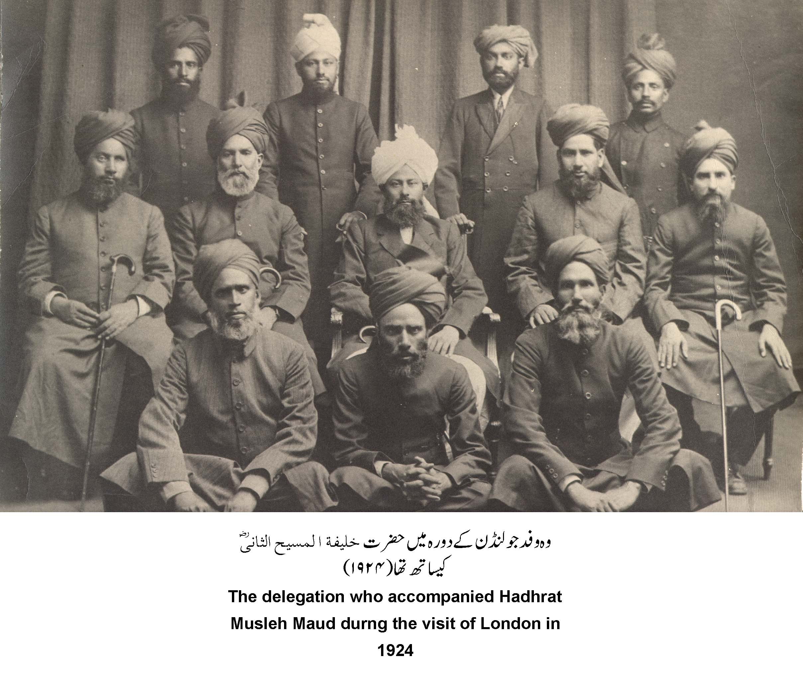
The Wembley Conference
The background
The treatise
The vision of the Promised Messiah AS
Views and remarks
funeral
A conference on world religions was held in London in 1924 which was graced by Hazrat Khalifatul Masih II (may Allah be pleased with him).
28 February 2014

Slide 4
The Wembley Conference
The background
The treatise
The vision of the Promised Messiah AS
Views and remarks
funeral
In the context of Hazrat Musleh Maud’s (may Allah be pleased with him) secular and spiritual knowledge and his achievements Huzoor aba mentioned that God created special circumstances and the management of the conference invited Hazrat Musleh Maud (may Allah be pleased with him) to travel to London and address the conference.
After prayer and Istikhara and consultation with the Jama’at the journey was made borne of special Divine succour. It was not a small matter for Hazrat Musleh Maud (may Allah be pleased with him) to travel with eleven people, given the financial situation of the Jama’at at the time.
This was a first ever European tour of a Khalifatul Masih. He also went to a few other countries [en route] including Syria and Egypt. Only Hazrat Khalifatul Masih II (may Allah be pleased with him) had the chance to visit Arab countries, later situation there worsened and restrictions continued to be put in place.
28 February 2014

Slide 5
The Wembley Conference
The background
The treatise
The vision of the Promised Messiah AS
Views and remarks
funeral
Overseas travels was done by sea in those days and used to take many days. En route once Hazrat Musleh Maud (may Allah be pleased with him) led Salat on the deck between the 1st class and the 2nd class and when finished he sat with his companions when the ship’s Italian doctor happened to pass by. Seeing them, he spontaneously remarked, ‘Jesus Christ and his twelve disciples!’
Dr Hashmat Ullah Sahib relates that he was astonished upon hearing this. An Italian, who was a follower of the Pope, said something most accurate and spiritual. The twelfth person travelling with Hazrat Khalifatul Masih II (may Allah be pleased with him) was Dr Muhammad Sharif Sahib who had joined them but was travelling privately.
28 February 2014

Slide 6
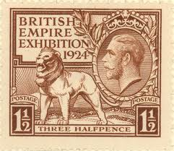
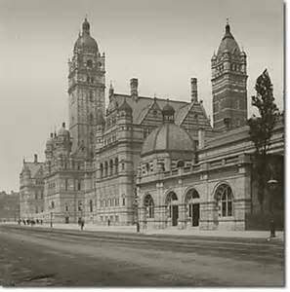
The Wembley Conference
The background
The treatise
The vision of the Promised Messiah AS
Views and remarks
funeral
A committee was formed under the auspices of The School of Oriental Studies of the London University to extensively prepare for the conference.
The Imperial Institute was chosen as the venue and the conference dates were fixed as 22 September to 3 October.
The committee chose to invite representatives from the following religions:
Hinduism, Islam, Buddhism, Zoroastrianism, Jain, Sikhism, Sufism, Brahmo Samaj, Arya Samaj, Confucianism etc.
The conference is widely known as Wembley Conference. In early 1924, a socialist leader William Loftus Hare suggested to hold a religious conference in conjunction with the renowned Wembley Exhibition to which religious representatives of the religions of the British Empire should be invited to expound principles of their religions.
28 February 2014

Slide 7
The Wembley Conference
The background
The treatise
The vision of the Promised Messiah AS
Views and remarks
funeral
Maulwi Abdul Rahim Nayyer Sahib had been in London since 1923 but he did not know about this proposed grand conference.
After the committee had already chosen speakers for the conference, Maulwi Sahib came to hear about the conference.
Nayyar Sahib showed great courage and went to see the joint secretary of the committee Mr. M Sharples, who after the meeting felt that the Ahmadi point of view on Islam should be included in the conference.
Nayyer sahib went to see the committee and, its vice-president, Dr Sir Thomas W Arnold suggested that Nayyar Sahib should be consulted about choosing speakers for the conference.
28 February 2014

Slide 8
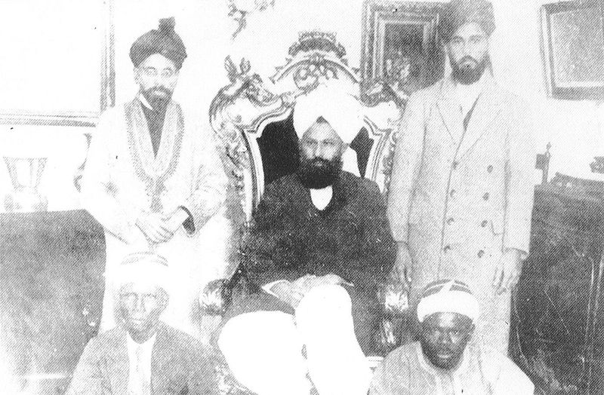
The Wembley Conference
The background
The treatise
The vision of the Promised Messiah AS
Views and remarks
funeral
From right to left: Fazl ul-Rahman Hakim sahib; Mirza Bashir ud-Din Mahmood Ahmad sahib and Abd ur-Rahim Nayyar sahib. At the bottom two West-Africans.
Nayyer Sahib suggested the name of Hazrat Sufi Roshan Ali Sahib for Sufism but also informed the committee that Sufi Sahib could only attend with the approval of Khalifatul Masih II (may Allah be pleased with him).
Thus an invite was sent to Hazrat Musleh Maud (may Allah be pleased with him) from the leading Orientalists
28 February 2014

Slide 9
The Wembley Conference
The background
The treatise
The vision of the Promised Messiah AS
Views and remarks
funeral
Hazrat Musleh Maud started writing the treatise for the conference.
Its translation and revision work was entrusted to Chaudhary Zafrulla Khan Sahib, Maulwi Sher Ali Sahib and Mirza Bashir Ahmad Sahib.
The piece turned out to be too lengthy for the conference and it was not appropriate to summarise it.
It was decided to write another treatise.
23 September 1924 was a golden day in Huzoor’s European tour when Huzoor’s superlative treatise was read out at the Wembley Conference
It was a splendorous representation of Islam Ahmadiyyat and brought the message of Islam in the true sense to Europe. This was also a fabulous fulfilment of the vision of the Promised Messiah (on whom be peace) about giving an address in London.
28 February 2014

Slide 10
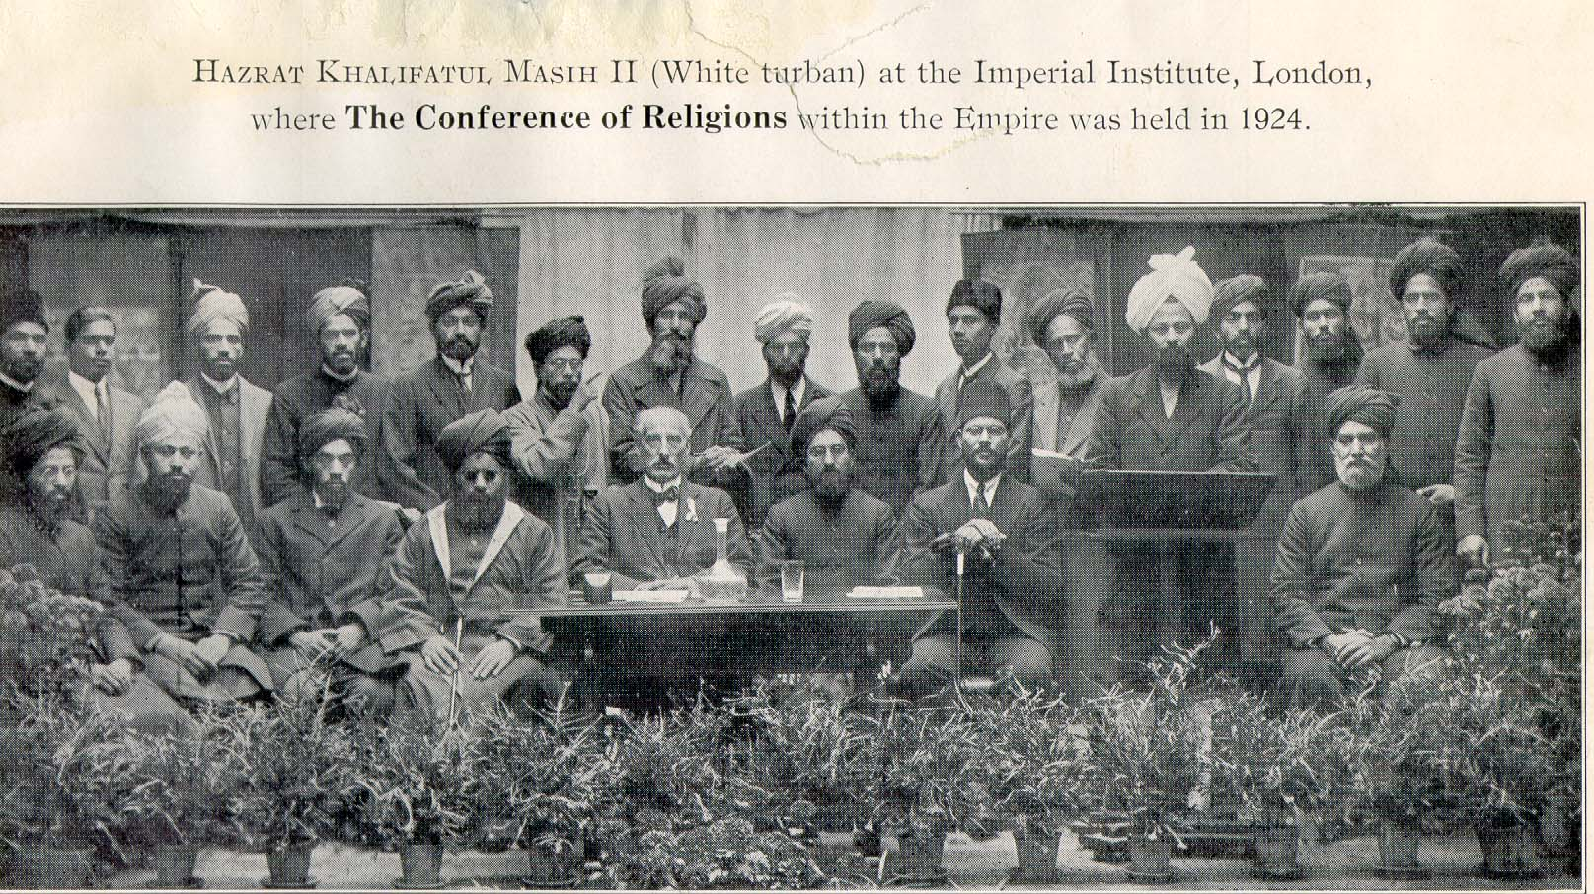
The Wembley Conference
The background
The treatise
The vision of the Promised Messiah AS
Views and remarks
funeral
The time for the treatise was 5 p.m.
Attendance for this addresses surpassed any other
Sir Theodore Mersin who was presiding the conference requested Hazrat Khalifatul Masih II (may Allah be pleased with him) to address the conference.
28 February 2014

Slide 11
The Wembley Conference
The background
The treatise
The vision of the Promised Messiah AS
Views and remarks
funeral
Huzoor was already on the stage with his associates; he stood up and briefly said:
‘Mr President, sisters and brothers! First and foremost I thank God Who put it in the hearts of the organisers of the conference that people should reflect in this manner on the subject of religion and after listening to speeches on different religions see which religion should be accepted. I now ask my follower Chaudhry Zafrulla Khan Sahib, Bar-at-law, to read my treatise. I am not accustomed to reading in this manner even in my own language because my speeches are always unprepared and I speak for up to six hours. The subject of religion does not conclude here in this world, rather after death it moves on to the next world and man’s eternal happiness is associated with faith. Therefore, reflect and ponder over this and I hope you will listen attentively.’
28 February 2014

Slide 12
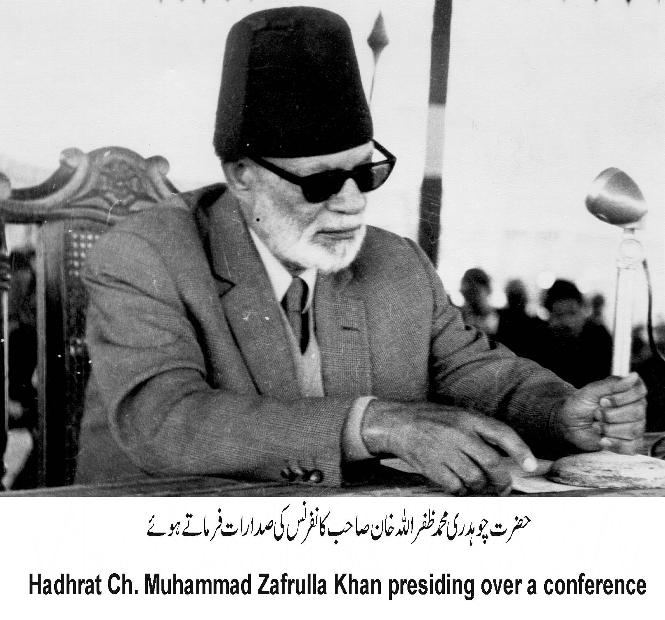
The Wembley Conference
The background
The treatise
The vision of the Promised Messiah AS
Views and remarks
funeral
Chaudhry Zafrulla Khan Sahib read the treatise in a commanding tone although he had a bit of sore throat but Divine succour was with him, he took one hour to read the treatise.
The audience listened to the address in a trance. When the address touched upon something about Islam which was new for them, some people would bounce in their chairs with joy. Subjects such as slavery, usury, polygamy etc. were explained most articulately.
Hazrat Khalifatul Masih II (may Allah be pleased with him) once said, ‘although Chaudhry Zafrulla Sahib read the treatise, it was my tongue [speaking].’
28 February 2014

Slide 13
The Wembley Conference
The background
The treatise
The vision of the Promised Messiah AS
Views and remarks
funeral
The gist of the treatise
Hazrat Musleh Maud (may Allah be pleased with him) mentioned the forming of the Ahmadiyya Movement in 1889
He mentioned the Promised Messiah’s (on whom be peace) claim to be the Mahdi as prophesised by the Holy Prophet (peace and blessings of Allah be on him)
His claim to be the Messiah as foretold by the Gospels and also Muslim books.
He said that due to this claim he faced intense opposition on all fronts.
Yet, in spite of all the enmity people thronged around him and with the grace of God a community was formed which was spreading to different countries of the world
28 February 2014

Slide 14
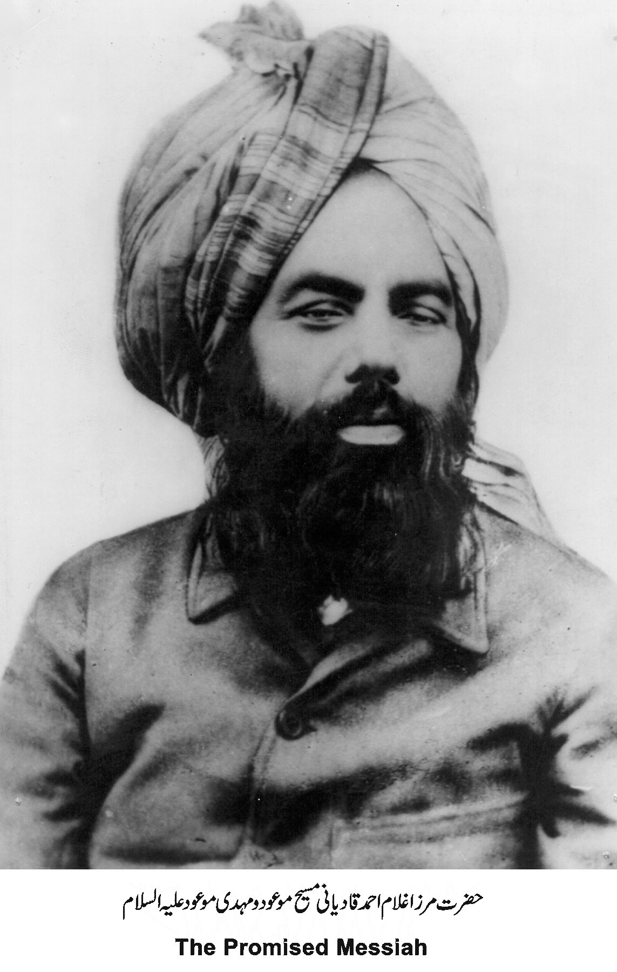
The Wembley Conference
The background
The treatise
The vision of the Promised Messiah AS
Views and remarks
funeral
The gist of the treatise
This indeed was the time and the condition when a reformer was needed who was foretold and whose signs were also given.
He mentioned that the Promised Messiah (on whom be peace) told that God still talked to pious people and listened to their prayers, He is Ever Merciful and Compassionate and by sending the Promised Messiah, He had facilitated reformation of the world.
The Promised Messiah (on whom be peace) had given proof of the existence of God by convincing people of belief in God, by proving His Oneness and by instilling connection with Him.
Hazrat Musleh Maud (may Allah be pleased with him) most clearly said that if a religion cannot offer perfect identification of existence of God, it is not worthy of being called a religion.
He also expounded the status of Prophets of God and connection with God of every human for spiritual development.
28 February 2014

Slide 15
The Wembley Conference
The background
The treatise
The vision of the Promised Messiah AS
Views and remarks
funeral
The gist of the treatise
He also explained that the Promised Messiah (on whom be peace) had elucidated with great wisdom and foresightedness that although the Holy Qur’an is the last law-bearing and perfect Book
That does not mean that man had reached the pinnacle of intellectual progress.
Rather, the beauty of the Qur’an being the last Book is that it has a profound treasure-trove of knowledge hidden in it which is given to those who are sincerely serious in its search. Serious search leads to spiritual progress and this also facilitates one to find worldly and academic subjects in the Qur’an in accordance to personal understanding and discernment.
The Holy Qur’an rejects the objection that Islam was spread with force and he gave the verse of ‘there is no compulsion in religion’ as a proof.
He said fighting is only allowed when there are attempts to eliminate and harm Islam.
Thus with great wisdom and great courage Hazrat Musleh Maud (may Allah be pleased with him) mentioned the qualities of Islam and also invited people to Islam. The treatise was extremely well-received.
28 February 2014

Slide 16
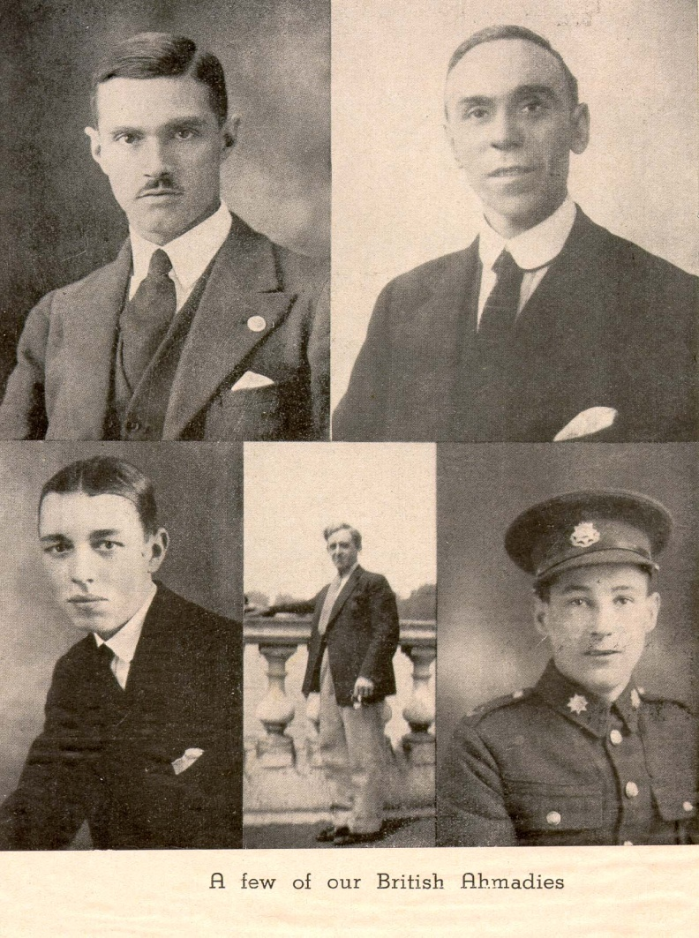
The Wembley Conference
The background
The treatise
The vision of the Promised Messiah AS
Views and remarks
funeral
He mentioned Divine signs corroborating truthfulness of the Promised Messiah (on whom be peace) and mentioned the following vision of the Promised Messiah:
‘I saw in a vision that I was standing on a pulpit in the city of London and was setting forth the truth of Islam in the English language, in a very well reasoned address. Thereafter I caught several birds who were sitting upon small trees and were of white colour and their bodies resembled the bodies of partridges. I interpreted this vision as meaning that though I would not be able to travel to that country but that my writings will be published there and many righteous English people will accept the truth.’ [Tadhkirah, p. 239 2009 edition]
The first fulfilment of this vision was this treatise of Hazrat Musleh Maud (may Allah be pleased with him).
He also said that truth is revealed to one if one prays while being free from all bias for forty days for the truth.
28 February 2014

Slide 17
The Wembley Conference
The background
The treatise
The vision of the Promised Messiah AS
Views and remarks
funeral
In conclusion these are the words with which Hazrat Musleh Maud’s (may Allah be pleased with him) treatise finished:
‘Sisters and brothers, the Light of God has shone forth for you, and that which the world had, owing to the lapse of time, come to regard as a romantic tale, has appeared before your very eyes. The Glory of God has been made manifest to you through a Prophet; yea, a Prophet whose advent had been foretold by all previous Prophets from Noah to Muhammad (on whom be peace and the blessings of God), and God has again demonstrated to you the fact that He is not only the God of those that are dead, but also of those that are living; and not only the God of those that have gone before, but also of those that shall come after. Accept ye then this Light, and let your hearts be lit up with it. Sisters and brothers, this life is but an episode, and it is wrong to imagine that it is followed by annihilation; there is no such thing as annihilation. The soul was not created for annihilation, but for eternal life.
From the moment of his birth, man begins to tread along a never-ending path, and death is nothing but a device to quicken his pace. How is it that you who are constantly striving to outstrip each other in small competitions are completely neglecting this huge competition which is for ever proceeding between those that have gone before and those that have taken their place?
28 February 2014

Slide 18
The Wembley Conference
The background
The treatise
The vision of the Promised Messiah AS
Views and remarks
funeral
Do you not perceive that a righteous man was raised in the East and God has, through him, caused the Truth to be brought to your doors? Be truly grateful for this Grace which you have received, so that you may receive more abundant Grace, and run forward to receive His Mercy, so that His love for you should swell in volume. How is it that you who condemn all such intoxicants as render the brain sluggish are content with teachings that profit not and merely still the yearnings of the soul? You refuse to bow before idols, then how can you bow before an imaginary image of God that gives no sign of life? Come and drink of the Divine nectar of life that God has provided for you; this is a nectar that kills not reason, but illumines it; it does not undermine the nervous system, but strengthens it.
Rejoice, ye bridesmaids, and sing joyful hymns, for the bride-groom has come. He who has been sought after has been found. He who was being waited for till the eyes of those who waited had become dim now illumines your eye; blessed is he who comes in the name of the Lord. Those who find him find all, and those who see him not will see nothing. And the end of our discourse is praise be to Allah, the Lord of the Universe.’
28 February 2014

Slide 19
The Wembley Conference
The background
The treatise
The vision of the Promised Messiah AS
Views and remarks
funeral
The president of the conference said in his remarks
The Ahmadiyya Movement and other such current movements prove that Islam is a living religion and high level scholarship was engaged in for its renaissance. Mirza Bashir ud Din who was accompanied by many green-turbaned followers said that Ahmadiyya Movement is an important and natural revival of Islam just as dispensation of Jesus was for the dispensation of Moses. Its objective is not to introduce any new religious law; rather it is the dissemination of the true and real Islam. ..the treatise had itself proved its quality and refinement. He thanked Hazrat Musleh Maud from himself and also on behalf of the audience for the excellence of order and excellence of thought of the treatise and said that the faces of the audience were in accord with what he was saying.
He said he was sure that he was rightfully thanking on behalf of the audience and was paying the dues of representing them. He congratulated Hazrat Musleh Maud on the success of the treatise and said that his piece was the best among the ones read on the day. He said ‘do you not think that you came here for the success that you received today!’
28 February 2014

Slide 20
The Wembley Conference
The background
The treatise
The vision of the Promised Messiah AS
Views and remarks
funeral
Head of the Free Church Dr Walter Wash
who was a great orator said that he was most fortunate to listen to the treatise.
A professor of law
said that as he listened he felt as if it was the beginning of a new era. He also said that had thousands been spent in some other way, it would not have availed such great success.
A priest
said that three years ago he had seen in a dream that Jesus had come with thirteen disciples and now the dream had been fulfilled. Huzoor explained the thirteenth person in the group was Chaudhary Zafrulla Khan.
Miss Sharples, the conference secretary
said that His Holiness appeared to be the Luther of the age.
Some said, ‘there is fire in him’, someone said this treatise was the best.
A German professor
After the conference came forward while walking on the road to greet Hazrat Musleh Maud and congratulate him and said that very important Englishman were sitting next to him who would slap their knees and say that these were great ideas and one did not get to hear such great ideas every day. He said many spontaneously remarked, ‘what a beautiful and true principle.’
Mr Lane
a high-ranking officer in the India Office
acknowledge that Hazrat Musleh Maud’s treatise was excellent and the best among the rest.
28 February 2014

Slide 21
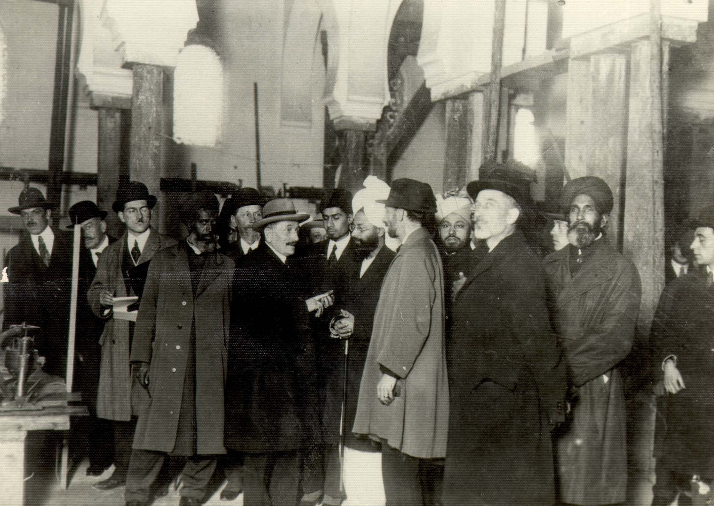
The Wembley Conference
The background
The treatise
The vision of the Promised Messiah AS
Views and remarks
funeral
A French person
said that he used to give preference to Islam over Christianity but gave preference to Buddhism over Islam. After listening to Hazrat Musleh Maud’s treatise as well as the Buddhism viewpoint he acknowledged that in reality Islam was the best religion. He said he was most influenced by the way Islam’s excellence was depicted and no other religion could contend with it
28 February 2014

Slide 22
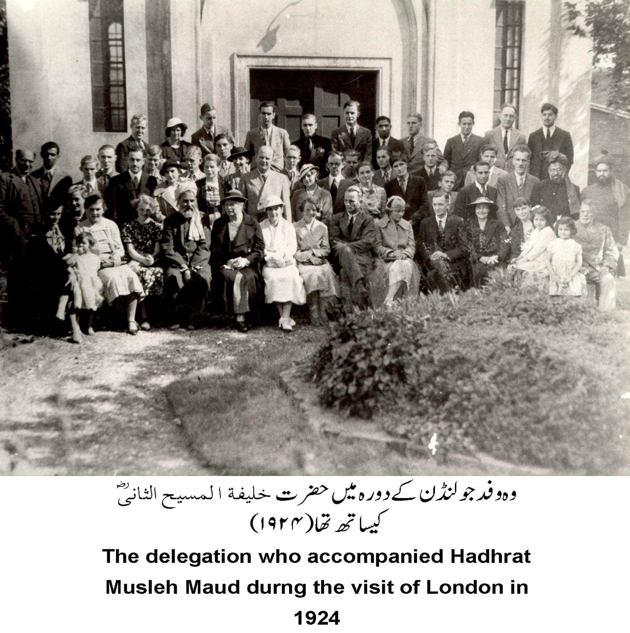
The Wembley Conference
The background
The treatise
The vision of the Promised Messiah AS
Views and remarks
funeral
A woman said she was from the Baha’i faith but after listening to the treatise she had changed her mind and wanted to listen to further such lectures and said that if she was informed of the time and place she would definitely attend
Although Mr Lane from the India Office had attended, his wife came the next day and met with people of the entourage and said that her husband had told her how successful and popular the treatise had been.
An atheist woman said she had found the treatise charming and she found the ideas in it great and truthful.
28 February 2014

Slide 23
The Wembley Conference
The background
The treatise
The vision of the Promised Messiah AS
Views and remarks
funeral
Bhai Abdul Rahman Qadiani related that a unanimous resolution was passed after the conclusion of the treatise which thanked His Holiness for useful information, academic ideas and great advice.
A Christian woman
who had attended the conference with her daughter followed Hazrat Musleh Maud (may Allah be pleased with him) and insisted on inviting him to tea. Huzoor declined owing ….she continued to insist and had him to agree, saying it did not matter what time they came as long as they did!
Another person said that he found the treatise to be lovelier than the sentiments of patriotism.
A person went up to Hazrat Musleh Maud (may Allah be pleased with him) and said that he had worked in India for thirty years as a missionary and had studied the circumstances and arguments of Muslims. However, he had never heard something as clear and refined as the treatise presented on the day. It had affected him greatly as regards its thoughts, its order and its arguments.
A professor who was also a priest
first came to the house and also attended the conference. He was most impressed and also took some books away. While listening to the treatise he bounced on his chair with excitement. He later said he would preach Islamic thoughts.
28 February 2014

Slide 24
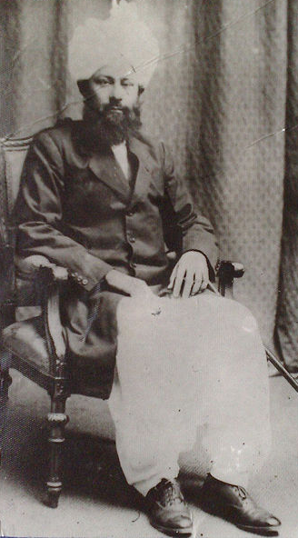
The Wembley Conference
The background
The treatise
The vision of the Promised Messiah AS
Views and remarks
funeral
24 September 1924
‘An incident that caused excitement in the conference took place when a new sect of Islam was mentioned.’….
‘According to people of this sect they were established 34 years ago by the Messiah who is prophesised in the Bible and other books. This Movement claims that God laid the foundation of this Movement in accordance with His explicit revelations so that mankind may reach God through Islam. A person from India wearing a white turban, with a radiant, pleasant face supporting a black beard and whose title is His Holiness Khalifatul Masih Al-Haaj Mirza Bashir ud Din Mahmood Ahmad, or for short Khalifatul Masih, presented the aforementioned challenge in his treatise which was entitled ‘Ahmadiyya Movement in Islam’…one of his followers wearing a red Turkish cap read his treatise in an excellent manner…he concluded his treatise which mostly promoted and supported Islam on a passionate appeal in which he invited the audience to accept this new Messiah and his new teaching. … the commendations and cheers this treatise received were not afforded to any other treatise before it.’
28 February 2014

Slide 25
The Wembley Conference
The background
The treatise
The vision of the Promised Messiah AS
Views and remarks
funeral
Funeral Prayer in absentia of Kamal Ahmed Krogh Sahib of Denmark.
His wife says when he came home late after Jama’at work he would start planning for the next day’s meetings and would then sit up till midnight writing reports which he would send to ameer sahib and only then went to bed.
born in 1942.
taught various subjects till 2003.
accepted Islam in 1960s ,students of Abdus Salam Madsen Sahib.
most loyal, sincere and loving Ahmadi,an ardent love of Khilafat.. served the Jama’at in various capacities for long periods of time.
love for Tabligh was obsessive.
Krogh Sahib was also very popular among people outside the Jama’at and many have left their comments on the Danish electronic media.
On 18 February he fell ill and passed away on 19 February. He leaves behind a widow, a son and a daughter. His widow is also serving the Jama’at and does translation work
28 February 2014

Slide 26
Ameer Sahib Denmark writes that Krogh Sahib always assisted him with obedience and compliance .. when a copy of Danish translation of the Qur’an was presented to the Danish prime minister … he had arranged the meeting.
He would hold a programme on every Friday evening for the education and training of youngsters.
He authored many books and also did many translations and revised/reviewed the Danish translation of The Philosophy of the Teachings of Islam.
He took the message of Islam Ahmadiyyat to many in 1970s and 1980s.
In 2004 he suffered from stroke and in spite of his ailment remained regular at Friday Prayers and Jama’at gatherings
One comment says that Krogh Sahib was a great man who was always greatly admired.
He was a role model and as an academic was well-versed in all his subjects.
Kamal Sahib was a teacher who can never be forgotten.
The Wembley Conference
The background
The treatise
The vision of the Promised Messiah AS
Views and remarks
funeral
Another comment says, I hope there will be another soul in Denmark to continue his works that he had initiated to build bridges between the Danes and Muslim immigrants. He had started this to create an atmosphere for dialogue. It is sad that rather than promote mutual accord some people in our society put fuel on fire.
May God elevate the status of the deceased, grant steadfastness and courage to his widow and children and may He ever keep them connected to the Jama’at.
28 February 2014

