Slide 1
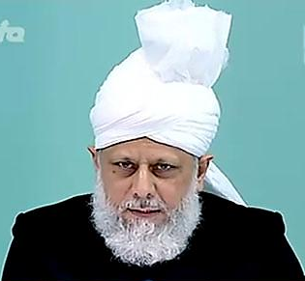
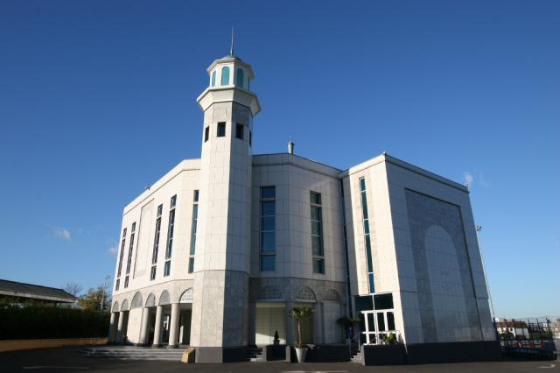
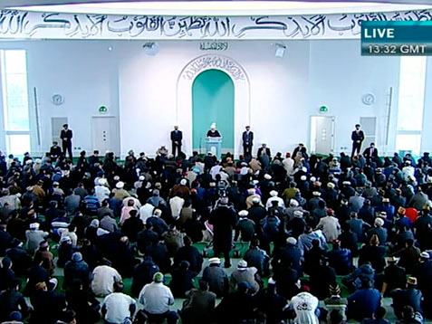
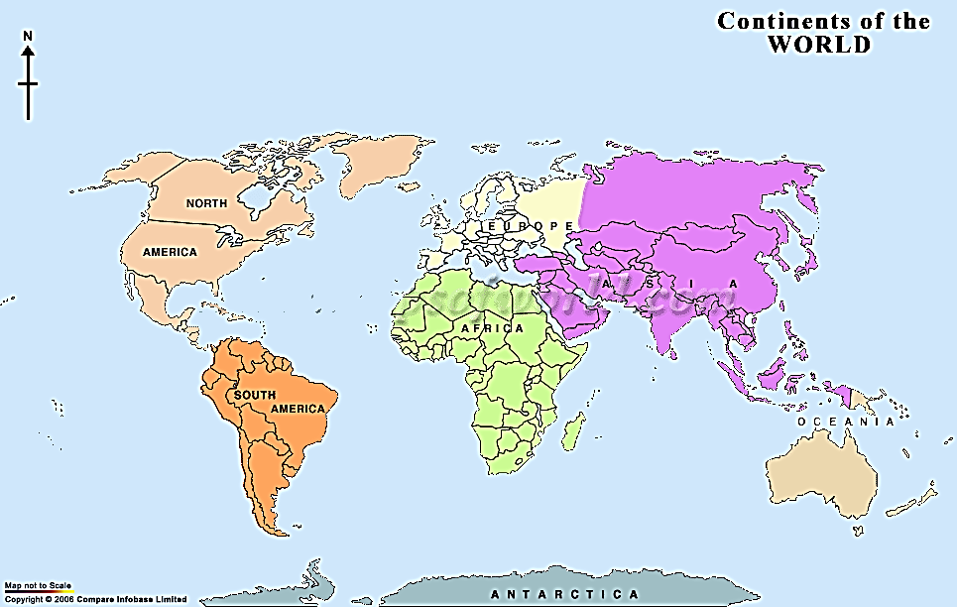
Sermon Delivered by Hadhrat Mirza Masroor Ahmad (aba) Head of the Ahmadiyya Muslim Community
Brutal torture and martyrdom of Master Abdul Qudoos in Rabwah
Friday Sermon April 6th, 2012

Slide 2
SUMMARY
As a part of enemy ploy, a sincere Ahmadi was brutally murdered in police custody after severe torture in Rabwah
Martyrdom in our Community started with the martyrdoms of Abdul Rahman shaheed and Sahibzada Abdul Latif shaheed
Hudhur Aqdas said that God listened to the prayers of the Promised Messiah (on whom be peace) and granted steadfastness to many Ahmadis and they offered their lives for the cause
Hudhur said that people of Rabwah should remember that Qudoos shaheed has done a tremendous favour on Jama’at and Jama’at never forgets its benefactors and InshaAllah we will always remember him
Ahmadis were tortured and martyred in 1974 in Pakistan and also in Indonesia
Friday Sermon April 6th, 2012

Slide 3
Hudhur began by reciting the following Quranic verses:
‘Think not of those, who have been slain in the cause of Allah, as dead. Nay, they are living, in the presence of their Lord, and are granted gifts from Him,Jubilant because of that which Allah has given them of His bounty; and rejoicing for those who have not yet joined them from behind them, because on them shall come no fear, nor shall they grieve. They rejoice at the favour of Allah and His bounty, and at the fact that Allah suffers not the reward of the believers to be lost. As to those who answered the call of Allah and the Messenger after they had received an injury — such of them as do good and act righteously shall have a great reward; Those to whom men said, ‘People have mustered against you, therefore fear them,’ but this only increased their faith, and they said, ‘Sufficient for us is Allah, and an excellent Guardian is He.’
(Surah Ale Imran, verses 170 – 174)
Friday Sermon April 6th, 2012

Slide 4
The Promised Messiah (on whom be peace) had a revelation: ‘Good news to thee, O My Ahmad, thou art My purpose and with Me. I have planted the tree of thy honour with My own hand.’ [Tadhkirah, p 301]
Hudhur Aqdas said under the influence of the Mullah the government in Pakistan and also in some other countries, thinks that by legislating against them, by depriving them of their civic rights and by targeting them with extremism and giving impunity to their killing, they can eradicate Ahmadiyyat
Ahmadiyyat was grafted by God’s hand and no power can destroy it
This is their mistake
Progress of Ahmadiyya Community
Hudhur Aqdas said .., the progress and advancement of the Community shows that God’s practical testimony is with our Community. Today our unification on the hand of Khilafat is a great practical testimony
Friday Sermon April 6th, 2012
Notes:
Hudhur Aqdas said under the influence of the Mullah the government in Pakistan and also in some other countries, thinks that by legislating against them, by depriving them of their civic rights and by targeting them with extremism and giving impunity to their killing, they can eradicate Ahmadiyyat. This is their mistake. Ahmadiyyat was grafted by God’s hand and no power can destroy it. The Promised Messiah (on whom be peace) had a revelation: ‘Good news to thee, O My Ahmad, thou art My purpose and with Me. I have planted the tree of thy honour with My own hand.’ [Tadhkirah, p 301] Hudhur Aqdas said human efforts against our Community have always gone on and will continue to go on but the Community will not be destroyed by them. At the time of this revelation there were only a few people with the Promised Messiah (on whom be peace). Today our Community is spread in 200 countries of the world and consists of astonishingly sincere people. In spite of the efforts of our enemies from the early days up till now to harm us we have progressed. This alone should be sufficient proof of the truthfulness of this Community. The Promised Messiah (on whom be peace) said that some people declared that God had informed them or revealed to them that ‘Mirza sahib’ was false, some people of other religions also made such assertions. However, the Promised Messiah (on whom be peace) said that there were also numerous people who had taken Bai’at and gave testimony that God had revealed to them that this person’s claim was truthful. Hudhur Aqdas said even today hundreds of people are guided by God through dreams etc.to accept Ahmadiyyat. The Promised Messiah (on whom be peace) said that God does not guide people in dissimilar ways and one measure of gauging the truth is to see what God’s actions tell. Hudhur Aqdas said when this point is considered, the progress and advancement of the Community shows that God’s practical testimony is with our Community. Today our unification on the hand of Khilafat is a great practical testimony. Outsiders acknowledge [our]selfless sacrifice of life, property and time; does this not constitute a practical testimony for them? God has strengthened our hearts as one in spite of the cruelties we endure and has kept us inclined. Each Ahmadi who gives life for Ahmadiyyat, for Kalima Tayyaba, for the ardent love of the Holy Prophet (peace and blessings of Allah be on him) and for the sake of becoming God’s servant alone, affirms and declares that their schemes will not stop the progress of our Community.

Slide 5
Martyrdoms
Martyrdom in our Community started with the martyrdoms of Abdul Rahman shaheed and Sahibzada Abdul Latif shaheed
The Promised Messiah (on whom be peace) said regarding the passing away of Sahibzada Abdul Latif shaheed: ‘The late shaheed has given my Community a model with his death and fact is, my Community was in need of a great model.’ He also said: ‘Thousands upon thousands of thanks to Allah the Exalted; there are those who have accepted with sincerity of heart and have adopted this way with sincerity of heart and are ready to bear every pain in this cause. However, the capacities of this Community, of the kind the model of which this gallant man has demonstrated, are as yet unseen. May God teach that faith to everyone and grant that steadfastness of which this late shaheed has presented a model.’
Hudhur Aqdas said God listened to the prayer in the last phrase of the Promised Messiah (on whom be peace) and granted steadfastness to many and they offered their lives for the cause
Friday Sermon April 6th, 2012
Notes:
Martyrdom in our Community started with the martyrdoms of Abdul Rahman shaheed and Sahibzada Abdul Latif shaheed. The Promised Messiah (on whom be peace) said regarding the passing away of Sahibzada Abdul Latif shaheed: ‘The late shaheed has given my Community a model with his death and fact is, my Community was in need of a great model.’ He also said: ‘Thousands upon thousands of thanks to Allah the Exalted; there are those who have accepted with sincerity of heart and have adopted this way with sincerity of heart and are ready to bear every pain in this cause. However, the capacities of this Community, of the kind the model of which this gallant man has demonstrated, are as yet unseen. May God teach that faith to everyone and grant that steadfastness of which this late shaheed has presented a model.’ Hudhur Aqdas said God listened to the prayer in the last phrase of the Promised Messiah (on whom be peace) and granted steadfastness to many and they offered their lives for the cause. Above others, Pakistani Ahmadis have offered their lives but every martyr has his own way, there have been martyrs in Indonesia and in India and other countries, but some become prominent.

Slide 6
Martyrdoms
In Indonesia Ahmadis were tortured publically and in the presence of the police
A few days ago, the in-charge of the Rabwah police station and his assistant locked up a most sincere Ahmadi for a month without bringing any charge against him
During the riots of 1974 against Ahmadis about thirty five Ahmadis were martyred, some of them were tortured. Father was tortured in front of son and son was tortured in front of father to detract them from Ahmadiyyat while police stood by watching
They then took him to another location where they subjected him to extreme torture for eight to ten days. This led to the sincere Ahmadi, whose name was Abdul Qudoos losing his life and attaining the status of martyrdom.
Friday Sermon April 6th, 2012
Notes:
During the riots of 1974 against Ahmadis thirty to thirty five Ahmadis were martyred, some of them were tortured. Father was tortured in front of son and son was tortured in front of father to detract them from Ahmadiyyat while police stood by watching. In Indonesia Ahmadis were tortured publically and in the presence of the police. But they safeguarded their faith while laying every fibre of their bodies open to torture. Be it the law of Pakistan or the law of Indonesia, it can take life but it cannot take away faith. Now Malaysia has also joined these two countries and there appears to be some legislating against us. They too can try, but they should be mindful when God’s Power will come into force it will be difficult to settle up. No Mullah and no legislation will be able to save them. Rather the Mullahs who bring disrepute to the person of the mercy for all the worlds (peace and blessings of Allah be on him) will be the accused in the dock and the faith of the Ahmadi will be resplendent. Ahmadis are not worried, they know the ultimate triumph will be theirs; the objective of their sacrifice is to gain the pleasure of God.
Persecution against Ahmadis is meted out most of all in Pakistan. Governmental workers continue to employ extreme measures and brutality there. A few days ago, the in-charge of the Rabwah police station and his assistant locked up a most sincere Ahmadi for a month without bringing any charge against him. They then took him to another location where they subjected him to extreme torture for eight to ten days. This led to the sincere Ahmadi, whose name was Abdul Qudoos losing his life Inna lillahe wa inna illaihe raji’oon and attaining the status of martyrdom.

Slide 7
On 17 March the police transferred Qudoos sahib to another location. Ten days after taking him away, they brought him back and asked one of his friends to come and collect him. His friend was asked to sign a plain piece of paper declaring that he was taking Qudoos sahib back
The detail of this incident is that a resident of Nusratabad, Rabwah was murdered in October. On the instigation of his son the police arrested different people on different occasions on suspicion of murder but they were all released without charge
On the say so of the deceased’s son, Master Abdul Qudoos was arrested on 10 February. However, his arrest was not formally registered.
Martyrdoms
Qudoos sahib was not very well so his friend promptly took him to hospital. It then transpired that he was subjected to extreme torture
Friday Sermon April 6th, 2012
Notes:
The detail of this incident is that a resident of Nusratabad, Rabwah was murdered in October. On the instigation of his son the police arrested different people on different occasions on suspicion of murder but they were all released without charge. The deceased’s son asked for Master Abdul Qudoos to be brought to the police station for questioning. Qudoos sahib was the local Jama’at sadr. Without any reason, the complainant chose to name Abdul Qudoos sahib in a request to the district police officer and he was arrested on 10 February. However, his arrest was not formally registered. When contacted the police said they knew Abdul Qudoos sahib was also innocent and that they would free him soon but had to keep him there for some reason or the other. On 17 March the police transferred Qudoos sahib to another location. Ten days after taking him away, they brought him back and asked one of his friends to come and collect him. His friend was asked to sign a plain piece of paper declaring that he was taking Qudoos sahib back. Qudoos sahib was not very well so his friend promptly took him to hospital. It then transpired that after taking him away to another location he was subjected to extreme torture. This affected his health adversely and he had blood in his stools as well as he vomited blood and his kidneys were affected. Qudoos sahib told that he was taken away in the dark of night to another place five hours drive away – Hudhur said due to dirt roads travel takes longer - where he was subjected to extreme torture. The torturers kept saying to him to name other office-holders of the Jama’at involved in the murder and by doing so he could be set free. Among the names they suggested were some Nazirs [directors] and others. They also tried to get him to sign some papers which he did not. They would say it was the first time they had got hold of an office-holder and then tortured him. During torture they used abusive language towards the Promised Messiah (on whom be peace) and his Khulafa. When Qudoos sahib’s health deteriorated they provided some medical treatment and brought him back to Rabwah police station. Later, in the ICU of Fazl e Umer hospital he was given continuous blood. On 29 March he again started vomiting blood and his lungs were affected. He passed away on 30 March. There had been preparations to take him to Tahir Heart Institute but he had suffered from internal injuries due to the torture and passed away.

Slide 8
Details of torture
He was asked to sign a documents by many police officers. The papers cited false allegations against some central figures of the Jama’at, so Qudoos sahib refused to sign
On the night of 17 March he was taken away from Rabwah and tortured brutally
Qudoos sahib refused saying it was not his statement and it was also not factual
He was told that if he signed the document saying that such and such people were involved in the murder he would be set free
Friday Sermon April 6th, 2012
Notes:
His brother-in-law visited him regularly at the hospital and writes the account that Qudoos sahib had related to him. He writes that on the night of 17 March he was taken away from Rabwah and tortured brutally. He said that the police station in-charge and the investigative officer both tortured him. He also said that at one point high ranking police officers sat on chairs in a circle and gave him some papers saying it was his statement and that he should sign it. The papers cited false allegations against some central figures of the Jama’at, so Qudoos sahib refused to sign. He was told that such and such people were involved in the murder and if he signed the papers he would be set free. Qudoos sahib refused saying it was not his statement and it was also not factual..

Slide 9
Details of torture
On refusing to sign documents, he was severely beaten
They put him through a range of brutal physical torture techniques
He was put him through sleep deprivation. As soon as he would fall asleep they would start beating him up
There was a well-known villain in the cells with him. If they hit him five times, they would hit Qudoos sahib twenty five times
They taunted him to call his superiors from London or Rabwah to come and save him and used abusive language for elders
He was not fed regularly
Qudoos sahib said he endured the physical torture but was agonised when they used abusive language about Jama’at's elders
He said he did not have the strength to face the torture so he prayed to God to give him strength and was granted the same
Friday Sermon April 6th, 2012
Notes:
When Qudoos sahib twice refused to sign they threw him to the floor and started hitting him and continually demanded him to comply. They put him through a range of brutal physical torture techniques as well as put him through sleep deprivation. As soon as he would fall asleep they would start beating him up. There was a well-known villain in the cells with him. If they hit him five times, they would hit Qudoos sahib twenty five times. At one point his health declined so they gave him some medicinal treatment but as soon as he was better they re-started the torture. They taunted him to call his superiors from London or Rabwah to come and save him and used abusive language for elders. Qudoos sahib said he endured the physical torture but was agonised when they used abusive language. He was not fed regularly. He said he did not have the strength to face the torture so he prayed to God to give him strength and was granted the same

Slide 10
Before his death, Qudoos sahib emotionally reported that despite all this torture police could not even make him write a dot
Hudhur said thus is the tale of one who kept his faith alive and stayed firm on truth
while this great martyr has given us other lessons, one lesson he gave us and on which the Ahmadiyya Community is based, is not to care for one’s life for the establishment of Tawheed, (Oneness of God)
Details of torture
Qudoos sahib also fulfilled his pledge of Bai’at in an excellent manner
Friday Sermon April 6th, 2012
Notes:
Hudhur Aqdas said Sadr Amoomi sahib also wrote to Hudhur and said that he asked Qudoos sahib that with all that torture they must have got something in writing from him. Qudoos sahib replied emotionally that they could not even make him write a dot. Hudhur said thus is the tale of one who kept his faith alive and stayed firm on truth. This personification of resolve and courage gave his life but did not give a false statement. God has declared falsehood tantamount to shirk (associating partners with God) and while this great martyr has given us other lessons, one lesson he gave us and on which the Ahmadiyya Community is based, is not to care for one’s life for the establishment of Tawheed, (Oneness of God). Qudoos sahib also fulfilled his pledge of Bai’at in an excellent manner.

Slide 11
Details of torture
Hudhur said if having succumbed to torture, Qudoos sahib had given the desired statement of the torturers it could have proved very damaging for the national and international reputation of the Community
The Jama’at is trying to take action while staying within law
Hudhur Aqdas reiterated that had Qudoos sahib signed the papers it would have been most dangerous, many central office-holders may have been drawn in murder case, there could have been restrictions on the central offices
Friday Sermon April 6th, 2012
Notes:
Hudhur said if having succumbed to torture, Qudoos sahib had given the desired statement of the torturers it could have proved very dangerous for the Community. Just as in the past a so-called organisation tried to make Mirza Ghulam Qadir shaheed a means, the police tried with Qudoos sahib. Hudhur Aqdas said the senior district police officers are expressing ignorance about the matter, it is entirely possible that they were by-passed and the orders came from above on governmental level and junior officers were used. If in the past Gen Zia ul Huq could personally call a local police station in-charge it may very well also happen in the current times. The provisional government is against us. Now that legal process against the perpetrators is afoot, there is talk of conciliation although in Pakistan it is the criminals who are in authority. The Jama’at is trying to take action while staying within law. Hudhur Aqdas reiterated that had Qudoos sahib signed the papers it would have been most dangerous, many central office-holders may have been drawn in murder case, there could have been restrictions on the central offices and there could have been efforts to bring the peaceful nature of our Community in disrepute

Slide 12
Hudhur Aqdas said: ‘O Qudoos, we pay tribute to you; for you accepted to endure extreme torture but did not let the honour of the Jama’at be slighted. By giving your life you saved the Jama’at from a great tribulation.’
Hudhur Aqdas said Qudoos shaheed was not an ordinary martyr, he ranks high among martyrs. Everyone has to leave this temporary world one day. Fortunate is Qudoos sahib who is called living by God and who has been given a provision which is far more excellent than worldly provision. He will find out the true glad-tiding in the Hereafter.
God broke enemy’s ploys through a gentle and sincere man
We should always remember the lesson of ‘Sufficient for us is Allah, and an excellent Guardian is He’ that he gave us.
Friday Sermon April 6th, 2012
Notes:
. The implications could have been on a national [in Pakistan] as well as international level but God broke their ploys through a gentle and sincere man. Hudhur Aqdas said: ‘O Qudoos, we pay tribute to you; for you accepted to endure extreme torture but did not let the honour of the Jama’at be slighted. By giving your life you saved the Jama’at from a great tribulation.’ Hudhur Aqdas said Qudoos shaheed was not an ordinary martyr, he ranks high among martyrs. Everyone has to leave this temporary world one day. Fortunate is Qudoos sahib who is called living by God and who has been given a provision which is far more excellent than worldly provision. He will find out the true glad-tiding in the Hereafter. We should always remember the lesson of ‘Sufficient for us is Allah, and an excellent Guardian is He’ that he gave us.

Slide 13
Abdul Qudoos Shaheed
The Promised Messiah (on whom be peace) said that worldly people cannot harm one in any way if one has a strong connection with God.
Hudhur Aqdas said these people verbally abuse Ahmadis and use indecent words for the Promised Messiah (on whom be peace) and injure our feelings and are happy to torture us but that day is coming soon when God will hold each and every one of them accountable
Qudoos shaheed has left a message for the Pakistani Ahmadis in general and Ahmadis of Rabwah in particular that without doubt we have to respect the law and respect governmental workers but there is no need to be afraid of any person, no matter how high a police officer he may be. One should only fear God
Friday Sermon April 6th, 2012
Notes:
The Promised Messiah (on whom be peace) said that worldly people cannot harm one in any way if one has a strong connection with God. Hudhur Aqdas said these people verbally abuse Ahmadis and use indecent words for the Promised Messiah (on whom be peace) and injure our feelings and are happy to torture us but that day is coming soon when God will hold each and every one of them accountable. Qudoos shaheed has left a message for the Pakistani Ahmadis in general and Ahmadis of Rabwah in particular that without doubt we have to respect the law and respect governmental workers but there is no need to be afraid of any person, no matter how high a police officer he may be. One should only fear God. The police workers [in Pakistan] only appear to enforce themselves on those who obey the law. They are scared witless in front of the Mullah, the terrorists who could blow them up. Hudhur Aqdas said he was recently asked by someone that it was the distinction of our Community that everyone has taken a pledge of allegiance, why then do we not take practical steps in changing the situation in Pakistan. Hudhur said he told them that we cannot be part of the political process because the law of Pakistan states that Ahmadis have to declare themselves as non-Muslims before becoming part of the democratic process, and we could never do this. And exhibiting street power is not our way. We are law-abiding people. The governmental organisations are with those or are afraid of those who have street power. The politicians also listen to them whereas the Ahmadis are deprived of the basic rights.

Slide 14
Hudhur Aqdas said a day will come when these very people will be obliged to respect Ahmadis. There may be delay in God’s ways but there is never injustice. So, these people may have some time but we should turn to God and wait for His decree
Hudhur Aqdas said some police officers have said that criminal proceedings will be brought about in the Qudoos shaheed incident but at the same time pressure is being applied. May God enable them to do justice
Abdul Qudoos Shaheed
It is being claimed that senior officers and the government had nothing to do with this brutal incidence; However, if this matter is not done justly then it will mean that the entire governmental machinery was involved in this state-sponsored terrorism
Friday Sermon April 6th, 2012
Notes:
Hudhur Aqdas said a day will come when these very people will be obliged to respect Ahmadis. There may be delay in God’s ways but there is never injustice. So, these people may have some time but we should turn to God and wait for His decree.
Hudhur Aqdas said some police officers have said that criminal proceedings will be brought about in the Qudoos shaheed incident but at the same time pressure is being applied. May God enable them to do justice. It is being said that although the perpetrators were governmental workers but senior officers and the government had nothing to do with it. If they are not fair in this matter it will mean that the entire governmental machinery was involved in this state-sponsored terrorism. Most certainly these people will reach their cautionary ending.

Slide 15
Martyrs of Ahmadiyyat
Hudhur Aqdas said the Community will InshaAllah continue to progress
Each martyrdom should be a source of progress
If, while being victimised we engage in Taqwa, patience, steadfastness, prayer and Istighfar more than before, we will soon experience triumph
May God make it so and may we soon see an end to cruelty in the name of religion and every other kind of cruelty in Pakistan and other Muslim countries
We should pray that our impatience and our weakness of faith may not distant our destined success from us.
Friday Sermon April 6th, 2012
Notes:
Hudhur Aqdas said the Community will InshaAllah continue to progress. The fact that we are spread in 200 countries is a result of these offerings of lives. The greater the sacrifice, the quicker we can hope for God’s grace. Each martyrdom should be a source of progress. Hudhur said some write and say that apart from patience and prayers we should take other steps. Hudhur Aqdas said patience and prayer are our only weapons. Even now God is granting us much more than our efforts and our prayers. There is no reason for us to be downcast. Apparently the enemy has dangerous ploys but the enemy will never be able to fulfil his longing, the pious-natured among them will continue to join us. Each sacrifice draws our attention; indeed it should draw our attention that in order to change ourselves from the minority to the majority God has made us undergo another attainment. Sacrifices like those of Qudoos shaheed become a source of hundreds of attainments. We believe in the promises God made to the Promised Messiah (on whom be peace) and we witness their fulfilment before us. Who can snatch our fate from us which has been decreed by God? We should pray that our impatience and our weakness of faith may not distant our destined success from us. It should also be remembered that our Jama’at worked for the creation of Pakistan and in its development and today it is the prayers of Ahmadis that are saving Pakistan; indeed can save Pakistan. There is only one antidote to such cruelty and to save this country and that is to turn to God more than before. If, while being victimised we engage in Taqwa, patience, steadfastness, prayer and Istighfar more than before, we will soon experience triumph. May God make it so and may we soon see an end to cruelty in the name of religion and every other kind of cruelty in Pakistan and other Muslim countries.

Slide 16
Qudoos shaheed was born in 1968, he was 43 years old. He was a teacher by profession. He was married in 1997.
He was an able swimmer, keen sportman
He was hard working, obedient, cheerful,
The sons are aged 14, 13 and 5 and the daughter is 10 years old.
Abdul Qudoos
sahib
His wife has written to Hudhur that one day before passing away he advised his children to be steadfast and stay connected to Khilafat
Martyrs of Ahmadiyyat
Hudhur said that Qudoos shaheed has done a tremendous favour on Jama’at and Jama’at never forgets its benefactors and InshaAllah we will always remember him
Notes:
Next Hudhur read an extract from the writings of the Promised Messiah (on whom be peace) in which he explained that each miracle is associated with trials and heart breaking situations bring about enhancement in faith.
Giving a brief profile of Qudoos shaheed Hudhur Aqdas said his grandfather was the first in the family to take Bai’at and he was a companion of the Promised Messiah (on whom be peace) as was his grandmother. Qudoos shaheed was born in 1968, he was 43 years old. He was a teacher by profession. He was married in 1997. His associates say he was a very hard-working and honest person. He began serving the Jama’at from a very young age and had been the sadr of his local majlis for the past two and half years. The people in his neighbourhood speak of him as a very courteous and courageous person. If anyone spoke harshly with him, he would laugh it off. Hudhur said office-holders should remember this. Qudoos shaheed was a cheerful person who was always involved in serving others. He was a good swimmer and whenever there was a case of drowning in the river he would not rest unless he recovered the body for the bereaved family. He was a personification of obedience and held office-holders in great regard. He was a sporty person. Hudhur Aqdas said he was one to do his duty in the background and let his team work in the forefront. Hudhur said Hudhur had personal experience of how he performed his duty. His wife has written o Hudhur that one day before passing away he advised his children to be steadfast and stay connected to Khilafat. His wife writes that he used to often say to her that later she would miss him. He may have had some premonition. Hudhur said she will indeed miss him but people of Rabwah should also promise; we do not disregard favours and Qudoos shaheed has done a tremendous favour on Jama’at and Jama’at never forgets its benefactors and InshaAllah we will always remember him. Hudhur Aqdas said he spoke with his elderly mother who sounded resolute and children and MashaAllah rather than express their own grief his children asked how Hudhur was. Qudoos shaheed leaves behind three sons and a daughter. The sons are aged 14, 13 and 5 and the daughter is 10 years old. Hudhur also spoke with his wife who too was patient and steadfast. May God enable them all to remain steadfast. Hudhur Aqdas said he would lead funeral Prayer in absentia of Master Abdul Qudoos shaheed after Friday Prayer.

