Slide 1
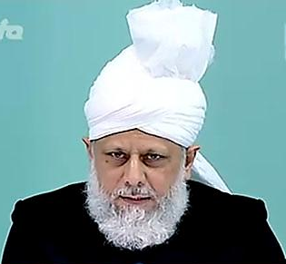
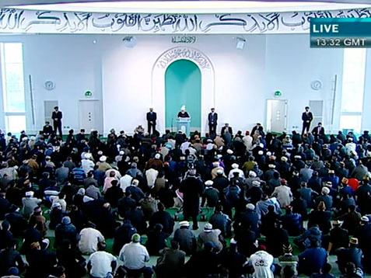
Blessings of Jalsa Salana and Allah's Guidance towards Truth
Friday Sermon
July 8th 2011

Slide 2
SUMMARY
Hudhur (aba) said that the expression of true gratitude for every Jama’at is to look after the new-comers and draw attention to their own improvement.
Hudhur (aba) said that in his sermon of last Friday which was delivered in Berlin, Germany, Hudhur mentioned the Divine blessings of Jalsa as well as the blessings during other programmes organised by the German Jama’at.
Many new aspects of these blessings were observed and new avenues of introduction of the Jama’at were opened which the Jama’at should fully avail of.
Hudhur (aba) prayed that may we always experience progress of our Jama’at.. May God always bestow His grace on us.
Friday Sermon
July 8th 2011
Notes:
Hudhur said that in his sermon of last Friday which was delivered in Berlin, Germany, Hudhur mentioned the Divine blessings of Jalsa which Hudhur saw and felt at Jalsa as well as the blessings Hudhur experienced during other programmes organised by the German Jama’at. Many new aspects of these blessings were observed and new avenues of introduction of the Jama’at were opened which the Jama’at should fully avail of.

Slide 3
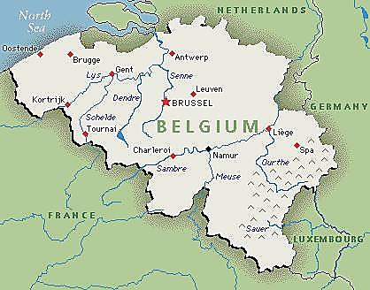
Jalsa Salana Belgium
Hudhur (aba) said Jalsa Salana has also taken place in Belgium and with the grace of God, Belgium is also progressing in Bai’ats, community relations and in taking the message of Ahmadiyyat to others.
Friday Sermon
July 8th 2011
Indeed, all these avenues are being opened by God and expression of true gratitude for every Jama’at is in taking full advantage of these new avenues; look after the new-comers and draw attention to their own improvement.
Notes:
Hudhur said Jalsa Salana has also taken place in Belgium and with the grace of God, Belgium is also progressing in Bai’ats, community relations and in taking the message of Ahmadiyyat to others. Indeed, all these avenues are being opened by God and expression of true gratitude for every Jama’at is in taking full advantage of these new avenues; look after the new-comers and draw attention to their own improvement.

Slide 4
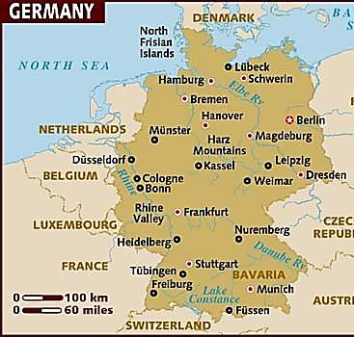
Enthusiasm of new Ahmadies
During the travel to Germany, Hudhur (aba) had stopped overnight at Belgium whereas on the way back Hudhur (aba) had stopped over at Holland and observed many blessings in both these places
One person requested that his Bai’at was taken so that he could be included in great helpers of the Promised Messiah (on whom be peace). Hudhur (aba) said seven or eight others joined him in taking Bai’at.
Hudhur (aba) added that with the grace of God there is great enthusiasm and keenness among them.
Friday Sermon
July 8th 2011
Notes:
During the travel to Germany, Hudhur had stopped overnight at Belgium whereas on the way back Hudhur had stopped over at Holland and observed many blessings in both these places. A meeting with Hudhur was arranged for sixty to seventy people in Belgium. Some among them were close to the Jama’at, God opened their hearts and they were granted persuasion of hearts and minds and were thus enabled to take Bai’at. Hudhur told them that the Promised Messiah’s (on whom be peace) advent took place among the latter-ones to take forward the task of his master, the Holy Prophet (peace and blessings of Allah be on him) who had indeed made the ignorant, who at times stooped to barbarism, recognise true human values and he took them close to God. These people attained high spiritual levels and were so connected to God that worldly matters lost their significance for them and later the Promised Messiah (on whom be peace) came in accordance with Quranic prophecy. Someone in the gathering, who Hudhur assumed was an Ahmadi sought permission to speak. In a very emotional way he told Hudhur that having listened to him that today it is also the task of the followers of the Promised Messiah (on whom be peace) to turn others into godly people, he pledged that he would reform himself as well as be a helper in spreading the true teaching of Islam in the world. He then announced that he wished to enter into the fold of Ahmadiyyat and requested that his Bai’at was taken so that he could be included in great helpers of the Promised Messiah (on whom be peace). Hudhur said seven or eight others joined him in taking Bai’at. Vakeelul Tabshir, Majid sahib is writing a detailed report on Hudhur’s European travel which will be printed in Al Fazl. Hudhur added that all those who took Bai’at were extremely emotional and said they would do whatever was needed of them and they would take to others what they had received. With the grace of God there is great enthusiasm and keenness among them.

Slide 5
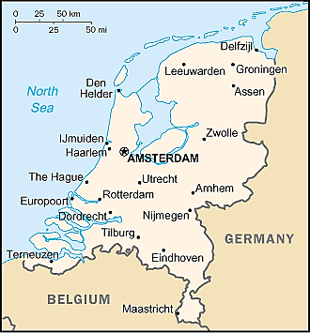
God’s favours on us
On the travels back from Germany Hudhur (aba) stopped at Holland. Today the Jalsa Salana of Holland begins; may it be blessed in every way and may the people there also greatly progress in Tabligh and Tarbiyyat matters.
Hudhur (aba) said that voices against Islam are raised time and again in Holland, they need to work extremely hard as well as pray.
God has indeed started favourable winds in our direction. It is our duty to put in complete efforts to take advantage of these blessings.
Friday Sermon
July 8th 2011
Notes:
On the travels back from Germany Hudhur stopped at Holland. Today the Jalsa Salana of Holland begins; may it be blessed in every way and may the people there also greatly progress in Tabligh and Tarbiyyat matters. As voices against Islam are raised time and again in Holland, they need to work extremely hard as well as pray. The Jama’at as well as the auxiliaries should make programmes to present the teachings of Islam to others. Hudhur met Arabic-speaking new Ahmadis as well as those who are close to the Jama’at. One person among them took Bai’at. God has indeed started favourable winds in our direction. It is our duty to put in complete efforts to take advantage of these blessings.

Slide 6
Hudhur (aba) explained that these people come to meet Hudhur, they speak with him and return with a new passion and vigour, bringing forth a fresh aspect of the revelation of the Promised Messiah (on whom be peace):
‘People whom We will direct from heaven will help you.’
[Tadhkirah, p. 442].
Hudhur (aba) explained that majority of the new Ahmadis are those who were granted the passion to search for the truth by God.
The proverbial mullah can try his best but it is God Who is purifying hearts and inclining them to Ahmadiyyat and these people do not show weakness out of fear of the world.
Passion of New Ahmadies
Friday Sermon
July 8th 2011
Notes:
The emotional condition of the new Ahmadis is ineffable. Such blessings are being bestowed by God on the Jama’at that they are evident even during short visits. The revolutionary changes appear to come about in minutes. Hudhur explained that these people come to meet Hudhur, they speak with him and return with a new passion and vigour, bringing forth a fresh aspect of the revelation of the Promised Messiah (on whom be peace): ‘People whom We will direct from heaven will help you.’ [Tadhkirah, p. 442]. Hudhur explained that majority of the new Ahmadis are those who were granted the passion to search for the truth by God. The proverbial mullah can try his best but it is God Who is purifying hearts and inclining them to Ahmadiyyat and these people do not show weakness out of fear of the world.

Slide 7
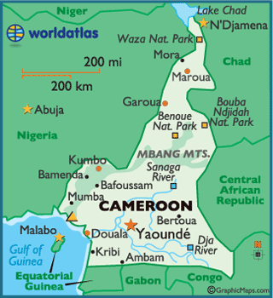
Message of Ahmadiyyat is spreading
Hudhur (aba) said he was recently looking at a report from Cameroon in which our missionary-in-charge wrote that after the English-speaking areas, the message of Ahmadiyyat is also fast spreading among the French-speaking areas.
As a result the jealousy of the local mullah, as well as some visiting mullah from Pakistan is on the increase.
Hudhur said people of Africa may not be well-versed in worldly knowledge but their hearts are illumined with faith.
Friday Sermon
July 8th 2011
Notes:
Hudhur said he was recently looking at a report from Cameroon in which our missionary-in-charge wrote that after the English-speaking areas, the message of Ahmadiyyat is also fast spreading among the French-speaking areas. As a result the jealousy of the local mullah, as well as some visiting mullah from Pakistan is on the increase. Some Pakistan mullahs came to our mosque and were abusive and tried to intimidate. The Ahmadis told them that if they wished to offer Salat, they should do so otherwise, they should leave because no one wished to listen to their nonsense. They left but some sixty kilometres further they went into another of our newly inaugurated mosque. A large majority of the Jama’at there had gone to attend a Khilafat convention in a nearby Jama’at and only a few people were in the mosque. The mullahs intimidated them. The Ahmadis there did not heed them but as some local mullahs as well as some high-ranking people were also in the party they could not do anything in response. The mullahs took some copies of the Qur’an as well as some other books and ripped the board from the front of the mosque and took it with them. When the Jama’at people returned, the authorities were notified. Our opponents had greatly incited everyone against us and they are also well-connected to the authorities. However, when the matter reached the head administrator whom we had invited at the inauguration of the mosque, he said if these people came again, he would have them arrested and would take them to court. Hudhur said people of Africa may not be well-versed in worldly knowledge but their hearts are illumined with faith. It is indeed Satan’s job to turn people away from faith. He had announced that only the pure and the sincere would not come under his spell, the rest he would leave astray. Thus, those who are going to entice to badness, will do so. But those who have been shown the truth and have become sincere servants of God will always stay firm on faith.

Slide 8
Kyrgyzstan
His teachers had taught him a prayer for guidance on the straight path. He made that prayer
He saw a dream in which he saw himself standing on the top of a hill and then jumping from one hilltop to another. He saw a couple of monkeys around which are pestering him. Just then something gigantic appears and saves him from the monkeys.
Later he understood the interpretation of the dream that according to hadith the religious leaders of this age are like monkeys/apes and Ahmadiyya Jama’at had saved him from them.
Our representative from Kyrgyzstan writes that he took his Bai’at last Ramadan.
Friday Sermon
July 8th 2011
Notes:
Our representative from Kyrgyzstan writes that he took his Bai’at last Ramadan. His teachers had taught him a prayer for guidance on the straight path a while ago but he did not make that prayer. A few days after he eventually made that prayer he saw a dream in which he saw himself standing on the top of a hill and then jumping from one hilltop to another. He saw a couple of monkeys around which are pestering him. Just then something gigantic appears and saves him from the monkeys. A few days after seeing this dream, he came in contact with our Jama’at. He obtained some books and read them and soon after he took his Bai’at. Later he understood the interpretation of the dream that according to hadith the religious leaders of this age are like monkeys/apes and Ahmadiyya Jama’at had saved him from them.

Slide 9
Indonesia
The account of an Ahmadi from Indonesia is that years ago before he became an Ahmadi he fell ill and was in hospital.
He saw in a vision the Kalima Shahadah written on a large screen, later Quranic verses and Ahadith appeared on the screen, followed by words; ‘do not die before accepting Islam’ and some other phrases.
In 1998 he retired from the military and met an Ahmadi officer, who told him about our Jama’at. The Ahmadi officer told him that the Ahmadiyya Community was the only community that had a worldwide Imam, the Khalifatul Masih.
He expressed what he had heard many negative things from the mullah about the Promised Messiah (on whom be peace) but the Ahmadi officer told him the facts
As a result his faith continued to enhance and he took his Bai’at. Now his keenness in Tabligh is of an obsessive level.
Friday Sermon
July 8th 2011
Notes:
The account of an Ahmadi from Indonesia is that years ago before he became an Ahmadi he fell ill and was in hospital. When he came to, he saw in a vision the Kalima Shahadah written on a large screen, later Quranic verses and Ahadith appeared on the screen, followed by words; ‘do not die before accepting Islam’ and some other phrases. The person became quite anxious about the message on the screen since he was a Muslim. He began reading books and looked into Ahadith. After reading the hadith about 73 sects of Islam and only one of them to be the true community, he started looking for such a community but remained unsuccessful. In 1998 he retired from the military. He met an Ahmadi officer to whom he mentioned his anxiety. The Ahmadi officer told him about our Jama’at and said that it is important for a Jama’at that it should have an Imam and followers and that the Imam should be on a worldwide level. The Ahmadi officer told him that the Ahmadiyya Community was the only community that had a worldwide Imam, the Khalifatul Masih. He expressed what he had heard many negative things from the mullah about the Promised Messiah (on whom be peace) but the Ahmadi officer told him the facts. As a result his faith continued to enhance and he took his Bai’at. Now his keenness in Tabligh is of an obsessive level.

Slide 10
Gambia
Ameer sahib from The Gambia writes that in a village called Sarai Mahmood, Ahmadis and non-Ahmadis used to offer Salat together.
Non-Ahmadis built a mosque in the neighbouring village. A villager decided to go to the non-Ahmadi mosque for his Friday Prayers.
He saw a dream in which he was told that the mosque he was about to abandon had more acceptance in the sight of God than the other.
After waking, he went to the Ahmadiyya mosque and related his dream to people there.
He said Ahmadiyyat was certainly the truth and he took his Bai’at.
Friday Sermon
July 8th 2011
Notes:
Ameer sahib from The Gambia writes that in a village called Sarai Mahmood Ahmadis and non-Ahmadis used to offer Salat together. Non-Ahmadis built a mosque in the neighbouring village. A villager decided to go to the non-Ahmadi mosque for his Friday Prayers. He took a nap before going for Prayers and had a dream in which he was told that the mosque he was about to abandon had more acceptance in the sight of God than the other. After waking, he went to the Ahmadiyya mosque and related his dream to people there. He said Ahmadiyyat was certainly the truth and he took his Bai’at.

Slide 11
Gambia
In another incident from Gambia someone in a village saw some fair-skinned people in Pakistani clothes in a dream and asked who they were
In the dream he was told they were from Qadian and had come with the Mahdi. The person who saw the dream had no knowledge of Qadian
Later, when he saw our Ameer sahib he said the people he had seen were of his kind and promptly took his Bai’at.
He is now a devoted Ahmadi at the forefront of financial giving and is leading a pious life.
Friday Sermon
July 8th 2011
Notes:
In another incident from The Gambia, Hudhur related that someone in a village saw some fair-skinned people in Pakistani clothes in a dream and asked who they were. In the dream he was told they were from Qadian and had come with the Mahdi. The person who saw the dream had no knowledge of Qadian. Later, when he saw our Ameer sahib he said the people he had seen were of his kind and promptly took his Bai’at. He is now a devoted Ahmadi at the forefront of financial giving and is leading a pious life.

Slide 12
Gambia
Muhammad Ramzan sahib came to our missionary and expressed the wish to join our Jama’at.
The missionary sahib asked him if he had been introduced to the Jama’at.
He replied that he had already wasted a lot of time as he had been guided in a dream for the third time.
He said he had asked God for guidance and was shown an Ahmadiyya mosque in his dream three times.
Friday Sermon
July 8th 2011
Notes:
Muhammad Ramzan sahib came to our missionary and expressed the wish to join our Jama’at. The missionary sahib asked him if he had been introduced to the Jama’at. He replied that he had already wasted a lot of time as he had been guided in a dream for the third time and certainly wanted to take his Bai’at. He said he had asked God for guidance and was shown an Ahmadiyya mosque in his dream three times.

Slide 13
Algeria
He became an Ahmadi and as a consequence his friends abandoned him but he says all he wants is God’s pleasure.
Muhammad Rabe sahib from Algeria writes that he had been viewing MTA for a while and was astonished to hear of the views on death of Jesus (on whom be peace), Dajjal and Imam Mahdi.
He performed Istakharah
He saw a dream in which he is in a mosque with Mustapha Thabit sahib and others who ask him how he came to know of Imam Mahdi. He answers ‘through Istakharah’.
Friday Sermon
July 8th 2011
Notes:
Muhammad Rabe sahib from Algeria writes that he had been viewing MTA for a while and was astonished to hear of the views on death of Jesus (on whom be peace), Dajjal and Imam Mahdi. When he performed Istakharah he saw a dream in which he is in a mosque with Mustapha Thabit sahib and others who ask him how he came to know of Imam Mahdi. He answers ‘through Istakharah’. He became an Ahmadi and as a consequence his friends abandoned him but he says all he wants is God’s pleasure.

Slide 14
Zimbabwe
.
Prior to his Bai’at he had a dream in which his entire body up to his neck is buried in a swamp when someone pulls him out of it. When he was shown a photo of the Promised Messiah (on whom be peace) he recognised him as the person who had rescued him.
The missionary sahib of Zimbabwe writes that an office-holder of Muslim Youth has taken Bai’at.
,
He saw a dream in which he is in a crowd and Jesus (on whom be peace) beckons him, but he cannot reach him in the crowd. He gave up the idea to join the church.
Prior to becoming a Muslim he wanted to join a Christian Church.
Friday Sermon
July 8th 2011
Notes:
The missionary sahib of Zimbabwe writes that an office-holder of Muslim Youth has taken Bai’at. At his first attempt for Baptism the priest fell ill, the second time the priest’s mother fell ill and the third time there was such a heavy downpour that none could rea. Prior to becoming a Muslim he wanted to join a Christian Churchch the church. He saw a dream in which he is in a crowd and Jesus (on whom be peace) beckons him, but he cannot reach him in the crowd. He gave up the idea to join the church. Prior to his Bai’at he had a dream in which his entire body up to his neck is buried in a swamp when someone pulls him out of it. Our missionary asked him if he remembered the person who had pulled him out of the swamp to which he said yes. When he was shown a photo of the Promised Messiah (on whom be peace) he recognised him as the person who had rescued him.

Slide 15
Burkina Fosa
Not only did he take his Bai’at, he did Tabligh in his family and as a result a hundred others also took Bai’at.
Missionary sahib from Burkina Faso writes that a 75 year old person took his Bai’at and said that he saw a holy man in a dream who told him that Hadhrat Adam’s advent had taken place and he should be accepted
A month later he saw the dream again.
The person was told that God had given the Promised Messiah (on whom be peace) the name Adam, this pleased him.
Friday Sermon
July 8th 2011
Notes:
Missionary sahib from Burkina Faso writes that a 75 year old person took his Bai’at and said that he saw a holy man in a dream who told him that Hadhrat Adam’s advent had taken place and he should be accepted. A month later he saw the dream again. The person was told that God had given the Promised Messiah (on whom be peace) the name Adam, this pleased him. Not only did he take his Bai’at, he did Tabligh in his family and as a result a hundred others also took Bai’at.

Slide 16
Egypt
Friday Sermon
July 8th 2011
A lady from Egypt, Haallah sahiba, saw in a dream that Imam Mahdi and his Jama’at are walking on water. She asks them if she could accompany them and they reply they would take her along on their way back.
One day while channel-hopping she happened to come across MTA and was astonished to see the person who she seen walking on water in the dream.
She wrote to Hudhur (aba) that she had seen him in the dream.
Hudhur (aba) explained that God’s objective to show people the Khulafa in dreams is to let them know that after the Promised Messiah (on whom be peace) his Khulafa are carrying on with his mission.
Notes:
A lady from Egypt, Haallah sahiba, saw in a dream that Imam Mahdi and his Jama’at are walking on water. She asks them if she could accompany them and they reply they would take her along on their way back. Following this dream, she looked into Sufism but was not satisfied. One day while channel-hopping she happened to come acorss MTA and was astonished to see the person who she seen walking on water in the dream. She wrote to Hudhur that she had seen him in the dream. Hudhur explained that God’s objective to show people the Khulafa in dreams is to let them know that after the Promised Messiah (on whom be peace) his Khulafa are carrying on with his mission.

Slide 17
Benin
Our missionary from Benin writes that their new domestic help called Lateefa fell ill. She said while she was ill she used to pray to God to forgive her and cause her to die while on the straight path.
The day the lady related this dream was the day of International Bai’at at the UK Jalsa. As she sat watching MTA, she kept repeating that is what she had seen in her dream.
In her dream she saw her room is filled with light and a holy person who is wearing a beautiful appears and beckons her to him. Next time she dreamed that the holy person enters a large white house and says something while he holds people’s hands. There are people of every race present there who repeat words after the holy person
Friday Sermon
July 8th 2011
she took her Bai’at and started paying chanda.
Notes:
Our missionary from Benin writes that their new domestic help called Lateefa fell ill and did not come to work for two to three weeks. When she returned to work it was time for UK Jalsa Salana. She told the murrabi shaib’s wife that she had seen some dreams a few times while she was off-work which had had a deep effect on her. She said while she was ill she used to pray to God to forgive her and cause her to die while on the straight path. In her dream she saw her room is filled with light and a holy person who is wearing a beautiful white turban appears and beckons her to him. Next time she dreamed that the holy person enters a large white house and says something while he holds people’s hands. There are people of every race present there who repeat words after the holy person. Later, the holy person stands up and gives a discourse on the Holy Prophet (peace and blessings of Allah be on him). The day the lady related this dream was the day of International Bai’at at the UK Jalsa. They took her to the mosque to see the proceedings of International Bai’at on TV. As she sat watching MTA, she kept repeating that is what she had seen in her dream. During the International Bai’at as Hudhur entered the white marquee, she remarked, ‘look, he is entering the large white house’ as she had seen in her dream. Murrabi sahib explained to her that God had guided her with great clarity and the Khalifatul Masih had beckoned her himself. She said that although she had repeated the words but she would think about it. She came back to say her parents were very upset with her. Another time she came and cried and said that the holy person (Hudhur Aqdas) had come in her dream again and had told her about the Holy Prophet (peace and blessings of Allah be on him). She said she was confused, death could come at any time and she was over fifty years of age. She then decided she wanted to become an Ahmadi, she took her Bai’at and started paying chanda.

Slide 18
Hudhur (aba) said there were numerous other accounts like this
Hudhur (aba) said it is not possible to mention them all.
Hudhur (aba) said he would relate some during the forthcoming Jalsa.
Friday Sermon
July 8th 2011
Faith inspiring accounts
Hudhur (aba) said the new and long-term Ahmadis should pray for the strengthening of their faith and should praise God and be grateful to Him, for it is merely with His grace that He is showing us the paths of truth. May He always continue to show them to us.
Notes:
Hudhur said there were numerous other accounts like this and he would relate some during the forthcoming Jalsa. Hudhur said it is not possible to mention them all and that is why now Hudhur has started mentioning some accounts during the year. Hudhur said the new and long-term Ahmadis should pray for the strengthening of their faith and should praise God and be grateful to Him, for it is merely with His grace that He is showing us the paths of truth. May He always continue to show them to us.

Slide 19
Dr. Syed Farooq Ahmad sahib who was originally from India and lived in Birmingham, UK passed away on 6 July. He obtained his medical degree from Patna University in 1958 and came to the UK in 1964 where he worked as a GP.
He was a very simple, sincere and compassionate person. He had great enthusiasm for Tabligh and had the opportunity to bring many families in the fold of Ahmadiyyat. He served the Jama’at as secretary Tabligh, Zaeem Ansarullah, Sadr Jama’at and Regional Ameer.
He always keenly participated in financial Tehriks. As the Regional Ameer, he was enabled to have the Birmingham mosque Darul Barakat as well as other mosques built. He was a Moosi. His younger brother Syed Laeeq Ahmad was one of the Lahore martyrs; his entire family is sincere and devoted. May God elevate his station.
Friday Sermon
July 8th 2011
Funeral Prayers
Sadiqa Qudsia sahiba (57) was a school teacher. Hers was the only Ahmadi household in the village which cause many trials but she always displayed steadfastness. She was deeply loyal to the Jama’at. She was a pious lady who was regular in her Prayers and had great enthusiasm for Tabligh. She was most regular with her chandas and keenly observed Purdah. She was a Moosia.

Slide 20
Shahid Talpur, who lived in Adelaide, Australia passed away while crossing the road in front of his house on 2 June. He was 38 years old. He had studied electrical engineering and was currently working as a network analyst. While in Pakistan he served as a Qaid in his majlis and was among the best award-winning Qaids. In 1992, along with 21 other [Ahmadis] he was taken as a prisoner of conscience. His father was a resourceful lawyer and the judge offered him that he would release his son on bail. However, his father told the judge that all the 22 people were his sons, he should either release them all or keep his son locked up. Once released, Shahid Talpur used to take other Khuddam in his car for court appearances for eight consecutive years. He went to Australia in 1999 and also served the Jama’at there in various capacities. On the day of his passing he had gone with the members of Masjid Committee to view a few sites. He had just returned when while crossing the road he had an accident and lost his life. He was a very complaint person who worked assiduously and sincerely at whatever Jama’at task was given to him.
Friday Sermon
July 8th 2011
Hudhur (aba) said that his death also took place while on Jama’at work which is a great honour. He was a very courteous person, a devout worshipper who helped the needy privately. He respected everyone and was a Moosi. He leaves behind a widow and three daughters. May God elevate his station.

Slide 21
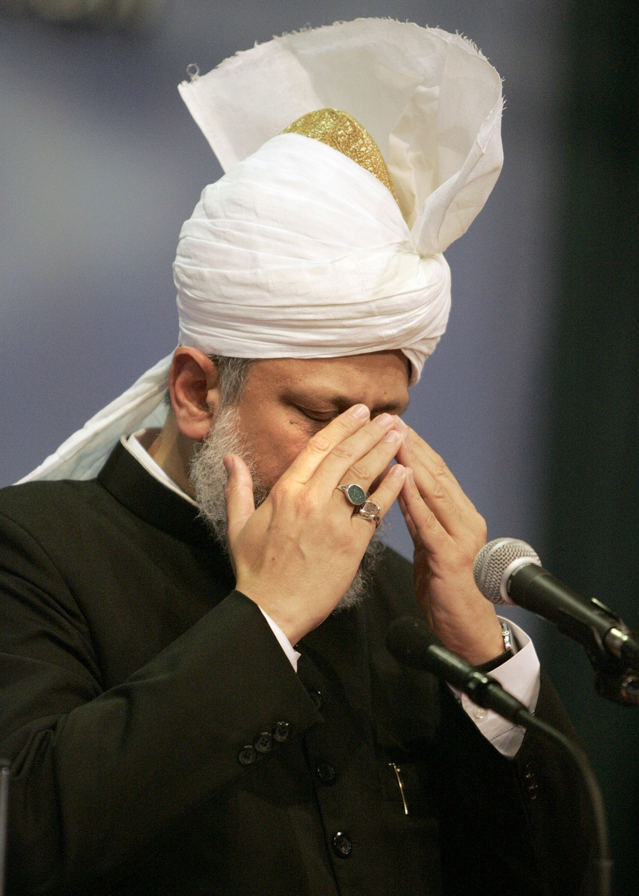
May God enhance the faith of new Ahmadis
May we always experience progress of our Jama’at
May God always bestow His grace on us.
Ameen
Friday Sermon
July 8th 2011
Notes:
Hudhur said although this trip was planned spontaneously, yet it received many blessings of God and many bai’ats took place. May God enhance the faith of new Ahmadis and may we always experience progress of our Jama’at. This grace of God is in support of the Promised Messiah (on whom be peace) and in accordance to Divine promises made to him and it strengthens our faith. May God always bestow His grace on us.

