Slide 1
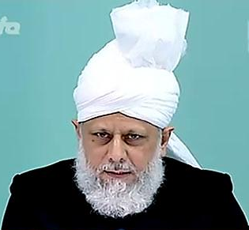
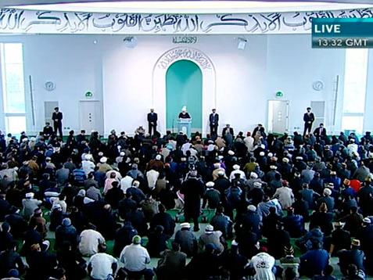
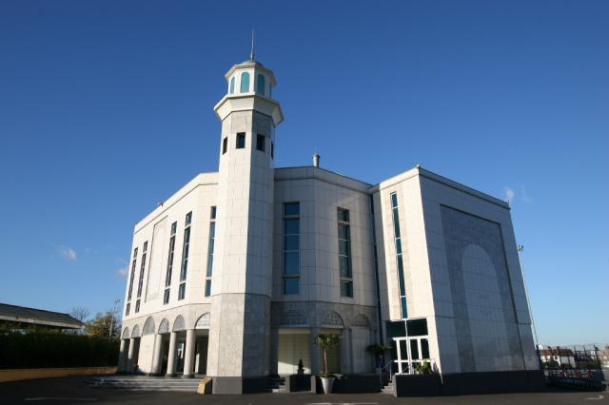
Potent Power of Salaat, Dua and connection with God
Friday Sermon
May 20th 2011

Slide 2
SUMMARY
Friday Sermon
May 20th 2011
It should be prayed to God that just as He has bestowed fruits and various other pleasures, He lets us savour the pleasure of worship and Salat
The best way to thank God for giving us the blessings of the Imam of our times, would be to read his pronouncements and the writings, reflect over them and make them a part of our lives
There is no advantage to God in Salat, rather it is beneficial to man that he is given the opportunity and the honour to supplicate to God
The main outcome of dua is Divine nearness. When a believer’s dua attains perfect sincerity, then God has mercy and becomes his or her Friend
Hudhur (aba) said special prayers should be made for the security of the Community; our detractors are increasing in their enmity
Hudhur (aba) gave a discourse on the Promised Messiah’s (on whom be peace) pronouncements on dua, Salat and connection with God explaining that Salat is prayer at a very high level
Notes:
In his Friday sermon today, Hudhur gave a discourse on the Promised Messiah’s (on whom be peace) pronouncements on dua, Salat and connection with God

Slide 3
We could not thank God adequately for His blessing in sending the true and ardent devotee of the Holy Prophet (pbuh) and the Imam of the age, as foretold
The best way to try and thank God would be to read the pronouncements and the writings of the one commissioned by God, reflect over them and make them a part of our lives
God states in the Holy Qur’an: ‘…and be with the truthful.’ (9:119).
The Companions of the Holy Prophet (pbuh) attained beneficence of the noble company of the Prophet (pbuh) and conveyed his advice and counsel to us
Friday Sermon
May 20th 2011
Sagacious discourses
Then came the era of his ardent devotee, who held many assemblies with his companion, made speeches made at Jalsa, the Jama’at newspapers of the time secured these pronouncements.
We are also grateful to those who sat in those assembles, asked questions, and saved those sagacious discourses
Notes:
We could not thank God adequately for His blessing in sending the true and ardent devotee of the Holy Prophet (peace and blessings of Allah be on him) and the Imam of the age, as foretold, after a long and dark period. The best way to try and thank God would be to read the pronouncements and the writings of the one commissioned by God, reflect over them and make them a part of our lives. God states in the Holy Qur’an: ‘…and be with the truthful.’ (9:119). The most beautiful manifestation of keeping the company of ‘the truthful’ was when the Companions of the Holy Prophet (peace and blessings of Allah be on him) attained beneficence of the noble company of the Prophet (peace and blessings of Allah be on him) and thus conveyed his advice and counsel to us.
Then came the era of his ardent devotee, who wrote numerous books, extoling the beauty of the teachings of Islam and through them proved Islam’s superiority over other religions. He held many assemblies with his companions. Some were small, others large. In addition, there were speeches made at Jalsa. This material is not available in his books, but his companions received its beneficence and the Jama’at newspapers of the time secured these pronouncements. We are also grateful to those who sat in those assembles, asked questions, and saved those sagacious discourses, which we can now read and in our imagination be part of the assembly of the Promised Messiah (on whom be peace).

Slide 4
Salat, dua (prayer) and connection with God
God began the Qur’an with dua and ended it on dua. This signifies that mankind is weak and cannot be purified without the grace of God. Until God’s help and succour is forthcoming, one cannot develop in piety
As a hadith relates: All are lifeless except one whom God grants life. All are astray except one whom God guides. And all are blind except one whom God gives sight.
Regarding ridding oneself of evil temptations during Salat, the Promised Messiah (on whom be peace) said that what sort of dua would it be if one utters the words: ‘Guide us in the right path’(1:6) while imagining and thinking about making business deals. Unless God is given precedence over everything else, Salat is merely a waste of time.
Until there is blessing of God, the yoke of this world’s adoration remains around one’s neck. Only those are saved from this on whom there is God’s grace but it should be remembered that God’s beneficence also starts with dua.
Friday Sermon
May 20th 2011
Notes:
Today, Hudhur expounded some of those counsels and advices from the assemblies of the Promised Messiah (on whom be peace) regarding Salat, dua (prayer) and connection with God. Explaining dua in his Jalsa address of 1907, the Promised Messiah (on whom be peace) said that God began the Qur’an with dua and ended it on dua. This signifies that mankind is weak and cannot be purified without the grace of God. Until God’s help and succour is forthcoming, one cannot develop in piety.
As a hadith relates: All are lifeless except one whom God grants life. All are astray except one whom God guides. And all are blind except one whom God gives sight.
Until there is blessing of God, the yoke of this world’s adoration remains around one’s neck. Only those are saved from this on whom there is God’s grace but it should be remembered that God’s beneficence also starts with dua.
Regarding ridding oneself of evil temptations during Salat, the Promised Messiah (on whom be peace) said that what sort of dua would it be if one utters the words: ‘Guide us in the right path’(1:6) while imagining and thinking about making business deals. Unless God is given precedence over everything else, Salat is merely a waste of time.

Slide 5
The philosophy of offering Salat
The Promised Messiah (on whom be peace) said:
‘Salat is a prayer which is submitted to God in travail and burning with a heart aflame, so that vicious thoughts and evil designs may be got rid of and a holy love and a pure relationship may be established and one may be enabled to keep God’s commandments
The word Salat indicates that true Prayer is not offered only with the tongue but must be accompanied by burning and sizzling and being consumed by fire.
God Almighty does not accept Prayer until the worshipper at the time of prayer arrives a kind of death….
[Essence of Islam, Vol. II, p. 296]
Friday Sermon
May 20th 2011
Notes:
In an address in 1906, the Promised Messiah (on whom be peace said: ‘Salat is a prayer which is submitted to God in travail and burning with a heart aflame, so that vicious thoughts and evil designs may be got rid of and a holy love and a pure relationship may be established and one may be enabled to keep God’s commandments. The word Salat indicates that true Prayer is not offered only with the tongue but must be accompanied by burning and sizzling and being consumed by fire. God Almighty does not accept Prayer until the worshipper at the time of prayer arrives a kind of death….
[Essence of Islam, Vol. II, p. 296]

Slide 6
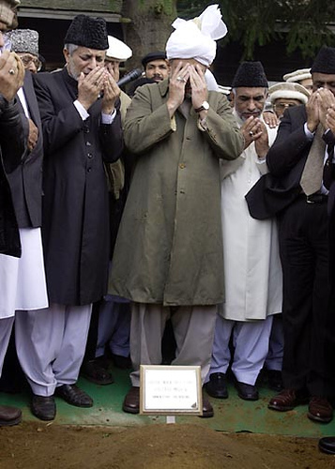
The requisites of prayers
Explaining the requisites of prayers, the Promised Messiah said prayer should be such that it makes:
‘The heart melt and the soul flow at the Divine threshold with pain and anxiety instilled in it…and one is not hasty and impatient, rather continues to pray with patience and steadfastness. It can then be expected that the dua will gain acceptance
Friday Sermon
May 20th 2011
Notes:
Explaining the requisites of prayers, the Promised Messiah said prayer should be such that it makes: ‘The heart melt and the soul flow at the Divine threshold with pain and anxiety instilled in it…and one is not hasty and impatient, rather continues to pray with patience and steadfastness. It can then be expected that the dua will gain acceptance

Slide 7
Salat, an underappreciated blessing
Salat is prayer at a very high level,
but people do not appreciate it duly
‘It should be prayed to God with extreme tenderness and passion that just as He has bestowed fruits and various other pleasures,
He lets us savour the pleasure of worship and Salat once.
One remembers what one has tasted.’
The way of the Holy Prophet (pbuh) was that at a time of difficulty… he stood up in Salat and made his supplications in the Salat
My experience is that nothing takes one so near to God as Salat.
Friday Sermon
May 20th 2011
Notes:
The Promised Messiah (on whom be peace) also said: ‘Salat is prayer at a very high level, but people do not appreciate it duly. In this age many Muslims are devoted to frequent repetition of pious formulas…For a seeker none of these innovations is of any benefit compared with the Salat. The way of the Holy Prophet (peace and blessings of Allah be on him) was that at a time of difficulty… he stood up in Salat and made his supplications in the Salat… My experience is that nothing takes one so near to God as Salat. The various postures of the Salat demonstrate respect, humility and meekness. In Qiyam (standing posture) the worshipper stands with his arms folded as a slave stands respectfully before his master and king. In Ruku‘ (bowing) the worshipper bends down in humility. The climax of humility is reached in Sajdah (prostration), which indicates extreme helplessness.’
[Essence of Islam, Vol. II, pp. 296-297].
The Promised Messiah (on whom be peace) said: ‘Prayer should be made to God with extreme tenderness and passion that just as He has bestowed fruits and various other pleasures, He lets us savour the pleasure of worship and Salat once. One remembers what one has tasted.’ The Promised Messiah (on whom be peace) further explained that people are indifferent about Salat because they do not know about the pleasure and joy of Salat.

Slide 8
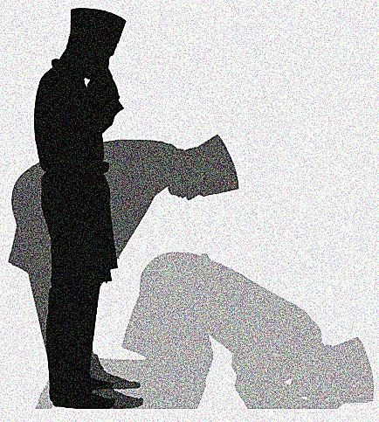
The various postures of the Salat demonstrate respect, humility and meekness.
In Qiyam (standing posture) the worshipper stands with his arms folded as a slave stands respectfully before his master and king.
In Ruku‘ (bowing) the worshipper bends down in humility.
The climax of humility is reached in Sajdah (prostration), which indicates extreme helplessness.’
[Essence of Islam, Vol. II, pp. 296-297].
The postures of the Salat
Friday Sermon
May 20th 2011

Slide 9
It is not wise to offer Salat as a mere ritual
The Promised Messiah (on whom be peace) said that steadfastness is the condition for acceptance of dua.
He also said that it is not wise to offer Salat as a mere ritual because God has condemned such worshippers: ‘So woe to those who pray’ (107:5) let alone their dua gaining acceptance.
This is about those worshippers who are unaware about the significance of Salat.
It is important for us to understand the meanings of the prayers made in Salat.
There is no advantage to God in this, rather it is beneficial to man that he is given the opportunity and the honour to supplicate to God. And this can get him out of many of his problems
Friday Sermon
May 20th 2011
Notes:
The Promised Messiah (on whom be peace) said that steadfastness is the condition for acceptance of dua. He also said that it is not wise to offer Salat as a mere ritual because God has condemned such worshippers: ‘So woe to those who pray’ (107:5) let alone their dua gaining acceptance. This is about those worshippers who are unaware about the significance of Salat. The Companions of the Holy Prophet (peace and blessings of Allah be on him) knew Arabic very well and appreciated the reality of it superbly but it is important for us to understand the meanings of the prayers made in Salat. There is no advantage to God in this, rather it is beneficial to man that he is given the opportunity and the honour to supplicate to God. And this can get him out of many of his problems. The Promised Messiah (on whom be peace) said he was astonished that there were people who lived through their days and their nights without realising that they had a God. He said it was an important advice from him which he wished people listened to; he said: ‘Life is passing by, abandon negligence and adopt humility. Pray to God in solitude that He may keep faith alive and that He is pleased with you.’

Slide 10
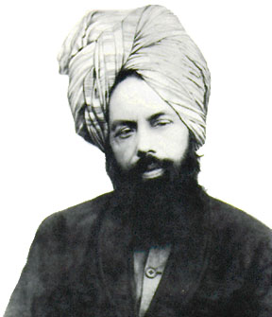
‘Life is passing by, abandon negligence and adopt humility.
Pray to God in solitude that He may keep faith alive and that He is pleased with you.’
An important advice
The Promised Messiah (on whom be peace) said it was an important advice from him which he wished people listened to; he said
Friday Sermon
May 20th 2011

Slide 11
Prayer and a clean heart
‘Until the heart is clean, prayer does not gain acceptance. Even if you have malice about a worldly matter with one person your prayer cannot be accepted.
It should be remembered very well not to have enmity with anyone over worldly matters.
What worth does this world and its matters have that one should keep enmity regarding them?’
Unless prayer is made repeatedly and with profusion and tenderness of heart, He does not care…unless there is genuine angst in dua, it is ineffective and futile. Angst is conditional for acceptance of prayer.
As it is stated: ‘Or, Who answers the distressed person when he calls upon Him, and removes the evil…’ (27:63)
‘With some people it is in one ear and out of the other. They do not take these matters to heart no matter how much advice is given there is no effect on them. Remember that God is Independent and Besought of all.
Friday Sermon
May 20th 2011
Notes:
Disagreement between two people was mentioned in an assembly in 1907. Among other words of advice, the Promised Messiah (on whom be peace) said: ‘Until the heart is clean, prayer does not gain acceptance. Even if you have malice about a worldly matter with one person your prayer cannot be accepted. It should be remembered very well not to have enmity with anyone over worldly matters. What worth does this world and its matters have that one should keep enmity regarding them?’
In 1908, during an early morning stroll, the Promised Messiah (on whom be peace) said while advising his companions: ‘With some people it is in one ear and out of the other. They do not take these matters to heart no matter how much advice is given there is no effect on them. Remember that God is Independent and Besought of all. Unless prayer is made repeatedly and with profusion and tenderness of heart, He does not care…unless there is genuine angst in dua, it is ineffective and futile. Angst is conditional for acceptance of prayer. As it is stated: ‘Or, Who answers the distressed person when he calls upon Him, and removes the evil…’ (27:63)

Slide 12
Dua is a channel which absorbs that power and beneficence which comes from God.
One who engages in prayers with profusion, ultimately attracts this beneficence…Indeed, prayer on its own is not God’s will.
Rather, first all efforts and endeavours should be brought in action and then prayer made
‘The true significance of Islam is that man makes his own preference secondary to the preference of God. However, the truth is that this station cannot be attained by one’s own power. Although there is no doubt that it is man’s obligation to make endeavours for this.
The true and real source to attain this station is dua. Man is weak, unless he attains strength and help from dua, he cannot traverse this difficult passage.
For this, there is a great need of dua; dua has tremendous power which solves great difficulties and man traverses challenging passages with extreme ease
Dua is a channel which absorbs that power and beneficence which comes from God
Friday Sermon
May 20th 2011
Notes:
In an assembly in Lahore where non-Ahmadis were also present, the Promised Messiah (on whom be peace) delivered a long address on dua, during which he said: ‘The true significance of Islam is that man makes his own preference secondary to the preference of God. However, the truth is that this station cannot be attained by one’s own power. Although there is no doubt that it is man’s obligation to make endeavours for this. The true and real source to attain this station is dua. Man is weak, unless he attains strength and help from dua, he cannot traverse this difficult passage. God Himself has stated regarding man’s weakness and infirmity: ‘… for man has been created weak.’ (4:29). Thus, in spite of such weakness, it is vain imagination to claim attaining such an elevated station through one’s own strength. For this, there is a great need of dua; dua has tremendous power which solves great difficulties and man traverses challenging passages with extreme ease. Dua is a channel which absorbs that power and beneficence which comes from God. One who engages in prayers with profusion, ultimately attracts this beneficence…Indeed, prayer on its own is not God’s will. Rather, first all efforts and endeavours should be brought in action and then prayer made. To not avail of planning and only avail of prayer is ignorance of the etiquette of dua and is challenging God. And to only rely on planning and to consider dua nothing is atheism/non-belief…Dua is a great treasure. No calamity will befall one who does not abandon dua.’

Slide 13
The Promised Messiah (on whom be peace) said that after correcting one’s morals, one should try and attain God’s love through dua, shunning every kind of sin and evil.
Cleansing all inner filth, one should become like a drop of pure liquid. Alongside dua, planning should also be done to achieve one’s objective. God likes planning and effort, He states in the Qur’an: ‘And by those who plan and execute their task well.’ (79:6).
To not avail of planning and only avail of prayer is ignorance of the etiquette of dua and is challenging God.
And to only rely on planning and to consider dua nothing is atheism/non-belief…
Dua is a great treasure. No calamity will befall one who does not abandon dua.’
The etiquette of dua
Friday Sermon
May 20th 2011
Notes:
Dua is a channel which absorbs that power and beneficence which comes from God. One who engages in prayers with profusion, ultimately attracts this beneficence…Indeed, prayer on its own is not God’s will. Rather, first all efforts and endeavours should be brought in action and then prayer made. To not avail of planning and only avail of prayer is ignorance of the etiquette of dua and is challenging God. And to only rely on planning and to consider dua nothing is atheism/non-belief…Dua is a great treasure. No calamity will befall one who does not abandon dua.’
During an assembly in Lahore, the Promised Messiah (on whom be peace) said that after correcting one’s morals, one should try and attain God’s love through dua, shunning every kind of sin and evil. Cleansing all inner filth, one should become like a drop of pure liquid. Alongsidedua, planning should also be done to achieve one’s objective. God likes planning and effort, He states in the Qur’an: ‘And by those who plan and execute their task well.’ (79:6).

Slide 14
‘An example of good works is like a bird. If kept in a cage of truth and sincerity, they will stay, otherwise they will ‘fly away.
And this cannot be attained without God’s grace. He states: ‘…So let him who hopes to meet his Lord do good deeds, and let him join no one in the worship of his Lord.’ (18:111). Good works here signify that there is no adulteration of any wickedness in them and they only constitute goodness.
There is no pride, haughtiness, arrogance or a measure of selfish motives, or hopes associated with people. So much so, that there is not even a desire for heaven or hell and the deed stems from love of God alone.’
Good work
Truth
Sincerity
Good deed and dua
Friday Sermon
May 20th 2011
Notes:
The Promised Messiah (on whom be peace) said: ‘An example of good works is like a bird. If kept in a cage of truth and sincerity, they will stay, otherwise they will ‘fly away. And this cannot be attained without God’s grace. He states: ‘…So let him who hopes to meet his Lord do good deeds, and let him join no one in the worship of his Lord.’ (18:111). Good works here signify that there is no adulteration of any wickedness in them and they only constitute goodness. There is no pride, haughtiness, arrogance or a measure of selfish motives, or hopes associated with people. So much so, that there is not even a desire for heaven or hell and the deed stems from love of God alone.’

Slide 15
It is very important to seek spiritual knowledge from God through dua
‘There are many who pay lip service to God’s existence but if they are probed it is discovered that they are atheistic.
Because when they are occupied in worldly matters they completely forget God’s wrath and His greatness. This is why it is very important that you should seek spiritual knowledge from God through dua.
Without this one’s faith can never be complete
Hudhur (aba) said it was very important especially for the young people to abide by this and avoid all such places that incite sin
It will be attained with the knowledge that there is death in separation from God. While praying to avoid sin do not let go of planning [in this regard].
Abandon all those gatherings and assemblies that instigate sin and pray alongside.’
Friday Sermon
May 20th 2011
Notes:
In August 1904, the Promised Messiah (on whom be peace) said in Lahore: ‘There are many who pay lip service to God’s existence but if they are probed it is discovered that they are atheistic. Because when they are occupied in worldly matters they completely forget God’s wrath and His greatness. This is why it is very important that you should seek spiritual knowledge from God through dua. Without this one’s faith can never be complete. It will be attained with the knowledge that there is death in separation from God. While praying to avoid sin do not let go of planning [in this regard]. Abandon all those gatherings and assemblies that instigate sin and pray alongside.’ Hudhur said it was very important especially for the young people to abide by this and avoid all such places that incite sin

Slide 16
It is important to seek spiritual progress through dua
The Promised Messiah (on whom be peace) said that for dua, one should probe one’s heart whether one is inclined towards this world or towards faith. Are one’s prayers mostly for worldly comforts or to serve faith.
If it is discovered that during the course of a day one is only concerned with this world, then it is a regrettable situation
He said it is often seen that people make great effort to pray for worldly matters and fall ill during the course of this process and some even get mental illness.
However, if all is for faith, God would never let them go to waste
Friday Sermon
May 20th 2011
Notes:
In an assembly in 1904 in which people who had newly taken their Bai’at were included, the Promised Messiah (on whom be peace) said that for dua, one should probe one’s heart whether one is inclined towards this world or towards faith. Are one’s prayers mostly for worldly comforts or to serve faith. If it is discovered that during the course of a day one is only concerned with this world, then it is a regrettable situation. He said it is often seen that people make great effort to pray for worldly matters and fall ill during the course of this process and some even get mental illness. However, if all is for faith, God would never let them go to waste

Slide 17
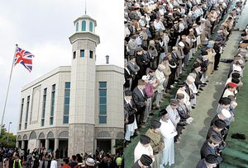
The Promised Messiah (on whom be peace) said that dua is of two kinds.
One that is made in an ordinary way and the other that it is taken to its extreme. The latter is the real dua.
One should pray even if no troubles are faced because one does not know what God’s will is and what the future holds. Thus prayer should be made in advance so that one is saved in time.
Sometimes adversity falls in a way that one does not even find any time for dua.
At such difficult junctures, prayer that is made beforehand is of avail
Friday Sermon
May 20th 2011
Notes:
In January 1908, the Promised Messiah (on whom be peace) said that dua is of two kinds. One that is made in an ordinary way and the other that it is taken to its extreme. The latter is the realdua. One should pray even if no troubles are faced because one does not know what God’s will is and what the future holds. Thus prayer should be made in advance so that one is saved in time. Sometimes adversity falls in a way that one does not even find any time for dua. At such difficult junctures, prayer that is made beforehand is of avail

Slide 18
Otherwise, they have perfect faith in God and complete belief in His promises. They are cognisant of: ‘Most surely We help Our Messengers and those who believe, both in the present life…’ (40:52). They know that God alone is the True Helper. Worldly support is insignificant for them, but in order to teach the world a broad method they adopt this way.
If God so willed, He would have not left His Prophets in need of helpers, but at times even they have no choice but to call out: ‘…Who will be my helpers in the cause of Allah?’ (3:53). It is not because they are needy, rather there is glory in proclaiming so. They wish to teach the world.
The human physical form and its limbs help each other. As such, it is astonishing that mankind does not understand the concept as stated in the Qur’an: ‘…And help one another in righteousness and piety…’ (5:3).
Dua and help
Friday Sermon
May 20th 2011
Notes:
In another assembly, the Promised Messiah (on whom be peace) said that the human physical form and its limbs help each other. As such, it is astonishing that mankind does not understand the concept as stated in the Qur’an: ‘…And help one another in righteousness and piety…’ (5:3). If God so willed, He would have not left His Prophets in need of helpers, but a times comes when they have no choice but to call out: ‘…Who will be my helpers in the cause of Allah?’ (3:53). It is not because they are needy, rather there is glory in proclaiming so. They wish to teach the world. Otherwise, they have perfect faith in God and complete belief in His promises. They are cognisant of: ‘Most surely We help Our Messengers and those who believe, both in the present life…’ (40:52). They know that God alone is the True Helper. Worldly support is insignificant for them, but in order to teach the world a broad method they adopt this way.

Slide 19
The main outcome of dua is Divine nearness
Dua is like a spring of delicious water and a believer can satiate himself on it whenever he wishes.
Just as fish cannot survive without water, similarly dua is like water for a believer without which he cannot live.
The most appropriate occasion of such dua is Salat in which a believer finds rapture and delight
The main outcome of dua is Divine nearness.
When a believer’s dua attains perfect sincerity and deep devotedness, then God has mercy and becomes his or her Friend
Friday Sermon
May 20th 2011
Notes:
The Promised Messiah (on whom be peace) said dua is like a spring of delicious water and a believer can satiate himself on it whenever he wishes. Just as fish cannot survive without water, similarly dua is like water for a believer without which he cannot live. The most appropriate occasion of such dua is Salat in which a believer finds rapture and delight. The main outcome ofdua is Divine nearness. When a believer’s dua attains perfect sincerity and deep devotedness, then God has mercy and becomes his or her Friend

Slide 20
Resolve of prophets comes from Dua
The Promised Messiah (on whom be peace) said that troubles that befall Prophets of God are immense but they do not sadden them because they receive God’s help through dua. If ordinary people had even an iota of the troubles and persecution that Prophets of God face, they could be annihilated.
Hundreds of thousands of people become bloodthirsty enemies of Prophets of God, yet they cannot disturb them in their mission. Their steadfastness and resolve is miraculous. The resolute determination and steadfastness of the Holy Prophet (peace and blessings of Allah be on him) was the greatest miracle from among his thousands of miracles.
Friday Sermon
May 20th 2011
Notes:
Explaining the eminent belief of Prophets of God in dua, the Promised Messiah (on whom be peace) said that troubles that befall Prophets of God are immense but they do not sadden them because they receive God’s help through dua. If ordinary people had even an iota of the troubles and persecution that Prophets of God face, they could be annihilated. Hundreds of thousands of people become bloodthirsty enemies of Prophets of God, yet they cannot disturb them in their mission. Their steadfastness and resolve is miraculous. The resolute determination and steadfastness of the Holy Prophet (peace and blessings of Allah be on him) was the greatest miracle from among his thousands of miracles.

Slide 21
Dua is our only weapon
The Promised Messiah (on whom be peace) said that God repeatedly informed him through revelations that whatever will be accomplished will be through dua.
He said dua was the only weapon he had. He said whatever he asked privately, God made it evident. He said if fighting was destined for him, God would have provided all the arrangements. Pious is one who understands how God now wills faith to progress.
The Promised Messiah (on whom be peace) said that the enemy only objects to us because of his enmity. They foolishly assert that he [the Promised Messiah] sits in one place and does not perform his work.
He said he knew all his objectives were to be realised through dua and dua has great potency.
Friday Sermon
May 20th 2011
Notes:
In one of his assemblies, the Promised Messiah (on whom be peace) said that the enemy only objects to us because of his enmity. They foolishly assert that he [the Promised Messiah] sits in one place and does not perform his work. They do not realise that it is not stated about the Messiah that he will raise a sword or will fight. Rather, it is stated that through his ‘blowing’ the disbelievers will die, that is, he will do all his work through dua. He said if he knew that his going out and about would help, he would not stay in one place even for one moment. He said he knew all his objectives were to be realised through dua and dua has great potency.
The Promised Messiah (on whom be peace) said that God repeatedly informed him through revelations that whatever will be accomplished will be through dua. He said dua was the only weapon he had. He said whatever he asked privately, God made it evident. He said if fighting was destined for him, God would have provided all the arrangements. Pious is one who understands how God now wills faith to progress.

Slide 22
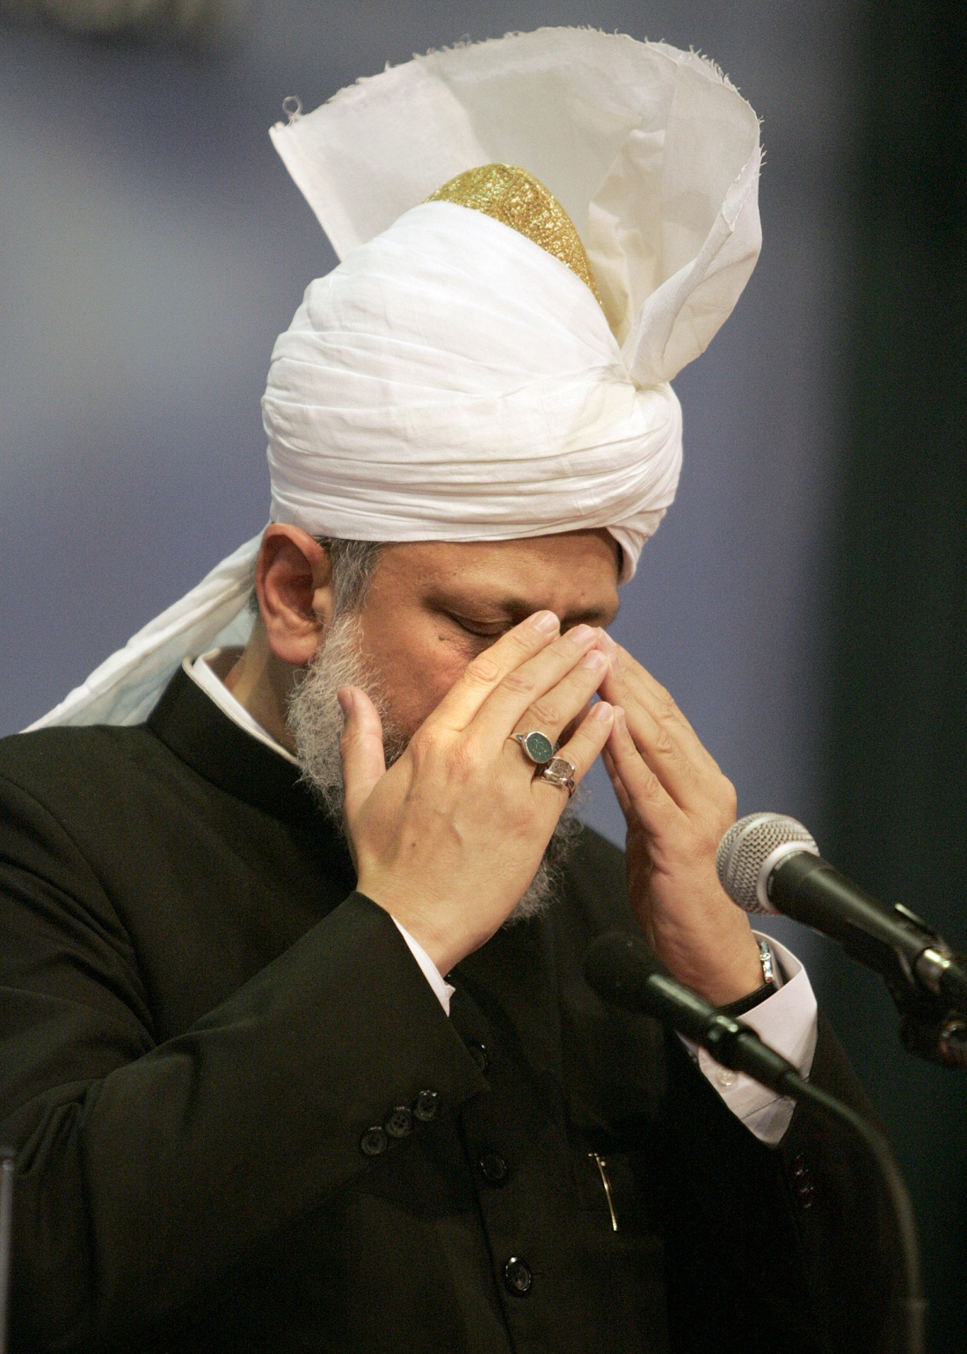
May God enable us to understand the subject of dua and make it part of our lives
May we always, in prosperity and difficulty alike, have God’s pleasure in our view our Jama’at
May we understand the spirit of the responsibilities of coming into Bai’at
May God enable us to give precedence to faith over worldly matters
Indeed, it is a great responsibility that our each word and deed should be for the pleasure of God.
Hudhur (aba) said special prayers should be made for the security of the Community; our detractors are increasing in their enmity, may God rebound all their wickedness on them and protect us each moment
Friday Sermon
May 20th 2011
Notes:
Hudhur prayed that may God enable us to understand the subject of dua and make it part of our lives. May we always, in prosperity and difficulty alike, have God’s pleasure in our view. May we understand the spirit of the responsibilities of coming into Bai’at. Indeed, it is a great responsibility that our each word and deed should be for the pleasure of God. May God enable us to give precedence to faith over worldly matters.
Hudhur said special prayers should be made for the security of the Community; our detractors are increasing in their enmity, may God rebound all their wickedness on them and protect us each moment

Slide 23
اَللَّھُمَّ اِنَّا نَجْعَلُكَ فِـیْ نُحُوْرِ ھِمْ وَنَعُوْذُبِكَ مِنْ شُرُوْرِ ھِمْ
O Allah, we make You a shield against the enemy and we seek Your protection against their evil designs
(Abu Dawud Kitabul Salat)
رَ بّ ِ تَوَ فنیْ ممسلماً والحقنیْ بالصالحینَ
‘O my God, cause me to die a Muslim and join me to the pious.’
رَبِّ ڪُلُّ شَـیْءٍ خَادِمُكَ رَبِّ فَاحْفَظْنـِیْ وَانْصُرْنـِیْ وَارْحَـمْنـِیْ
O my Lord everything serves You. So O my Lord, protect me and help me and have mercy on me.
Tadhkirah page No 571
We should recite the prayers
ربّ ِ انیْ مظلوْ مٌ فانتصرْ
‘O my Lord, I have been wronged; You avenge me.
Friday Sermon
May 20th 2011
Notes:
We should recite the prayers: ‘O Allah, we make You a shield against the enemy and we seek Your protection against their evil designs.’ And ‘ O’ Lord, everything is subservient to You. O’ Lord protect us, help us and have mercy on us.’ Hudhur said say many other prayers, pray for them to get their just deserts. Hudhur said we now have one more martyr as a Dr. Imran sahib, who was injured in the incident has passed away.

