Slide 1
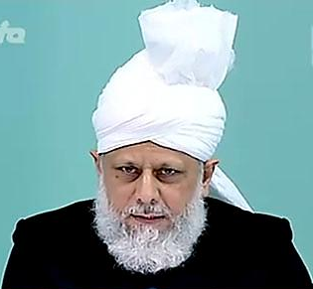
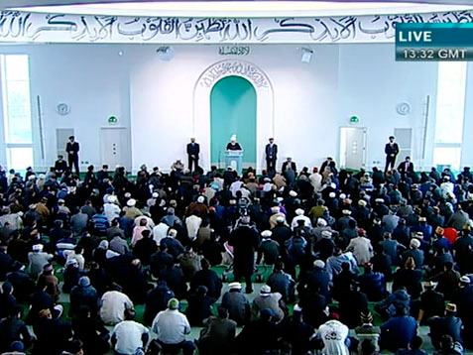
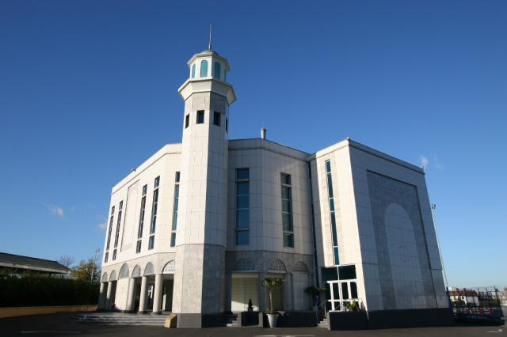
The Correct Islamic Viewpoint of Intercession
Friday Sermon
May 6th 2011

Slide 2
SUMMARY
Hudhur (aba) recited Ayatul Kursi at the beginning of his Friday Sermon and gave a discourse on the correct Islamic viewpoint of intercession.
God alone is worthy of worship, therefore if one wishes to seek the beneficence of intercession, one should avoid open and hidden, overt and covert shirk.
If we wish to have a measure of his intercession, we must follow the blessed model of the Holy Prophet (peace and blessings of Allah be on him) and implement the commandments of the Qur’an in our lives
Hudhur (aba) prayed that may God truly make us and our generations to come, part of the Ummah of the Holy Prophet (peace and blessings of Allah be on him), so that we may seek the beneficence of intercession.
Friday Sermon
May 6th 2011

Slide 3
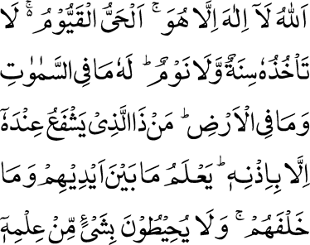
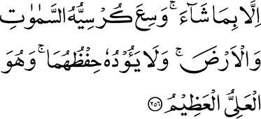
Ayatul Kursi
Allah — there is no God but He, the Living, the Self-Subsisting and All-Sustaining. Slumber seizes Him not, nor sleep. To Him belongs whatsoever is in the heavens and whatsoever is in the earth. Who is he that will intercede with Him except by His permission? He knows what is before them and what is behind them; and they encompass nothing of His knowledge except what He pleases. His knowledge extends over the heavens and the earth; and the care of them burdens Him not; and He is the High, the Great.
Chapter 2: Verse 256
Friday Sermon
May 6th 2011
Notes:
Hudhur recited Ayatul Kursi at the beginning of his Friday Sermon and gave a discourse on the correct Islamic viewpoint of intercession. The translation of Ayatul Kursi reads: ‘Allah — there is no God but He, the Living, the Self-Subsisting and All-Sustaining. Slumber seizes Him not, nor sleep. To Him belongs whatsoever is in the heavens and whatsoever is in the earth. Who is he that will intercede with Him except by His permission? He knows what is before them and what is behind them; and they encompass nothing of His knowledge except what He pleases. His knowledge extends over the heavens and the earth; and the care of them burdens Him not; and He is the High, the Great.’ (2:256).

Slide 4
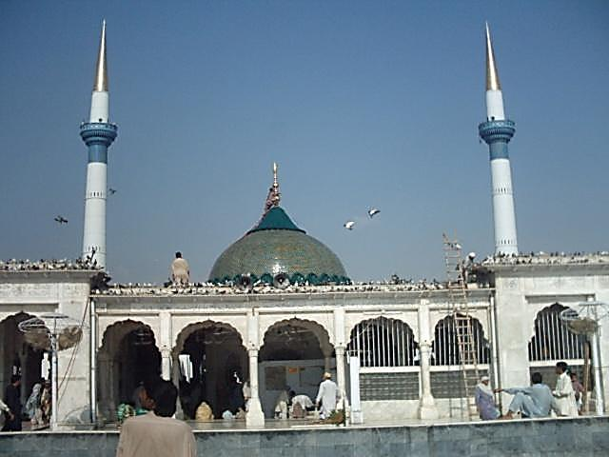
Women maintain that they have been blessed with child through the help of a dead saint
Friday Sermon
May 6th 2011
Shirk makes one closer to Idolaters
While the teaching of Islam focuses on the Oneness of God, unfortunately many Muslims are embroiled in shirk (associating partners with God). At times the extent of their involvement in shirk makes them closer to idolaters
Notes:
Hudhur said a while ago he had mentioned the erroneous practices by some Muslims to visit shrines of Pirs and ascetics as well as some saints and ask in a manner that one asks God. Due to lack of education, a large majority in India and Pakistan assume that Pirs can fulfil their wishes and some exceed in this wrong practice to the extent of prostrating before graves of Pirs and saints and women maintain that they have been blessed with child through the help of a dead saint. While the teaching of Islam focuses on the Oneness of God and demands of its adherents to be believers in it, unfortunately many are embroiled in shirk (associating partners with God). At times the extent of their involvement in shirk makes them closer to idolaters.

Slide 5
Teachings of Christianity
Friday Sermon
May 6th 2011
Hudhur (aba) said, these are the viewpoints of Christians, whereas the reality is that their teaching is contrary to the teaching of Jesus and is based on shirk.
Christianity claims that through the atoning death of Jesus (on whom be peace) his followers are ‘reconciled’ to God. Some saints are also thought to be means of intercession.
It has been recently said about the previous Pope, John Paul II that owing to a miracle healing of a woman he had reached the station of intercession with God, while in Paradise.
Notes:
Christianity claims that through the atoning death of Jesus (on whom be peace) his followers are ‘reconciled’ to God. Some saints are also thought to be means of intercession. It has been recently said about the previous Pope, John Paul II that owing to a miracle healing of a woman he had reached the station of intercession with God, while in Paradise. Hudhur said, these are their viewpoints, whereas the reality is that their teaching is contrary to the teaching of Jesus and is based on shirk.

Slide 6
Huzur (aba) said
It was God’s great favour on us that He sent the true and ardent devotee of the Holy Prophet (pbuh) to guide us
He was the Hakm (Judge) and the Adl (Arbiter) of the age
He guided us precisely in light of the teaching of the Quran, which had established the Oneness of God and which tells us about the true teachings of the Holy Prophet (pbuh)
Friday Sermon, May 6th 2011
Notes:
It was God’s great favour on us that He sent the true and ardent devotee of the Holy Prophet (peace and blessings of Allah be on him) so that he could guide us away from the deteriorated state of the teaching. He was the Hakm (Judge) and the Adl (Arbiter) of the age and as such in order to rid us of the infestation of shirk, he guided us precisely in light of the teaching of the Quran, which had established the Oneness of God and which tells us about the true teachings of the Holy Prophet (peace and blessings of Allah be on him) as well as Islam’s superiority over other world religions.

Slide 7
Jesus did not claim of Divinity
For Jesus to be crucified for his followers and for the sins of his followers to be imputed to him is a meaningless creed that is far-removed from reason.
It is beyond the Divine attributes of fairness and justice that the punishment of the sin of someone should be given to another. In short, this creed is a collection of errors’.
The Promised Messiah (on whom be peace) informs us:
‘Remember, it is wholly calumnious to ascribe divinity to Jesus (on whom be peace). He certainly did not make any such claim. Whatever he said as regards himself did not go beyond intercession.
Friday Sermon
May 6th 2011
Notes:
The Promised Messiah (on whom be peace) informs us: ‘Remember, it is wholly calumnious to ascribe divinity to Jesus (on whom be peace). He certainly did not make any such claim. Whatever he said as regards himself did not go beyond intercession. As such, who can deny the intercession of Prophets? Many times Israelites were saved from raging torment because of the intercession of Moses (on whom be peace) And I have experience of this myself. Many esteemed people of my Community know very well that due to my intercession some embroiled in problems and illnesses were relieved of their grief and they had been informed of this beforehand. For Jesus to be crucified for his followers and for the sins of his followers to be imputed to him is a meaningless creed that is far-removed from reason. It is beyond the Divine attributes of fairness and justice that the punishment of the sin of someone should be given to another. In short, this creed is a collection of errors’.

Slide 8
The Islamic Viewpoint of Intercession
Explaining the requisites of intercession, the Promised Messiah (on whom be peace) wrote
‘Firstly, it is essential that an intercessor has a perfect connection with God, so that he can attain beneficence from God. And [he] also has an intense connection with mankind so that he can take to mankind the beneficence and the good that he attains from God.
Unless both these connections are not sound, one cannot be an intercessor.
The Promised Messiah (on whom be peace) also wrote that Jesus (on whom be peace) could not even reform his disciples. By contrast, through his perfect model, our Prophet (peace and blessings of Allah be on him) saved his followers from physical and spiritual chastisement and transformed their world
Friday Sermon
May 6th 2011
Notes:
Explaining the requisites of intercession, the Promised Messiah (on whom be peace) wrote: ‘Firstly, it is essential that an intercessor has a perfect connection with God, so that he can attain beneficence from God. And [he] also has an intense connection with mankind so that he can take to mankind the beneficence and the good that he attains from God. Unless both these connections are not intense, one cannot be an intercessor…unless these two models are not to be seen, there can be no beneficial outcome’.
The Promised Messiah (on whom be peace) also wrote that Jesus (on whom be peace) could not even reform his disciples. By contrast, through his perfect model, our Prophet (peace and blessings of Allah be on him) saved his followers from physical and spiritual chastisement and transformed their world. The intercession of Moses (on whom be peace) had similar outcome. However, after Jesus (on whom be peace) the condition of his followers deteriorated.

Slide 9
Hudhur (aba) explained that he had spoken regarding the Pope [John Paul II] because there is a lot of debate going on these days in schools about his ‘miracles’ and Hudhur wished to inform our youngsters about the facts
Always remember that the lofty station of the Holy Prophet (peace and blessings of Allah be on him) is the real station of intercession. And his miracles have taken place from his lifetime to this day
We Ahmadis, firmly believe that God continues to manifest His Powers through adherence to the Holy Prophet (peace and blessings of Allah be on him).
We are also firm on the belief that there is no need for any saint or any recommendation; God is found by following the teachings of the Holy Quran and the commandments of the Holy Prophet (peace and blessings of Allah be on him)
.
Friday Sermon
May 6th 2011
Notes:
Hudhur said thus the Promised Messiah (on whom be peace) illustrated the facts about Christianity. In his lifetime, Jesus could not reform his disciples, his death on the Cross was also considered accursed by the Jews, although we Ahmadi Muslims do not accept this concept and say that God saved His Prophet from all the accusations that the Jews wanted to ascribe to him. He lived a long life and was successful in the objective for which God had sent him. Hudhur explained that he had spoken regarding the Pope [John Paul II] because there is a lot of debate going on these days in schools about his ‘miracles’ and Hudhur wished to inform our youngsters about the facts. They listen to what is said out there and can at times be influenced by it. Always remember that the lofty station of the Holy Prophet (peace and blessings of Allah be on him) is the real station of intercession. And his miracles have taken place from his lifetime to this day. People are being born among his followers who can show miracles. We Ahmadis, firmly believe that God continues to manifest His Powers through adherence to the Holy Prophet (peace and blessings of Allah be on him). We are also firm on the belief that there is no need for any saint or any recommendation; God is found by following the teachings of the Holy Quran and the commandments of the Holy Prophet (peace and blessings of Allah be on him). Whereas Christians are beatifying the Pope, after his death, for miracles the validity of which is disputed. A Polish newspaper has raised objections regarding this, stating it is possible that the team of doctors which ascertains the legitimacy of ‘miracles’ did not research the matter properly about the woman about whom it is said that she suffered from Parkinson’s disease. It is possible that she had some other illness which naturally is cured after a while.

Slide 10
The Islamic Viewpoint of Intercession
The Promised Messiah (on whom be peace) related that once Nawab Muhammad Ali Khan sahib’s son fell very ill and he requested the Promised Messiah (on whom be peace) for prayer. The prayer was not answered favourably, so the Promised Messiah (on whom be peace) said if the prayer did not work, he would try intercession. On this God told him who was he to intercede without being granted permission to do so. The Promised Messiah (on whom be peace) was left trembling upon this.
Seeing his condition, after a short while, God told the Promised Messiah (on whom be peace) ‘You are given permission to intercede’. With the grace of God, Nawab Muhammad Ali Khan sahib’s son was better and lived a long age. )
Friday Sermon
May 6th 2011
Notes:
The Promised Messiah (on whom be peace) related that once Nawab Muhammad Ali Khan sahib’s son fell very ill and he requested the Promised Messiah (on whom be peace) for prayer. The prayer was not answered favourably, so the Promised Messiah (on whom be peace) said if the prayer did not work, he would try intercession. On this God told him who was he to intercede without being granted permission to do so. The Promised Messiah (on whom be peace) was left trembling upon this. Seeing his condition, after a short while, God told the Promised Messiah (whom be peace) ‘You are given permission to intercede’. With the grace of God, Nawab Muhammad Ali Khan sahib’s son was better and lived a long age.

Slide 11
The Qur’an mentions this subject in many places and the Promised Messiah (on whom be peace) has explained the concept to us in light of its verses
According to a tradition Satan runs away from the home of one who reads the first four verses of Surah Al Baqarah, Ayatul Kursi and its two adjoining verses and the last three verses
Hudhur said of course this entails that one reads these verses while fully understanding them and also tries to put them in practice. God has thus placed blessing in these verses.
The Holy Prophet (pbuh) called Ayatul Kursi as the chief of all the verses.
Friday Sermon
May 6th 2011
The Qur'anic teaching on intercession
Ahadith prove that in spite of their human frailties, people who try and abide by these matters, are the recipients of the Prophet’s (peace and blessings of Allah be on him) intercession.
Notes:
Hudhur said he wished to speak on the correct Islamic viewpoint on intercession and what should a Muslim consider intercession. The Qur’an mentions this subject in many places and the Promised Messiah (on whom be peace) has explained the concept to us in light of its verses. The Holy Prophet (peace and blessings of Allah be on him) called the verse recited at the beginning by Hudhur, Ayatul Kursi as the chief of all the verses. According to another tradition Satan runs away from the home of one who reads the first four verses of Surah Al Baqarah, Ayatul Kursi and its two adjoining verses and the last three verses. Hudhur said of course this entails that one reads these verses while fully understanding them and also tries to puts them in practice. God has thus placed blessing in these verses. Ahadith prove that in spite of their human frailties, people who try and abide by these matters, are the recipients of the Prophet’s (peace and blessings of Allah be on him) intercession.

Slide 12
Ayatul Kursi and Intercession
Hudhur (aba) said how could one who has limited life span listen to prayers and grant children?
The Promised Messiah (on whom be peace) explained in light of Ayatul Kursi that God is that Being Who combines all perfect attributes and is free from all defects. He is truly Worthy of worship and He alone is Living, Self-Subsisting and All-Sustaining. All else is given life and ultimately dies.
Ayatul Kursi states from the very start that God alone is worthy of worship, therefore if one wishes to seek the beneficence of intercession, one should avoid open and hidden, overt and covert shirk. It is God alone Who does not slumber or sleep and is running the entire cosmos and this does not tire Him
Hudhur (aba) said intercession cannot take place without God’s permission.
Friday Sermon
May 6th 2011
Notes:
The Promised Messiah (on whom be peace) explained in light of Ayatul Kursi that God is that Being Who combines all perfect attributes and is free from all defects. He is truly Worthy of worship and He alone is Living, Self-Subsisting and All-Sustaining. All else is given life and ultimately dies. Hudhur said how could one who has limited life span listen to prayers and grant children? Ayatul Kursi states from the very start that God alone is worthy of worship, therefore if one wishes to seek the beneficence of intercession, one should avoid open and hidden, overt and covert shirk. It is God alone Who does not slumber or sleep and is running the entire cosmos and this does not tire Him. Our Pirs certainly get tired, in fact the Gaddi Nasheens (keeps of tombs of saints etc.) pay no attention to Salat and worship; they are only interested in eating, drinking, amusement and sleeping.
Ayatul Kursi also mentions intercession. Hudhur said intercession cannot take place without God’s permission. Who can make a claim today of intercession even among the Muslims, who practice the faith fully, that anyone has permission to intercede? As it is, those [Muslims] who have not accepted the Promised Messiah (on whom be peace) do not fulfil God’s commandment. No matter how devout an Ahmadi is, they will never claim to have knowledge of intercession.

Slide 13
The Islamic Viewpoint of Intercession
Once a person came to the Holy Prophet (peace and blessings of Allah be on him) and said, ‘O Prophet of God, I have a need, which is that on the Day of Judgement you intercede for me’. Holy Prophet (PBUH) asked who had drawn his attention to this, to which the person replied, ‘my Lord’. The Prophet (PBUH) answered, ‘why not, you should help me with a profusion of prostration [to God]’.
Explaining, Hudhur (aba) said if intercession is desired then we need to offer prostrations to God in abundance.
Intercession does not come about by prostrating before graves; rather it is sincere and devout worship of God which can facilitate this blessing.
Friday Sermon
May 6th 2011
Hadith also inform us that the Holy Prophet (pbuh) interceded when God gave him the permission to do so.
Notes:
Hadith also inform us that the Holy Prophet (peace and blessings of Allah be on him) interceded when God gave him the permission to do so. Once a person came to the Prophet (peace and blessings of Allah be on him) and said, ‘O Prophet of God, I have a need, which is that on the Day of Judgement you intercede for me’. The Prophet (peace and blessings of Allah be on him) asked who had drawn his attention to this, to which the person replied, ‘my Lord’. The Prophet (peace and blessings of Allah be on him) answered, ‘why not, you should help me with a profusion of prostration [to God]’. Explaining, Hudhur said if intercession is desired then we need to offer prostrations to God in abundance. Intercession does not come about by prostrating before graves; rather it is sincere and devout worship of God which can facilitate this blessing.

Slide 14
The Islamic Viewpoint of Intercession
The Holy Prophet (PBUH) was asked: O’ Prophet of God who is the fortunate one among people for whom you will intercede on the Day of Judgement?’ The Prophet (peace and blessings of Allah be on him) replied, ‘Abu Huraira, I had thought that no one would ask me this question before you. For I have seen the eagerness you have regarding Hadith. On the Day of Judgement, that person among others will be fortunate through my intercession who has said with the sincerity of heart: there is none worthy of worship except Allah.’
Hudhur (aba) explained that when it is said with sincerity: ‘Allah — there is no God but He’, that alone is of significance in terms of intercession
Friday Sermon
May 6th 2011
Notes:
Another hadith narrated by Hadhrat Abu Huraira (may Allah be pleased with him) relates that the Prophet (peace and blessings be of Allah be on him) was asked: O’ Prophet of God who is the fortunate one among people for whom you will intercede on the Day of Judgement?’ The Prophet (peace and blessings of Allah be on him) replied, ‘Abu Huraira, I had thought that no one would ask me this question before you. For I have seen the eagerness you have regarding Hadith. On the Day of Judgement, that person among others will be fortunate through my intercession who has said with the sincerity of heart: there is none worthy of worship except Allah.’ Hudhur explained that when it is said with sincerity: ‘Allah — there is no God but He’, that alone is of significance in terms of intercession.

Slide 15
The Islamic Viewpoint of Intercession
The Promised Messiah (on whom be peace) said that this verse tells us that man can become God’s beloved by following in the footsteps of the Prophet (peace and blessings of Allah be on him) with love, respect and obedience and his sins are forgiven
Say, ‘If you love Allah, follow me: then will Allah love you and forgive you your faults. And Allah is Most Forgiving, Merciful.’
This verse is a challenge for us not to be Muslims in mere name but try and follow the Holy Prophet (pbuh).
If we wish to have a measure of his intercession, we must follow the blessed model of the Holy Prophet (pbuh) and implement the commandments of the Qur’an in our lives
Friday Sermon
May 6th 2011
Notes:
The Qur’an states: ‘Say, ‘If you love Allah, follow me: then will Allah love you and forgive you your faults. And Allah is Most Forgiving, Merciful.’ (3:32). This verse is an open declaration for the Jews and the Christians and is also a challenge for us not to be Muslims in mere name but try and follow the Prophet (peace and blessings of Allah be on him). If we wish to have a measure of his intercession, we must follow the blessed model of the Prophet (peace and blessings of Allah be on him) and implement the commandments of the Qur’an in our lives, because as Hadhrat ‘Aishah (may Allah be pleased with her) said the Prophet was a personification of the Holy Qur’an.

Slide 16
Intercession
The Promised Messiah (on whom be peace) further unfolded the subject: ‘It should never be thought that intercession is of no significance. It is our belief that intercession is truth and hence it is evident: ‘… And pray for them; thy prayer is indeed a source of tranquillity for them…’ (9:103). This is the philosophy of intercession; that the passion of selfishness of sin is cooled off. The outcome of intercession tells that death descends on life of sin and selfish impulses and desires cool off. This puts an end to sins and in their place, virtues begin. Thus, the issue of intercession has not rendered deeds useless, rather it inspires good works.’
The Promised Messiah (on whom be peace) said: ‘If one has consumed the toxin of sin, then the antidote of love and obedience and adherence removes the effect of this toxin. Just as through medicine one can be free of disease, similarly a person becomes free of sin. Just as light dispels darkness and antidote removes the effect of toxin and fire burns, similarly, true obedience and love has its effect’.
Friday Sermon
May 6th 2011
Notes:
The Promised Messiah (on whom be peace) said the Qur’an cites the intercession of the Holy Prophet (peace and blessings of Allah be on him) in various places, as in the aforementioned verse (3:32). He said that this verse tells us that man can become God’s beloved by following in the footsteps of the Prophet (peace and blessings of Allah be on him) with love, respect and obedience and his sins are forgiven. He said: ‘If one has consumed the toxin of sin, then the antidote of love and obedience and adherence removes the effect of this toxin. Just as through medicine one can be free of disease, similarly a person becomes free of sin. Just as light dispels darkness and antidote removes the effect of toxin and fire burns, similarly, true obedience and love has its effect’.
The Promised Messiah (on whom be peace) further unfolded the subject: ‘It should never be thought that intercession is of no significance. It is our belief that intercession is truth and hence it is evident: ‘… And pray for them; thy prayer is indeed a source of tranquillity for them…’ (9:103). This is the philosophy of intercession; that the passion of selfishness of sin is cooled off. The outcome of intercession tells that death descends on life of sin and selfish impulses and desires cool off. This puts an end to sins and in their place, virtues begin. Thus, the issue of intercession has not rendered deeds useless, rather it inspires good works.’

Slide 17
The difference between intercession and atonement
He also said: ‘How does intercession stimulate good works? The answer to this question is also found in the Holy Qur’an, it is stated: ‘…I am near. I answer the prayer of the supplicant when he prays to Me…’ (2:187)…this verse also tells of a secret of acceptance of prayer, and that is to inculcate perfect belief in the Power of Allah the Exalted and to always believe Him to be near’.
The Promised Messiah (on whom be peace) also said that prayer can only be beneficial for that person who also reforms himself. If the Prophet intercedes but the person for whom he intercedes does not come out of life of negligence, intercession can not avail that person.
The Promised Messiah (on whom be peace) wrote:
‘Atonement frees one from good works and intercession inspires one towards good works’
Friday Sermon
May 6th 2011
Notes:
As regards the difference between intercession and atonement, the Promised Messiah (on whom be peace) wrote: ‘Atonement frees one from good works and intercession inspires one towards good works’. He also said: ‘How does intercession stimulate good works? The answer to this question is also found in the Holy Qur’an and it is proven that it does not have the connotation of atonement as the Christians believe, because that which produces indolence and idleness has not been relied on. Rather, it is stated: ‘…I am near. I answer the prayer of the supplicant when he prays to Me…’ (2:187)…this verse also tells of a secret of acceptance of prayer, and that is to inculcate perfect belief in the Power of Allah the Exalted and to always believe Him to be near’.
The Promised Messiah (on whom be peace) also said that prayer can only be beneficial for that person who also reforms himself. If the Prophet intercedes but the person for whom he intercedes does not come out of life of negligence, intercession can not avail that person.

Slide 18
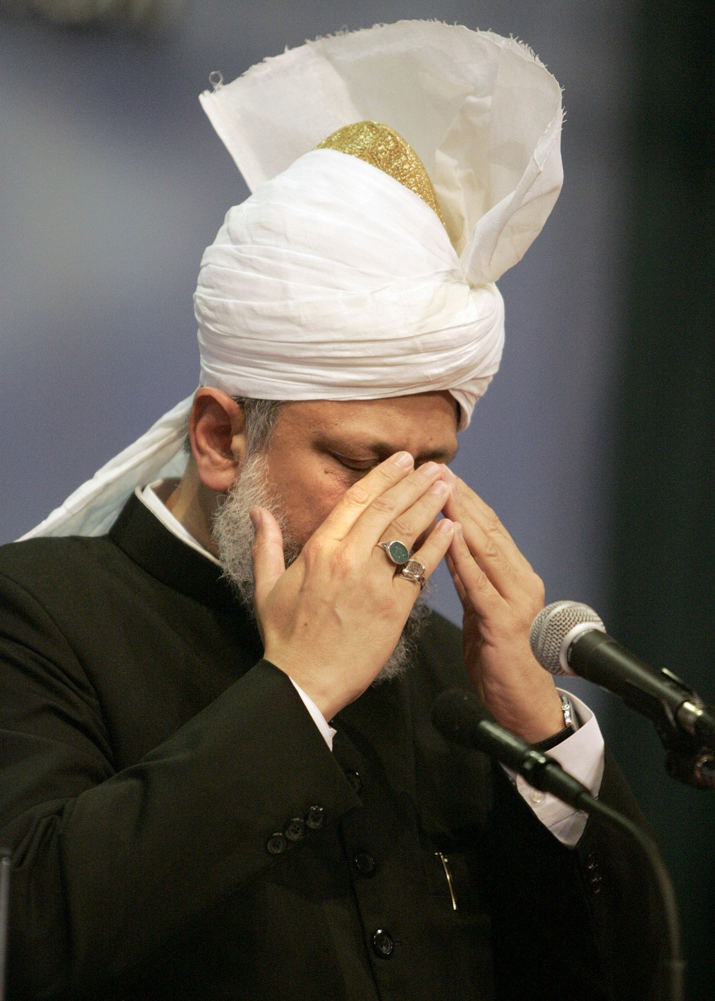
The Islamic Viewpoint of Intercession
Hudhur (aba) prayed that may God truly make us and our generations to come, part of the Ummah of the Holy Prophet (peace and blessings of Allah be on him) so that we may seek the beneficence of intercession. Ameen
Friday Sermon
May 6th 2011
Notes:
Hudhur prayed that may God truly make us and our generations to come, part of the Ummah of the Holy Prophet (peace and blessings of Allah be on him) so that we may seek the beneficence of intercession.

Slide 19
Sayings of Promised Messiah (on whom be peace)
‘Grant this noble Prophet from us the most excellent reward that can be given to anyone among creation. And let death overtake us while we are in his following and raise us on the Day of Judgement while we are in his Ummah and make us drink from his fountain and make his fountain a source of satiation for us. And make him in this world and also in the Hereafter an intercessor for us; whose intercession is accepted. O’ our Lord, accept this prayer of ours and give us place in this abode of refuge.’
‘O Allah, send grace and peace on this intercessor, whose intercession is accepted and who is the saviour of mankind.’
‘O my Lord, listen to my prayer for my nation and my supplication for my brothers. I seek from you through the agency of Your Prophet, Khatamun Nabiyeen and successful intercessor of sinners.’
Friday Sermon
May 6th 2011
Notes:
Next Hudhur presented a few prayers of the Promised Messiah (on whom be peace) as regards intercession:
‘Grant this noble Prophet from us the most excellent reward that can be given to anyone among creation. And let death overtake us while we are in his following and raise us on the Day of Judgement while we are in his Ummah and make us drink from his fountain and make his fountain a source of satiation for us. And make him in this world and also in the Hereafter an intercessor for us; whose intercession is accepted. O’ our Lord, accept this prayer of ours and give us place in this abode of refuge.’
‘O Allah, send grace and peace on this intercessor, whose intercession is accepted and who is the saviour of mankind.’
‘O my Lord, listen to my prayer for my nation and my supplication for my brothers. I seek from you through the agency of Your Prophet, Khatamun Nabiyeen and successful intercessor of sinners.’

Slide 20
True love for Holy Prophet (PBUH) to have salvation
Hudhur (aba) read another extracts from the writings of the Promised Messiah (on whom be peace) stating that now there is no Book other than the Qur’an for mankind and no other Prophet, but the Holy Prophet (PBUH), thus efforts should be made to attain true love of the Holy Prophet (PBUH) so that one is granted salvation. He is the intercessor for true salvation and it is through his spiritual beneficence that the Promised Messiah (on whom be peace) was sent.
Hudhur (aba) explained that now the only living Prophet is the Holy Prophet (pbuh) and it is through seeking beneficence of his beneficence that the Promised Messiah (on whom be peace) came. It is thus imperative for us to remain connected to him.
Friday Sermon
May 6th 2011
Notes:
Hudhur read another extracts from the writings of the Promised Messiah (on whom be peace) stating that now there is no Book other than the Qur’an for mankind and no other Prophet, but the Holy Prophet (peace and blessings of Allah be on him), thus efforts should be made to attain true love of the Prophet (peace and blessings of Allah be on him) so that one is granted salvation. He is the intercessor for true salvation and it is through his spiritual beneficence that the Promised Messiah (on whom be peace) was sent.
Hudhur explained that now the only living Prophet is the Holy Prophet (peace and blessings of Allah be on him) and it is through seeking beneficence of his beneficence that the Promised Messiah (on whom be peace) came. It is thus imperative for us to remain connected to him. May God enable us to make this connection stronger and stronger and may we continue to seek God’s grace.

