Slide 1
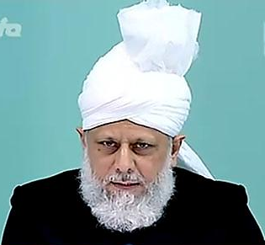
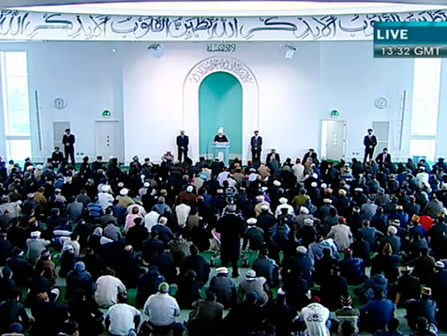
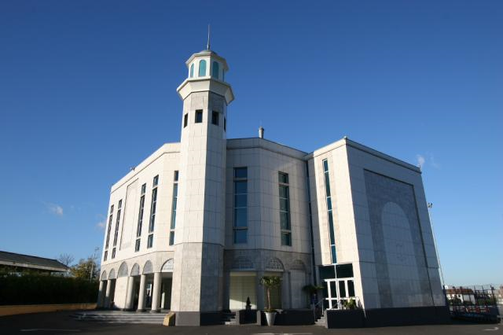
Faith Inspiring Stories of New Converts to Islam
Friday Sermon
29th April 2011

Slide 2
SUMMARY
Hudhur (aba) gave many faith inspiring stories of new converts from various parts of the world
Hudhur (aba) prayed, May Allah open the hearts of the Muslims. May they be the seekers of help from Allah in recognizing the reality. May Allah continue to strengthen our faiths as well.
Promised Messiah(as) said many pious natured sought guidance from Allah and Allah guided them. In these times too, to prove the truth of the Promised Messiah(as), Allah continues to guide those who are sincere in the search of truth.
Hudhur (aba) said that the Promised Messiah (on whom be peace), drew attention of the people that they should seek guidance from Allah regarding him being Mesiah and Mehdi.
Friday Sermon
29th April 2011

Slide 3
Hudhur (aba) said that the Promised Messiah (on whom be peace), drew attention of the people that they should seek guidance from Allah regarding him being Mesiah and Mehdi.
The Promised Messiah (on whom be peace) writes in his book Heavenly sign
‘after sincere repentance, the seeker should
offer two Rak‘at of prayer at night. He should recite Surah
Ya Sin in the first Rak‘at and in the second, after reciting
Surah Al-Ikhlas twenty-one times, recite Durud and
Istighfar three hundred times. He should then pray to
Allah’
One should pray that O Allah your are aware of everything, let me know the truth about such a person.
The Promised Messiah (on whom be peace) said that repentance is the of fundamental importance for this prayer.
Prayers for guidance
If one does this Allah will guide him
Friday Sermon
29th April 2011

Slide 4
Sincere Repentance is the Key to prayers
The scholars whose hearts are filled with grudges do not take the advice and they drown taking along people with them.
The Promised Messiah (on whom be peace), in his book KITABUL BARRIYYA, advised the scholars and Holy people to seek guidance from Allah.
The Promised Messiah (on whom be peace) said
If your heart is full of ranker and grudges and you are filled with of ill thinking then satanic thoughts will come to your mind
Many pious-natured sought guidance from Allah and Allah guides such people who are in search of righteousness.
If your heart is full of ill thoughts then God will not guide you.
In these times too, to prove the truth of the Promised Messiah (on whom be peace), Allah continues to guide those who are sincere in the search of truth.
Friday Sermon
April 29th 2011

Slide 5
Hudhur (aba) said that the Shaikhs, the so-called scholars, have continued to deceive the Muslims and the general public for the last 120 years. Even today, the words of the Promised Messiah, peace be on him, are being fulfilled with great splendour.
Hudhur (aba) explained that though the Promised Messiah, peace be on him, is physically not present among us,
but the increase in the Ahmadiyya Community and his appearance in dreams confirming his truth is a proof of his life.
The Promised Mesiah (peace be on him) said
“I observe, and you also see, that the ones who considered us infidel have disappeared while Allah has kept me alive and has multiplied my Community.”
Progress of Ahmadiyyat
Friday Sermon
April 29th 2011
Notes:
The Shaikhs, the so-called scholars, have continued to deceive the Muslims and the general public for the last 120 years. Even today, the words of the Promised Messiah, peace be on him, are being fulfilled with great splendor. He said, “I observe, and you also see, that the ones who considered us infidel have disappeared while Allah has kept me alive and has multiplied my Community.”
Though the Promised Messiah, peace be on him, is physically not present among us, the increase in the Community and his appearance in dreams confirming his truth is a proof of his life.

Slide 6
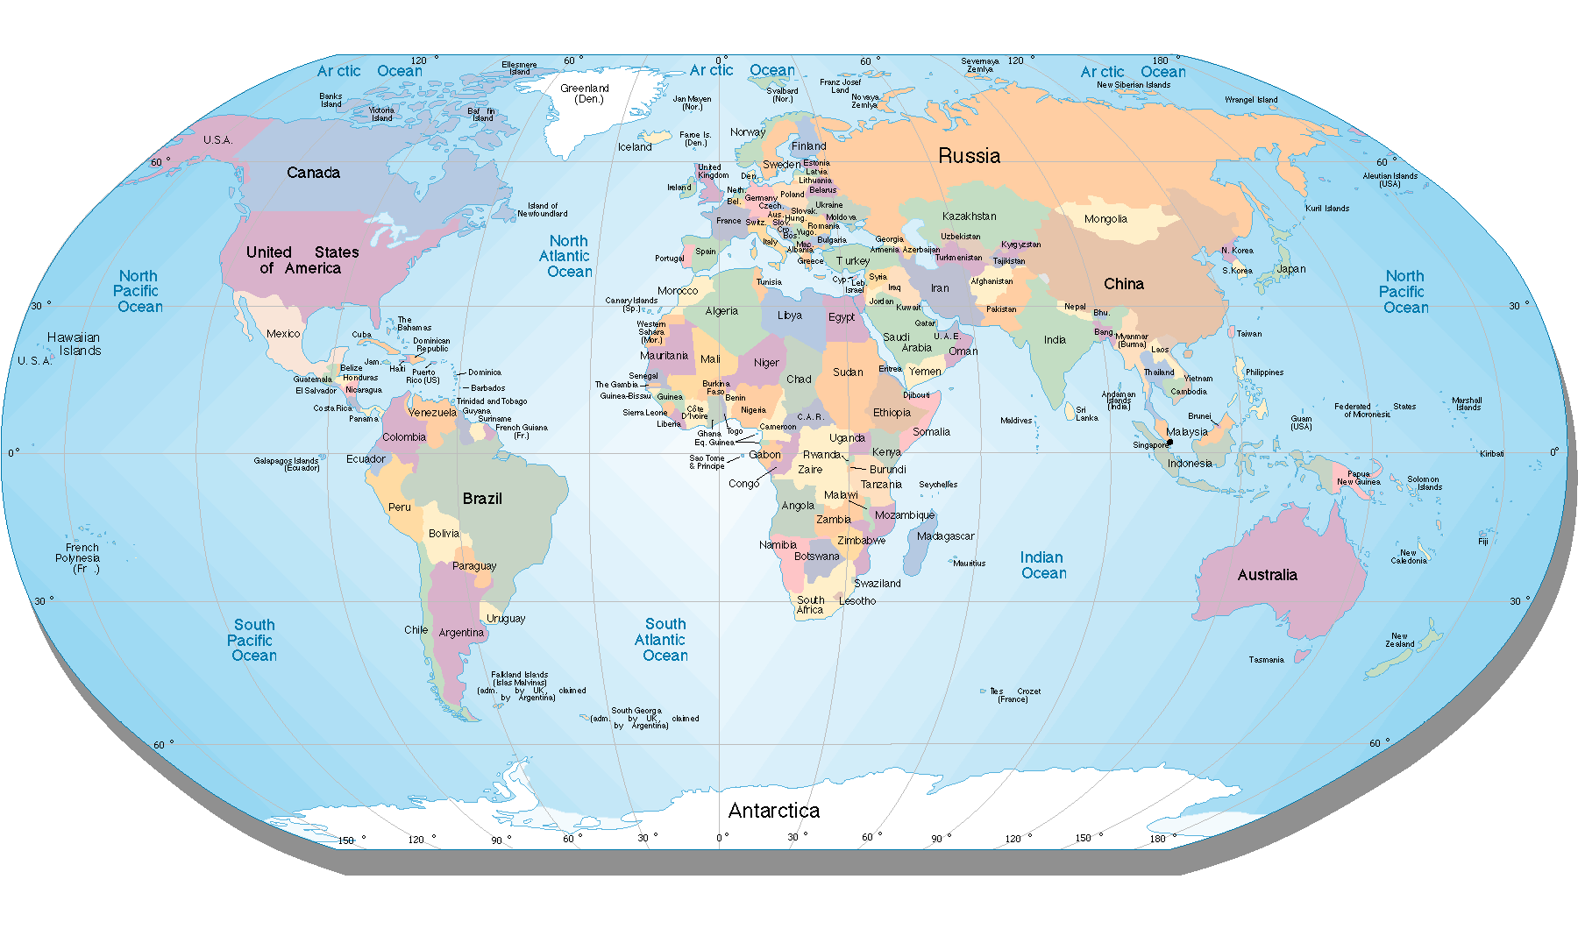
Faith Inspiring Stories of New Converts to Islam
Hudhur (aba) gave many faith inspiring stories from various parts of the world.
.
Friday Sermon
April 29th 2011

Slide 7

EGYPT
An Egyptian friend related: “I performed Istikhara in accordance with the procedure outlined by the promised Messiah, peace be on him, and prayed
I saw the dream that I am standing in front of my relative, and waving the finger of my hand I say to him three times that by God, the Ahmadiya Community is on truth.
Allah provided him the opportunity to pledge allegiance to the Khilafat.
Friday Sermon
29th April 2011

Slide 8

USA
.
A missionary of ours in the US writes that Abdus-Saleem Sahib offered the istikhara Prayer.
..
He saw the Promised Messiah, (peace be on him), in a dream
.
He attained satisfaction and wanted to pledge himself to the Ahmadiya Khilafat
Key point
He entered the Ahmadiya Community. The same night the promised Messiah (peace be on him) appeared in his dream and shook hands with him, and congratulated him on accepting Ahmadiyat
Friday Sermon
29th April 2011
Notes:
… A missionary of ours in the US writes that Abdus-Saleem … was made aware of the traditional procedure for the Istikhara Prayer. He offered the istikhara Prayer. He saw the Promised Messiah, peace be on him, in a dream. … He … saw the Promised Messiah, peace be on him, in a dream. … He … said that he had attained satisfaction … and wanted to pledge himself to the Ahmadiyya Khilafat. He entered the Ahmadiyya Community. The same night the promised Messiah, peace be on him, manifestly appeared in his dream and saluted him, shook hands with him, and congratulated him on accepting Ahmadiyyat. …

Slide 9

Indonesia
The Amir sahib of Indonesia writes about a member. One day he was asked to consider performing the Istikhara Prayer
He was shown a vision. A strong person was reciting the words, “I bear witness that there is none worthy of worship except Allah, and I bear witness that Muhammad is His messenger. Ahmadiyyat is true. You definitely attained the night of decree (Lailatul-Qadr). Hadhrat Mirza Ghulam Ahmad is the Mahdi.” He says that he saw this vision many times.
he accepted Ahmadiyyat in 2008 along with his spouse.
He had to face many difficulties after that. By the grace of Allah, he bore all difficulties with patience and steadfastness.
Friday Sermon
April 29th 2011

Slide 10

Canada
.
Amir Sahib of Canada writes
“Bill Robinson was a resident of St Thomas, Ontario. He used to be an enthusiastic Christian. He became distanced from Christianity over time and started praying to God, ‘O God, show me the right path.
’ He says that one night he prayed very fervently that if God exists then may He show him the right path. In the morning he saw that there was a pamphlet from the Ahmadiyya Community in his e-mail inbox. Taking the e-mail as a heavenly sign, he contacted the Community.
,
Friday Sermon
April 29th 2011
He accepted Ahmadiyyat in 2011

Slide 11

Yemen
Abdul-Qa’id Ahmad Sahib from Yemen writes,
“I have been watching MTA for the last two years. I have found the answers to all those questions to which no one else had a rejoinder. My heart was satisfied on seeing the picture of the Promised Messiah, peace be on him, the first time on the MTA. I felt that this person cannot be a liar
I saw numerous dreams after that which carried glad tidings.”
He entered the pledge of allegiance afterwards
Friday Sermon
29th April 2011

Slide 12

Kazakhstan
Our Mu‘allam from Kazakhstan writes. She accepted Ahmadiyyat.
A lady saw a dream as if someone had written on a board something in Arabic. She could not read it. She was told its meaning that Imam Mahdi is present among you
About two weeks after this, she was much affected when she saw me addressing on MTA during the German Jalsa Salana. She says that she had already been told that Imam Mahdi had come.
She entered the pledge of allegiance in 2010.
Friday Sermon
April 29th 2011

Slide 13

Borkina Fosa
He entered the pledge of allegiance
Our missionary-in-charge in Burkina Faso writes.
Zaila Abu Bakr Sahib saw a dream in which he was shown pictures.
He said, “It was the Promised Messiah, peace be on him, who was in his dream and was calling us to believe.”
Friday Sermon
29th April 2011

Slide 14

Kyrgyzstan
Our missionary in Kyrgyzstan writes.’
A young man writes “I saw in a dream … it is written in Russian, ‘Islam, the true Faith,’ and a loud voice was proclaiming, ‘Ahmadiyyat, the True Islam
My heart was satisfied after this dream .
He entered the pledge of allegiance.
Friday Sermon
29th April 2011

Slide 15

Algeria
Lady Fateeha from Algeria says, “After watching many programs on the MTA, I prayed to Allah.
. I saw in a dream that I am a part of a large community being guided by Hadrat Khalifatul-Masih V wearing his traditional garb.
He is guiding towards a mosque which has its doors open and there is light shining inside the mosque’.
She entered the pledge of allegiance.
Friday Sermon
April 29th 2011

Slide 16
The Promised Messiah (on whom be peace) said, “Time has come now that the grandeur and greatness of Islam be manifested again. I have appeared with this purpose. Muslims should appreciate the light and blessings which are descending from heaven, and thank Allah the Almighty that they were helped on time, and Allah according to His promise had supported them at the time of distress. But if they will not appreciate this blessing from Allah, Allah will not care about them a bit
May Allah open the hearts of the Muslims. May they be the seekers of help from Allah in recognizing the reality. May Allah continue to strengthen our faiths as well.
Muslims should be thankful to Allah
Friday Sermon
29th April 2011
Notes:
The Promised Messiah, peace be on him, says, “Time has come now that the grandeur and greatness of Islam be manifested again. I have appeared with this purpose. Muslims should appreciate the light and blessings which are descending from heaven, and thank Allah the Almighty that they were helped on time, and Allah according to His promise had supported them at the time of distress. But if they will not appreciate this blessing from Allah, Allah will not care about them a bit. He will have his objective achieved but there will be sorrow concerning them.”
May Allah open the hearts of the Muslims. May they be the seekers of help from Allah in recognizing the reality. May Allah continue to strengthen our faiths as well.

Slide 17
Ahmad Baqir Sahib of Syria who accepted Ahmadiyyat on the basis if a dream after Istikhara t on 15 July 2009 at the age of just 17. Despite that he was a cancer patient, he was quite enthusiastic about spreading the message. Some friends related that on the basis of a dream, he had informed some friends beforehand about the current conditions in Syria. His will be one of the funeral services.
Kamil Rasheed Rashid passed away on 8 April 2011 in Hims, Syria. is brother relates, “I was outside the house at the time of the firing. My brother went out to search for me on hearing the sound of firing. He spotted me and asked me to hurry home. As he turned after directing me, he became a target of a bullet which hit his heart and he passed away immediately.” He was just 31 years old
Friday Sermon
29th April 2011
Muhammad Mustafa Rab of Syria was hit by a bullet while trying to pull his son to safety from street demonstrations. He passed away. He was introduced to Ahmadiyyat through MTA
The sad news of demise
Our Lutfur-Rahman Shakir sahib passed away on April 27 after long illness. He was the eldest son of Maulana Abdur-Rahman Anwar who was the private secretary of the Khalifaul Masih II and the Khalifatul-Masih III, and was one of the initial members of Tahrik Jadid. He had devoted his life.

Slide 18
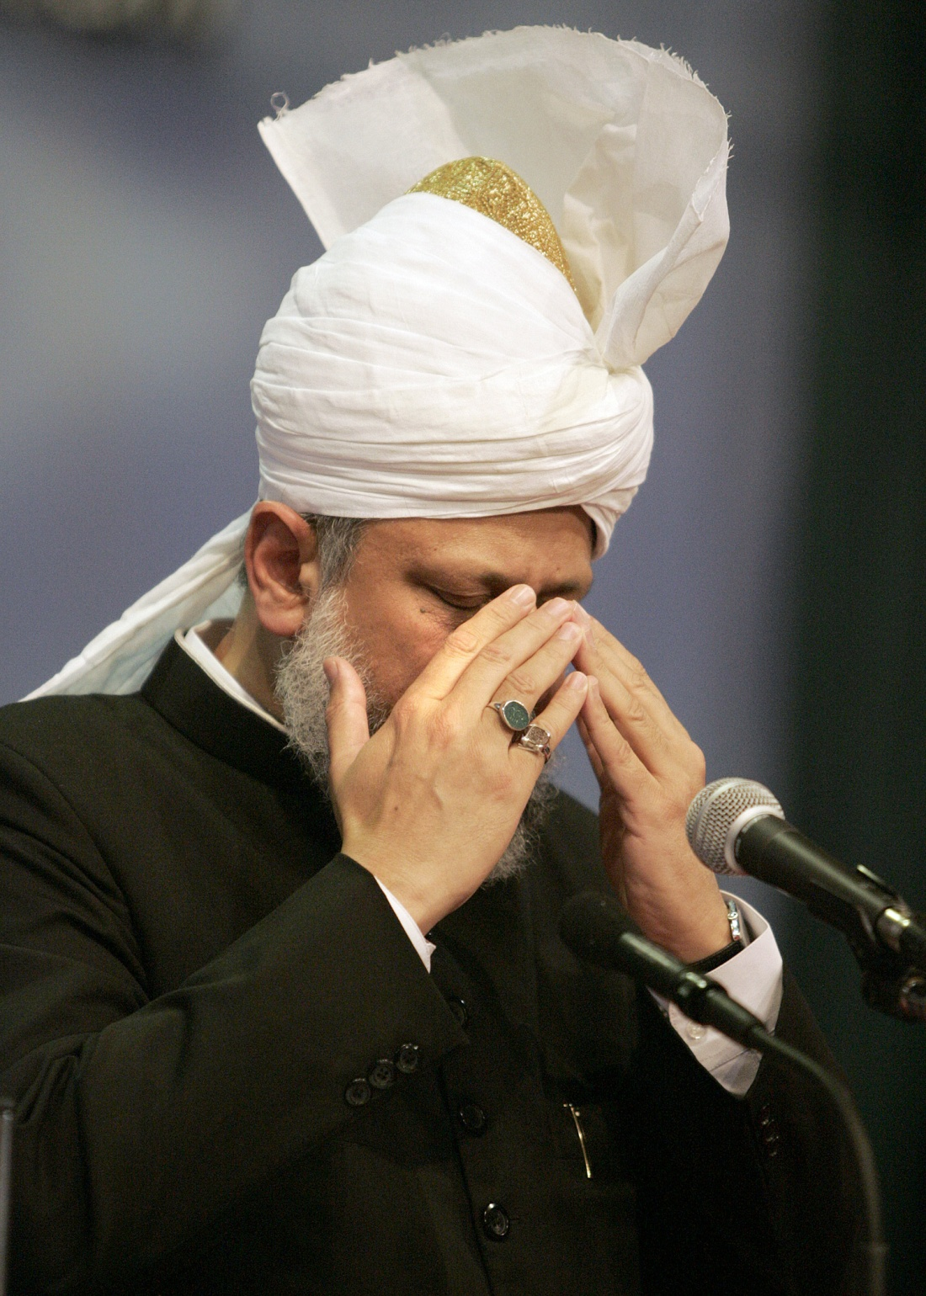
May God enhance the faith of new Ahmadis
May we always experience progress of our Jama’at
May God always bestow His grace on us.
Ameen
Friday Sermon
29th April 2011

