Slide 1
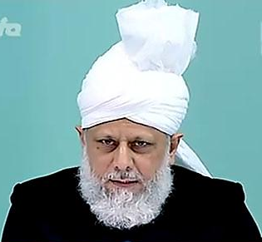
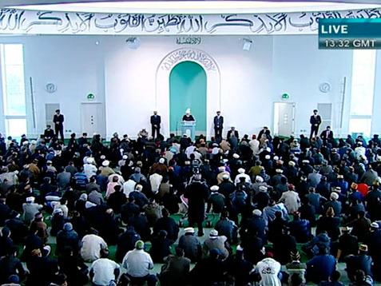
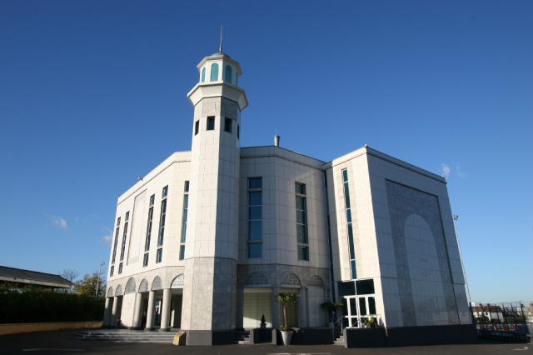
Natural Disasters and Divine Punishment
Friday Sermon
18th March 2011

Slide 2
Summary
The Holy Prophet (pbuh) knew that wind and storms blew to his advantage, as it happened in battles of Badr and Ditch; yet he used to get concerned over these
He feared that the arrogance of people and their misconception of God’s power may destroy the whole nation
True believers do not just fear God at the time of their own trouble, rather when affliction falls on others, it instils fear of God in them
The warnings of natural disasters and powerful earthquakes have been given by the Promised Messiah (on whom be peace)
Hudhur (aba) said the Muslims of the sub-continent should pay heed, they are not exempt
The news of natural disasters fill believers with fear in case their actions may become source of God’s displeasure in the future
May God enable them to understand this and may He enable us to be true Muslims, may we take our message to others with sincere compassion and prayers
Friday Sermon
18th March 2011

Slide 3
The news of natural disasters fill believers with fear in case their actions may become source of God’s displeasure in the future
Only true believers think like this as they have the insight and the perception of God
These people do not ascribe partners to God and are not those who only remember God in difficult, turbulent times and forget Him in peaceful times
Natural Disasters and belivers
They turn to God with greater intensity in times when they face difficulties or observe climatic changes
Friday Sermon
18th March 2011
Notes:
Whenever any natural disaster occurs in the world, those who fear God are frightened lest any such future disaster puts them in difficulty. That any act of theirs may become a source of God’s displeasure. Such thinking is only of true believers who have the insight and the perception that God does not need anyone and thus, with fear of God in their hearts, they try and tread the paths that lead to His pleasure. God states in the Holy Qur’an: ‘Verily, those who, out of fear of their Lord, always stand guard against sins. And those who believe in the Signs of their Lord,’ (23:58 – 59). The Surah goes on to state that these people do not ascribe partners to God and are not those who only remember God in difficult, turbulent times and forget Him in peaceful times. They turn to God with greater intensity in times when they face difficulties or observe climatic changes.
. They turn to God with greater intensity in times when they face difficulties or observe climatic changes.

Slide 4
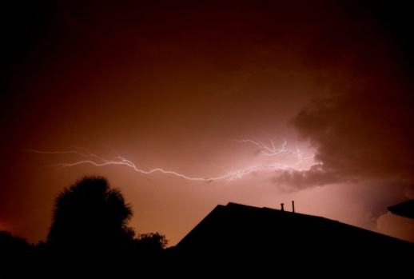
The blessed model of the Holy Prophet (pbuh) during Climatic disasters
Whenever there was a strong wind, the Holy Prophet (pbuh) used to say: ‘O Allah! I ask You for what is good in it, and the good which it contains, and the good of that which it was sent for. I seek refuge with You from what is evil in it, what evil it contains, and the evil of that which it was sent for; and when there was a thunder and lightning in the sky, his colour underwent a change, and he went out and in, backwards and forwards; and when the rain came, he felt relieved’.
Hadhrat 'A'ishah asked him about this and he answered: ‘It may be that these clouds are like those that had overcast the people of Ad. When they saw a cloud formation coming to their valley they said: ‘It is a cloud which would give us rain’. However, the cloud brought them a calamity.
Friday Sermon
18th March 2011
Notes:
The blessed model of the Holy Prophet (peace and blessings of Allah be on him) is there for us to follow for the rest of time. Hadhrat ‘Aishah (may Allah be pleased with her) narrates: ‘Whenever there was a strong wind, the Holy Prophet (peace and blessings of Allah be on him) used to say: ‘O Allah! I ask You for what is good in it, and the good which it contains, and the good of that which it was sent for. I seek refuge with You from what is evil in it, what evil it contains, and the evil of that what it was sent for; and when there was a thunder and lightning in the sky, his colour underwent a change, and he went out and in, backwards and forwards; and when the rain came, he felt relieved, and I noticed sign of relief on his face’. Hadhrat 'A'ishah asked him about this and he answered: ‘It may be that these clouds are like those that had overcast the people of Ad. When they saw a cloud formation coming to their valley they said: ‘It is a cloud which would give us rain’. However, the cloud brought them a calamity.

Slide 5
The blessed model of the Holy Prophet (pbuh) during climatic disasters
The Holy Prophet ( pbuh) knew that wind and storms blew to his advantage, as it happened in battles of Badr and Ditch.
Hudhur (aba) explained that here believers are enjoined that once they repent, they should follow the Prophet’s blessed model
Yet, he would feel concerned. His anxiety was borne out of his immense compassion, as he was ‘Mercy for all the worlds’. He feared that the arrogance of people and their misconception of His power may destroy the whole nation
The Holy Prophet’s (pbuh) was anxious that stormy clouds and winds could bring calamity because of bad deeds of those who call themselves believers
Friday Sermon
18th March 2011
Notes:
Such was the deportment of the perfect man (peace and blessings of Allah be on him) who had indeed been given countless promises by God. He was aware that no calamity would befall his life, in fact others were protected because of him. He was aware that the wickedness of any Dajjal (anti-Christ) was not going to avail against him, he also had the knowledge that wind and storms blew to his advantage, as it happened in battles of Badr and Ditch when stormy winds destroyed the enemy. Yet, he would feel concern. His anxiety was borne out of his immense compassion, as he was ‘Mercy for all the worlds’. His concern also stemmed from the fact that God does not need anyone or anything and he feared that the arrogance of people and their misconception of His power may destroy the whole nation. He had said that Surah Hud had aged him. Hudhur explained that Surah Hud relates destruction of nations.

Slide 6
If a true believer fears God through the bad ending of ancient people, how much more should the present disasters make one turn to God and fear Him
True believers do not just fear God at the time of their own trouble, rather when affliction falls on others, it instils fear of God in them
The natural disasters are attributed to simply climatic changes and laws of nature. It is correct that natural disasters occur due to the laws of nature
Friday Sermon
18th March 2011
True Believers
However, it is also noteworthy that the one commissioned by God in the current age foretold earthquakes.
Notes:
Hudhur explained that a true believer continues to call on God after trouble is averted while the ungrateful get embroiled in bad ways. As the blessed model of the Prophet (peace and blessings of Allah be on him) demonstrated, true believers do not just fear God at the time of their own trouble, rather when affliction falls on others, it instils fear of God in them. Hudhur said whether the calamities be of the past or current times, if a true believer fears God through the bad ending of ancient people, how much more should the present disasters make one turn to God and fear Him. However, the majority attributes natural disasters to simply climatic changes and laws of nature. It is correct that natural disasters occur due to the laws of nature. Earthquakes happen when the earth’s plate tectonics move. It is correct that New Zealand, Japan and many islands are located on plate tectonics and that is why they experience more earthquakes. However, it is also noteworthy that the one commissioned by God in the current age foretold earthquakes.

Slide 7
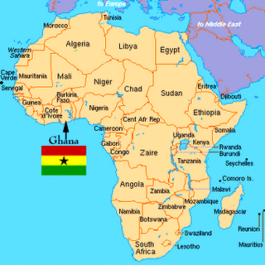
Many years ago, one of our missionaries in Ghana Mubasher sahib, was challenged by the local ulema (religious leaders/scholars) that earthquakes were one sign of the coming of the Mahdi. They demanded a sign of earthquake in their country.
The missionary sahib prayed and it so happened that an earthquake occurred in Ghana. This created a lot of restlessness and many came into the fold of Ahmadiyya Islam
Earthquakes are not common in Ghana
This sign became most renowned
Sign of Earthquake in Ghana
Friday Sermon
18th March 2011
Notes:
Many years ago, during his Tabligh efforts, one of our missionaries in Ghana Mubasher sahib, was told by the local ulema (religious leaders/scholars) that earthquakes were one sign of the coming of the Mahdi and if his claim about the Promised Messiah (on whom be peace) was truthful, then they wanted a sign of earthquake in their country. Earthquakes are not common in Ghana. The missionary sahib prayed and it so happened that an earthquake occurred in Ghana. This created a lot of restlessness among the Christians and many came into the fold of Ahmadiyya Islam and this sign became most renowned

Slide 8
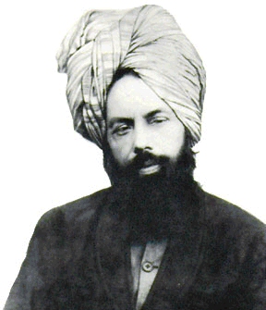
‘A warner came unto the world but the world accepted him not, yet God will accept him and demonstrate his truthfulness with mighty onslaughts.’
‘I shall bless thee, so much so that kings shall seek blessings from thy garments
‘Addressing me God Almighty said:
‘You are a warner on my behalf. I have sent you so that the guilty ones be separated from the righteous,
1835-1908
The warnings of natural disasters by the Promised Messiah (on whom be peace)
Friday Sermon
18th March 2011
Notes:
Hudhur said we observe that the Promised Messiah (on whom be peace) has indeed connected his advent with earthquakes and other natural disasters. Having being informed by God, he foretold that natural disaster would take place as a sign for him. He wrote: ‘Addressing me God Almighty said: ‘You are a warner on my behalf. I have sent you so that the guilty ones be separated from the righteous, ‘and He said, ‘A warner came unto the world but the world accepted him not, yet God will accept him and demonstrate his truthfulness with mighty onslaughts.’ And, ‘I shall bless thee, so much so that kings shall seek blessings from thy garments.’ And God informed me of another impending earthquake which would be of utmost severity and said: ‘Again the spring came and again the word of God was fulfilled.’ Thus another massive earthquake is bound to occur, but the righteous are safe from it. Be righteous, therefore, and fear God that you may be saved. Fear God today so that you may remain safe from the fear of that Day. It is inevitable for the heaven to show some sign for the earth to do likewise. But those who fear God shall be saved. God’s Word informed me that many calamities will occur and many disasters will descend on the earth – some during my life time and some after I have gone. And He will promote and advance this Jama’at to the full. A part of it will happen at my hands, and some after me.’
(The Will, pp. 3 – 5).

Slide 9
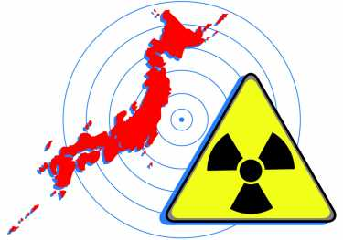
’ Thus another massive earthquake is bound to occur, but the righteous are safe from it. Be righteous, therefore, and fear God that you may be saved. Fear God today so that you may remain safe from the fear of that Day. It is inevitable for the heaven to show some sign for the earth to do likewise. But those who fear God shall be saved. God’s Word informed me that many calamities will occur and many disasters will descend on the earth – some during my life time and some after I have gone. And He will promote and advance this Jama’at to the full. A part of it will happen at my hands, and some after me.’
(The Will, pp. 3 – 5).
God informed me of another impending earthquake which would be of utmost severity and said:
‘Again the spring came and again the word of God was fulfilled.
The warnings of natural disasters by the Promised Messiah (on whom be peace)
Friday Sermon
18th March 2011
Notes:
Hudhur said we observe that the Promised Messiah (on whom be peace) has indeed connected his advent with earthquakes and other natural disasters. Having being informed by God, he foretold that natural disaster would take place as a sign for him. He wrote: ‘Addressing me God Almighty said: ‘You are a warner on my behalf. I have sent you so that the guilty ones be separated from the righteous, ‘and He said, ‘A warner came unto the world but the world accepted him not, yet God will accept him and demonstrate his truthfulness with mighty onslaughts.’ And, ‘I shall bless thee, so much so that kings shall seek blessings from thy garments.’ And God informed me of another impending earthquake which would be of utmost severity and said: ‘Again the spring came and again the word of God was fulfilled.’ Thus another massive earthquake is bound to occur, but the righteous are safe from it. Be righteous, therefore, and fear God that you may be saved. Fear God today so that you may remain safe from the fear of that Day. It is inevitable for the heaven to show some sign for the earth to do likewise. But those who fear God shall be saved. God’s Word informed me that many calamities will occur and many disasters will descend on the earth – some during my life time and some after I have gone. And He will promote and advance this Jama’at to the full. A part of it will happen at my hands, and some after me.’
(The Will, pp. 3 – 5).

Slide 10
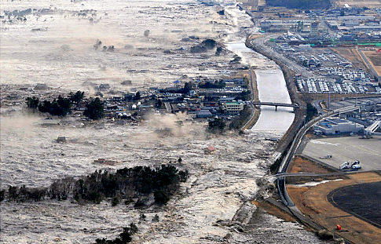
Hudhur (aba) said he has explained it before that the natural disasters that have occurred in the last 100 years have exceeded all previous records
God is repeatedly demonstrating these signs in different part of the world
Therefore, we should keep this warning in view and strengthen our faith
And we should take this message to the world
The warnings of natural disasters by the Promised Messiah (on whom be peace)
Friday Sermon
18th March 2011
Notes:
Hudhur said he has explained it before that the natural disasters that have occurred in the last 100 years have exceeded all previous records. God is repeatedly demonstrating these signs in different part of the world. Therefore, we should repeatedly keep this warning in view and strengthen our faith and take this message to the world.

Slide 11
The warnings of natural disasters by the Promised Messiah (on whom be peace)
In this most frightening situation, we should follow in the blessed model of the Holy Prophet (pbuh) and pray
Last week an extremely powerful earthquake hit Japan
It was followed by a tsunami which obliterated many towns
May God enable these people to recognize the truth so that they may be saved from disasters
May God enlighten their hearts
For this, we too have to take the message to them
Friday Sermon
18th March 2011
Notes:
Last week an extremely powerful earthquake hit Japan. It was followed by a tsunami which obliterated many towns. Hudhur said our team is on the ground helping the victims. En route they rang and said they were passing through a desolated area where once a town of 15,000 inhabitants stood. Roads, large buildings were wiped out. Hudhur said this is a most frightening situation and we should follow in the blessed model of the Holy Prophet (peace and blessings of Allah be on him) and pray that may God enable these people to recognize the truth so that they may be saved from disasters; may God open their hearts. For this, we too have to take the message to them.

Slide 12
The Promised Messiah (on whom be peace) had a particularly good intuition about the Japanese people
Hudhur said the Promised Messiah (on whom be peace) wished for Tabligh in Japan and said that there should be a comprehensive book on Islam to draw the attention of the Japanese.
Our Jama’at in Japan is small, but it should try its very best to take this message to people
In the current situation, discretion should be used in taking this message to them alongside service to humanity
Hadhrat Musleh Maud (may Allah be pleased with him) had a vision in 1945 about which he said that the Japanese were spiritually dead at the time, but God will incline them towards Ahmadiyyat and they will hearken at his voice just as birds responded to the voice of Hadhrat Ibrahim (on whom be peace).
Hudhur (aba) said this lays a huge responsibility on us to have such a book written in Japanese
Friday Sermon
18th March 2011
Notes:
The Promised Messiah (on whom be peace) had a particularly good intuition about the Japanese people. So, while they suffer from earthquakes, in light of the Promised Messiah’s (on whom be peace) good intuition, if they understand the true teachings, they can be saved. Our Jama’at in Japan is small, but it should try its very best to take this message to people. In the current situation, discretion should be used in taking this message to them alongside service to humanity. Our Ahmadi camps are indeed serving humanity there, but they need to make these links permanent so that people know about Ahmadiyyat. Hudhur said the Japanese are very proud of their Shinto and Buddhists beliefs. It is said that both these belief systems are observed in Japan. Marriages take place according to Shinto beliefs where as in death Buddhist rites are observed. A very influential Japanese friend of Hudhur told Hudhur a while ago that due to their Shinto beliefs, the Japanese will not be drawn to Islam. Hudhur told him that indeed Shinto belief has many good moral aspects but one day they will have to come to Islam. Hudhur said the Promised Messiah (on whom be peace) wished for Tabligh in Japan and said that there should be a comprehensive book on Islam to draw the attention of the Japanese. He had said that books on Islam published by others have errors in them and were not to be trusted. He said what he presented was indeed what Islam was. Hudhur said this lays a huge responsibility on us to have such a book written in Japanese. He said he did not think such a book has yet been written. Hudhur said the Promised Messiah (on whom be peace) had said that even if it meant paying someone Rupee 1000, which was a huge amount in those days, to get such a book translated, it should be done. Hudhur explained that currently the Japanese translation of the Holy Qur’an is being revised by Zia sahib. Hudhur also mentioned that Hadhrat Musleh Maud (may Allah be pleased with him) had a vision in 1945 about which he said that the Japanese were spiritually dead at the time, but God will incline them towards Ahmadiyyat and they will hearken at his voice just as birds responded to the voice of Hadhrat Ibrahim (on whom be peace).

Slide 13
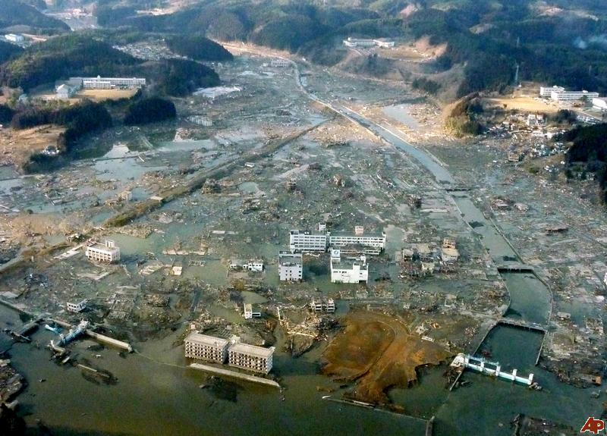
The warnings of natural disasters by the Promised Messiah (on whom be peace)
In Japan buildings are built to withstand earthquakes of 7 to 8 Richter scale. The current earthquake measured 9 on the Richter scale and was followed by a tsunami
Hudhur (aba) said may God bless and save from further destruction
It is being said that there has not been such a powerful earthquake for the past 1000 years
Friday Sermon
18th March 2011
Notes:
Hudhur said today it is our task to pay attention to this matter. It is our task to alert every nation. It is being said that there has not been such a powerful earthquake for the past 1000 years. Japan has many earthquakes and buildings are built there with this specification. However, when God’s decree comes to pass, nothing works. The Japanese plan for earthquakes of 7 to 8 Richter scale. The current earthquake measured 9 on the Richter scale and was followed by a tsunami. Man assumes that he has advanced a lot. Atomic/nuclear energy is now being utilized in beneficial ways. Although there is opposition to atomic energy in Japan because of the WWII history but it is being used there for mankind’s benefit. However, the recent earthquake has damaged a few nuclear reactors and as a result radiation is spreading. Hudhur said he has just received a fax informing him that as the attempt by helicopters to drop water at the reactors to cool them down has not worked, they are now hosing water at the reactors with tanks belonging to the fire brigade. Hudhur said may God bless and save from further destruction. Hudhur said he has sent a message to all our volunteers working in Japan to take homoeopathic remedy; specific medicine in specific order. It should also be given out to others and if stocks are not sufficient, Humanity First should have them delivered.

Slide 14
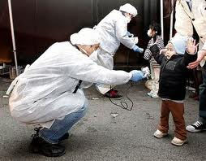
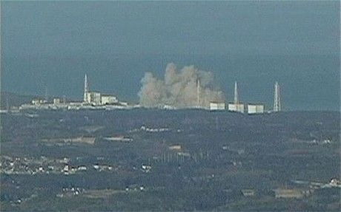
However, the recent earthquake has damaged a few nuclear reactors and as a result radiation is spreading
The effects of radiation are long-lasting; continue for generations and often result in disabled children born
May God have mercy
homoeopathic remedy for radiation exposure should be taken by relief workers in Japan; It should also be given out to others
Japan; impending nuclear Disaster
The nations that think they are safe are not safe according to the prophecy of the Imam of the age. If they do not pay heed, these calamities can engulf everyone.
Friday Sermon
18th March 2011
Notes:
Hudhur said aside from the earthquake destruction in Japan, there is danger of radiation. The effects of radiation are long-lasting; continue for generations and often result in disabled children born. May God have mercy. The nations that think they are safe are not safe according to the prophecy of the Imam of the age. If they do not pay heed, these calamities can engulf everyone.

Slide 15
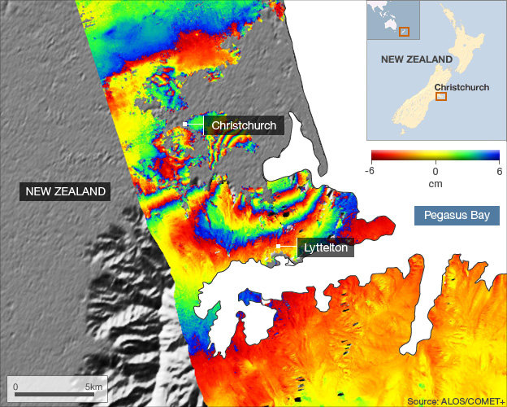
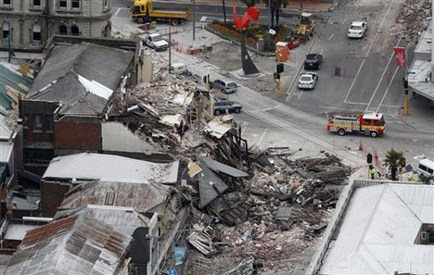
This year three different countries in the far eastern region and beyond have been affected by natural disasters.
In New Zealand a large part of a city [Christchurch] was badly damaged by an earthquake. 70,000 people had to leave the city.
The warnings of natural disasters by the Promised Messiah (on whom be peace)
Friday Sermon
18th March 2011
Notes:
This year three different countries in the far eastern region and beyond have been affected by natural disasters. In New Zealand a large part of a city [Christchurch] was badly damaged by an earthquake. 70,000 people had to leave the city.

Slide 16
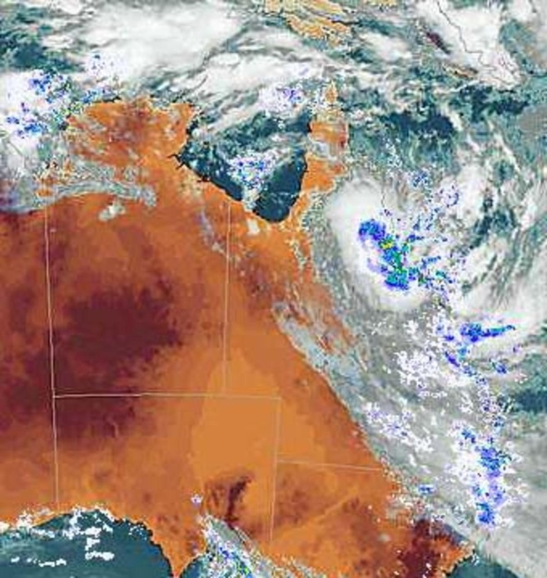
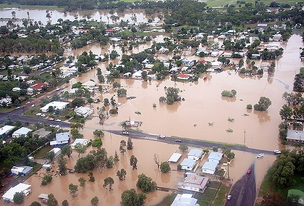
In Australia, heavy rain and floods affected 70 towns and cities in the state of Queensland
85% of Queensland coal mines have suffered loss and the floods have cost billions to the economy
The storm that hit the state of Victoria in Australia was the worst ever
The warnings of natural disasters by the Promised Messiah (on whom be peace)
Other countries should not assume that they are safe
Friday Sermon
18th March 2011
USA has also seen storms recently. How many could they save?
Notes:
In Australia, heavy rain and floods affected 70 towns and cities in the state of Queensland. Hudhur said to keep this in perspective, the state of Queensland is 4 times the size of Japan. This diminishes the assumption that if natural disaster strikes, people can move away from it. 85% of Queensland coal mines have suffered loss and the floods have cost billions to the economy. The storm that hit the state of Victoria in Australia was the worst ever storm there. USA has also seen storms recently. How many could they save? Other countries should not assume that they are safe.

Slide 17
God wills that the entire world is gathered on one hand and for this He has sent the Promised Messiah (on whom be peace).
The truth of Islam will now be established through him
We should reflect and ponder over the practice of the Holy Prophet (pbuh); how strong winds and rains used to make him anxious. Do we practice that?
Truth of Islam will establish
God does not need anyone. He is with one who truly honours the due of being His servant
Friday Sermon
18th March 2011
Notes:
God wills that the entire world is gathered on one hand and for this He has sent the Promised Messiah (on whom be peace). The truth of Islam will now be established through him. If others are to be contended with to prove the superiority of Islam, it has to be done by connecting to him, who was commissioned by God. No other organisation can achieve this.
We should reflect and ponder over the practice of the Holy Prophet (peace and blessings of Allah be on him); how strong winds and rains used to make him anxious. Do we practice that? God does not need anyone. He is with one who truly honours the due of being His servant.

Slide 18
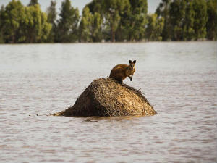
‘Bear in mind that God has informed me time and again about the coming of earthquakes. So be sure that just as there have been earthquakes in America and in Europe, in keeping with the prophecies, so will they occur in different parts of Asia, and some of them will be as terrifying as doomsday.
There will be death on such a large scale that rivers will run with blood, and even birds and animals will not escape it. Such destruction will overtake the earth as had not happened since man was born
The warnings of natural disasters by the Promised Messiah (on whom be peace)
Friday Sermon
18th March 2011
Notes:
The Promised Messiah (on whom be peace) wrote:
‘Bear in mind that God has informed me time and again about the coming of earthquakes. So be sure that just as there have been earthquakes in America and in Europe, in keeping with the prophecies, so will they occur in different parts of Asia, and some of them will be as terrifying as doomsday. There will be death on such a large scale that rivers will run with blood, and even birds and animals will not escape it. Such destruction will overtake the earth as had not happened since man was born. Most places will be turned upside down as if they had never been inhabited. There will also be other terrible afflictions, both in heaven and earth, and every sensible person will realize that they are no ordinary phenomena, and no trace of them will be found in books of astronomy or philosophy. Then people will be seized by anxiety and they will wonder what is going to happen? Many will be saved, and many will perish. Those days are near, indeed they are at the door, when the world shall witness a spectacle of doomsday. Not only will there be earthquakes, but other terrible calamities will also appear, some from heaven and some from the earth. This will happen because men have given up the worship of their God, and all their thoughts and their designs and their resolves are diverted towards the world. Had I not come, these calamities might have been delayed for a while, but with my coming the secret designs of God’s wrath, that had long been hidden, have been manifested. As God said: ‘We will punish until We have sent a Messenger.’ [17:16] Those who repent shall find security and those who fear before the calamity overtakes them will be shown mercy. Do you think that you will be safe from these earthquakes, or that you can save yourselves by your own designs? No, you cannot. All human designs will come to naught that day. Do not imagine that only America has been shaken by the earthquake and that you are safe, for you may experience even greater calamities. O Europe! you are not secure, O Asia! You are not secure, O you who dwell in the Islands, no artificial god will come to your aid. I see the cities falling and I see the habitations in ruin. The One and the Unique has long remained silent. Abominations were committed before His eyes and yet He remained silent. But now He shall reveal His countenance in a dreadful manner. He who has ears to hear, let him hear! The hour is not far. I tried to bring everyone under the security of God, but the decrees of destiny had to be fulfilled. Assuredly, I say that this country’s turn is also drawing near. The days of Noah shall appear before your eyes, and you will see with your own eyes what happened to the land of Lot. But God is slow to wrath, repent so that you are shown mercy. He who abandons God is a worm, not a man, and he
who does not fear Him is dead, not alive.’
[‘Haqiqat ul Wahi’ – Essence of Islam, Vol. V, pp. 148 – 150]

Slide 19
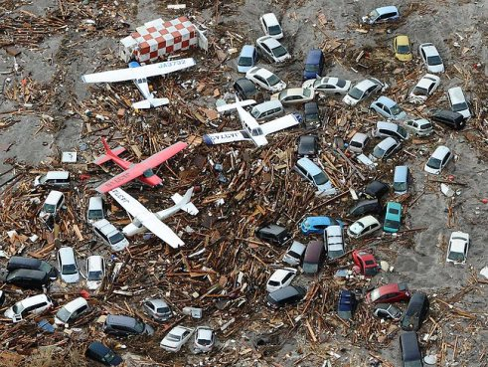
Most places will be turned upside down as if they had never been inhabited. There will also be other terrible afflictions, both in heaven and earth, and every sensible person will realize that they are no ordinary phenomena, and no trace of them will be found in books of astronomy or philosophy.
Then people will be seized by anxiety and they will wonder what is going to happen? Many will be saved, and many will perish. Those days are near, indeed they are at the door, when the world shall witness a spectacle of doomsday.
Not only will there be earthquakes, but other terrible calamities will also appear, some from heaven and some from the earth
The warnings of natural disasters by the Promised Messiah (on whom be peace)
Friday Sermon
18th March 2011
Notes:
The Promised Messiah (on whom be peace) wrote:
‘Bear in mind that God has informed me time and again about the coming of earthquakes. So be sure that just as there have been earthquakes in America and in Europe, in keeping with the prophecies, so will they occur in different parts of Asia, and some of them will be as terrifying as doomsday. There will be death on such a large scale that rivers will run with blood, and even birds and animals will not escape it. Such destruction will overtake the earth as had not happened since man was born. Most places will be turned upside down as if they had never been inhabited. There will also be other terrible afflictions, both in heaven and earth, and every sensible person will realize that they are no ordinary phenomena, and no trace of them will be found in books of astronomy or philosophy. Then people will be seized by anxiety and they will wonder what is going to happen? Many will be saved, and many will perish. Those days are near, indeed they are at the door, when the world shall witness a spectacle of doomsday. Not only will there be earthquakes, but other terrible calamities will also appear, some from heaven and some from the earth. This will happen because men have given up the worship of their God, and all their thoughts and their designs and their resolves are diverted towards the world. Had I not come, these calamities might have been delayed for a while, but with my coming the secret designs of God’s wrath, that had long been hidden, have been manifested. As God said: ‘We will punish until We have sent a Messenger.’ [17:16] Those who repent shall find security and those who fear before the calamity overtakes them will be shown mercy. Do you think that you will be safe from these earthquakes, or that you can save yourselves by your own designs? No, you cannot. All human designs will come to naught that day. Do not imagine that only America has been shaken by the earthquake and that you are safe, for you may experience even greater calamities. O Europe! you are not secure, O Asia! You are not secure, O you who dwell in the Islands, no artificial god will come to your aid. I see the cities falling and I see the habitations in ruin. The One and the Unique has long remained silent. Abominations were committed before His eyes and yet He remained silent. But now He shall reveal His countenance in a dreadful manner. He who has ears to hear, let him hear! The hour is not far. I tried to bring everyone under the security of God, but the decrees of destiny had to be fulfilled. Assuredly, I say that this country’s turn is also drawing near. The days of Noah shall appear before your eyes, and you will see with your own eyes what happened to the land of Lot. But God is slow to wrath, repent so that you are shown mercy. He who abandons God is a worm, not a man, and he
who does not fear Him is dead, not alive.’
[‘Haqiqat ul Wahi’ – Essence of Islam, Vol. V, pp. 148 – 150]

Slide 20
This will happen because men have given up the worship of their God, and all their thoughts and their designs and their resolves are diverted towards the world.
Had I not come, these calamities might have been delayed for a while, but with my coming the secret designs of God’s wrath, that had long been hidden, have been manifested.
As God said: ‘We never punish until We have sent a Messenger.’ [17:16]
1835-1908
The warnings of natural disasters by the Promised Messiah (on whom be peace)
Friday Sermon
18th March 2011
Notes:
This will happen because men have given up the worship of their God, and all their thoughts and their designs and their resolves are diverted towards the world. Had I not come, these calamities might have been delayed for a while, but with my coming the secret designs of God’s wrath, that had long been hidden, have been manifested. As God said: ‘We will punish until We have sent a Messenger.’ [17:16] Those who repent shall find security and those who fear before the calamity overtakes them will be shown mercy. Do you think that you will be safe from these earthquakes, or that you can save yourselves by your own designs? No, you cannot. All human designs will come to naught that day. Do not imagine that only America has been shaken by the earthquake and that you are safe, for you may experience even greater calamities. O Europe! you are not secure, O Asia! You are not secure, O you who dwell in the Islands, no artificial god will come to your aid. I see the cities falling and I see the habitations in ruin. The One and the Unique has long remained silent. Abominations were committed before His eyes and yet He remained silent. But now He shall reveal His countenance in a dreadful manner. He who has ears to hear, let him hear! The hour is not far. I tried to bring everyone under the security of God, but the decrees of destiny had to be fulfilled. Assuredly, I say that this country’s turn is also drawing near. The days of Noah shall appear before your eyes, and you will see with your own eyes what happened to the land of Lot. But God is slow to wrath, repent so that you are shown mercy. He who abandons God is a worm, not a man, and he
who does not fear Him is dead, not alive.’
[‘Haqiqat ul Wahi’ – Essence of Islam, Vol. V, pp. 148 – 150]

Slide 21
Those who repent shall find security and those who fear before the calamity overtakes them will be shown mercy.
Do you think that you will be safe from these earthquakes, or that you can save yourselves by your own designs?
No, you cannot. All human designs will come to naught that day
The warnings of natural disasters by the Promised Messiah (on whom be peace)
Friday Sermon
18th March 2011
Notes:
This will happen because men have given up the worship of their God, and all their thoughts and their designs and their resolves are diverted towards the world. Had I not come, these calamities might have been delayed for a while, but with my coming the secret designs of God’s wrath, that had long been hidden, have been manifested. As God said: ‘We will punish until We have sent a Messenger.’ [17:16] Those who repent shall find security and those who fear before the calamity overtakes them will be shown mercy. Do you think that you will be safe from these earthquakes, or that you can save yourselves by your own designs? No, you cannot. All human designs will come to naught that day. Do not imagine that only America has been shaken by the earthquake and that you are safe, for you may experience even greater calamities. O Europe! you are not secure, O Asia! You are not secure, O you who dwell in the Islands, no artificial god will come to your aid. I see the cities falling and I see the habitations in ruin. The One and the Unique has long remained silent. Abominations were committed before His eyes and yet He remained silent. But now He shall reveal His countenance in a dreadful manner. He who has ears to hear, let him hear! The hour is not far. I tried to bring everyone under the security of God, but the decrees of destiny had to be fulfilled. Assuredly, I say that this country’s turn is also drawing near. The days of Noah shall appear before your eyes, and you will see with your own eyes what happened to the land of Lot. But God is slow to wrath, repent so that you are shown mercy. He who abandons God is a worm, not a man, and he
who does not fear Him is dead, not alive.’
[‘Haqiqat ul Wahi’ – Essence of Islam, Vol. V, pp. 148 – 150]

Slide 22
Do not imagine that only America has been shaken by the earthquake and that you are safe, for you may experience even greater calamities.
O Europe! you are not secure, O Asia! You are not secure, O you who dwell in the Islands, no artificial god will come to your aid.
I see the cities falling and I see the habitations in ruin. The One and the Unique has long remained silent. Abominations were committed before His eyes and yet He remained silent.
But now He shall reveal His countenance in a dreadful manner
The warnings of natural disasters by the Promised Messiah (on whom be peace
Friday Sermon
18th March 2011
Notes:
Do not imagine that only America has been shaken by the earthquake and that you are safe, for you may experience even greater calamities. O Europe! you are not secure, O Asia! You are not secure, O you who dwell in the Islands, no artificial god will come to your aid. I see the cities falling and I see the habitations in ruin. The One and the Unique has long remained silent. Abominations were committed before His eyes and yet He remained silent. But now He shall reveal His countenance in a dreadful manner. He who has ears to hear, let him hear! The hour is not far. I tried to bring everyone under the security of God, but the decrees of destiny had to be fulfilled. Assuredly, I say that this country’s turn is also drawing near. The days of Noah shall appear before your eyes, and you will see with your own eyes what happened to the land of Lot. But God is slow to wrath, repent so that you are shown mercy. He who abandons God is a worm, not a man, and he
who does not fear Him is dead, not alive.’
[‘Haqiqat ul Wahi’ – Essence of Islam, Vol. V, pp. 148 – 150]

Slide 23
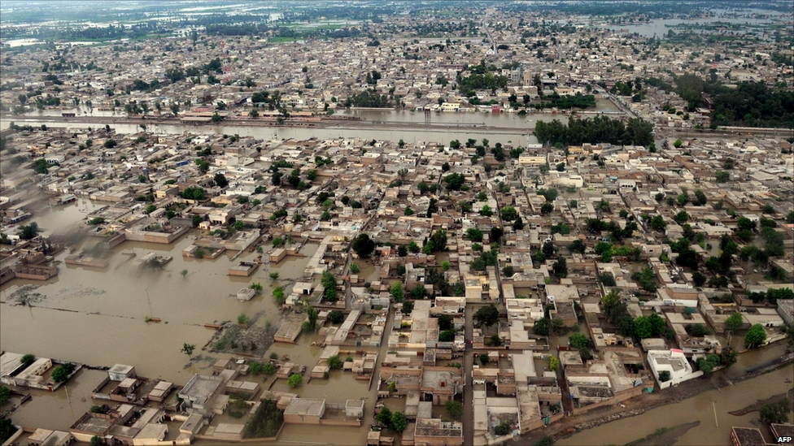
He who has ears to hear, let him hear! The hour is not far. I tried to bring everyone under the security of God, but the decrees of destiny had to be fulfilled. Assuredly, I say that this country’s turn is also drawing near.
The days of Noah shall appear before your eyes, and you will see with your own eyes what happened to the land of Lot. But God is slow to wrath, repent so that you are shown mercy.
He who abandons God is a worm, not a man, and he
who does not fear Him is dead, not alive’
The warnings of natural disasters by the Promised Messiah (on whom be peace
Friday Sermon
18th March 2011
Notes:
Do not imagine that only America has been shaken by the earthquake and that you are safe, for you may experience even greater calamities. O Europe! you are not secure, O Asia! You are not secure, O you who dwell in the Islands, no artificial god will come to your aid. I see the cities falling and I see the habitations in ruin. The One and the Unique has long remained silent. Abominations were committed before His eyes and yet He remained silent. But now He shall reveal His countenance in a dreadful manner. He who has ears to hear, let him hear! The hour is not far. I tried to bring everyone under the security of God, but the decrees of destiny had to be fulfilled. Assuredly, I say that this country’s turn is also drawing near. The days of Noah shall appear before your eyes, and you will see with your own eyes what happened to the land of Lot. But God is slow to wrath, repent so that you are shown mercy. He who abandons God is a worm, not a man, and he
who does not fear Him is dead, not alive.’
[‘Haqiqat ul Wahi’ – Essence of Islam, Vol. V, pp. 148 – 150]

Slide 24
Hudhur (aba) said the Muslims of the sub-continent should pay heed, they are not exempt
The Promised Messiah (on whom be peace) has repeatedly and very strongly warned against this and the strength of his warning is borne out of compassion
It is our duty to draw attention to it that the detractors of the Promised Messiah (on whom be peace) in India, Bangladesh and Pakistan have witnessed calamities at close range
Recently, many Muslim countries are facing the crisis of conflict between the masses and the government. Muslim is killing Muslim
If only they understood that the one who was to be sent for the good of the Ummah has come
Warning
May God enable them to understand this and may He enable us to be true Muslims, may we take our message to others with sincere compassion and prayers
Friday Sermon
18th March 2011
Notes:
Hudhur said the Muslims of the sub-continent should pay heed, they are not exempt. The Promised Messiah (on whom be peace) has repeatedly and very strongly warned against this and the strength of his warning is borne out of compassion. It is our duty to draw attention to it that the detractors of the Promised Messiah (on whom be peace) in India, Bangladesh and Pakistan have witnessed calamities at close range. The recent world disasters should be a cautionary sign for us. May God make the Muslims understand this. Recently, many Muslim countries are facing the crisis of conflict between the masses and the government. Muslim is killing Muslim. What could be more tragic than this? If only they understood that the one who was to be sent for the good of the Ummah has come. May God enable them to understand this and may He enable us to be true Muslims, may we take our message to others with sincere compassion and whilst prayerful.

Slide 25
A local Qaid and finance secretary, was shot by two unknown motorbike riders
He was on his way home from a Jama’at programme when he was attacked. He passed away as he was being rushed to a hospital
He leaves behind a widow and two daughters
Hudhur said this is the fifth martyrdom in Sangher in the past few years
Rana Zafrullah sahib
Martyrs of Ahmadiyyat
May God be the Protector and Helper of the bereaved family. Hudhur said he would lead funeral Prayer in absentia of the shaheed (martyr) after Friday Prayer
Friday Sermon
18th March 2011
Notes:
Next Hudhur gave the sad news of a martyrdom in Sangher, Pakistan. Rana Zafrullah sahib, a local Qaid and finance secretary, was shot by two unknown motorbike riders. He was on his way home from a Jama’at programme when he was attacked. He passed away as he was being rushed to a hospital in Nawab Shah. Hudhur prayed that may God elevate his status. He leaves behind a widow and two daughters. Hudhur said this is the fifth martyrdom in Sangher in the past few years. May God keep the Ahmadis of the area safe and may He soon bring the enemy to justice. May God be the Protector and Helper of the bereaved family. Hudhur said he would lead funeral Prayer in absentia of the shaheed (martyr) after Friday Prayer.

