Slide 1
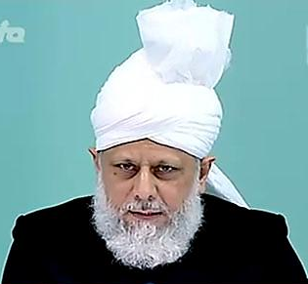
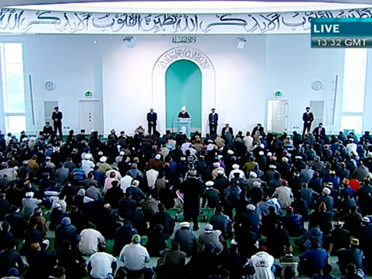
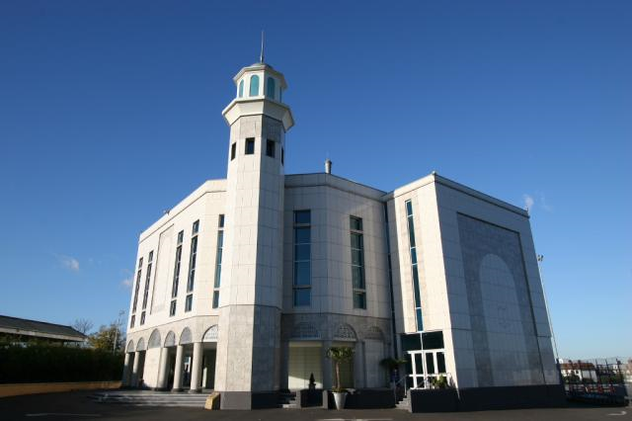
Ultimate Triumph of Divine Communities
Friday Sermon
4th March 2011

Slide 2
SUMMARY
Due to his ardent love for the Holy Prophet (PBUH) God granted him status of prophethood so that he could take the task of the Holy Prophet (PBUH) further. However, this was a prophethood which was not law-bearing and was in a shadow-like capacity
Hudhur gave a discourse on ultimate triumph of divine communities.
Hudhur said that we firmly believe that the Promised Messiah (on whom be peace) was from God.
When divine communities progress, their detractors try their utmost to stop their progress by means of force or through the help of supporters whom they deem powerful.
The ultimate triumph most certainly belongs to divine communities.
Special attention to prayers is needed during these days, may God also cover our faults and may no act of ours be such that it deprives us of experiencing this progress.
Each Ahmadi should increase his or her religious knowledge and be aware of what he or she believes in and why he or she believes it
March 4th 2011

Slide 3
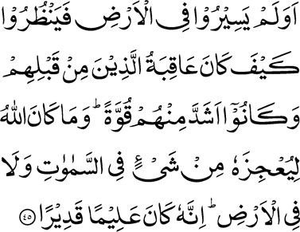
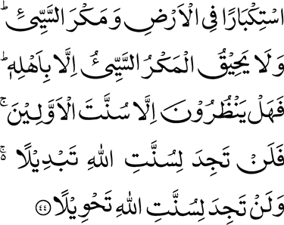
‘Out of arrogance in the earth and evil plotting. But the evil plot encompasses none but the authors thereof. Do they then look for anything but God’s way of dealing with the peoples of old? But thou wilt never find any change in the way of Allah; nor wilt thou ever find any alteration in the way of Allah.
Have they not travelled in the earth and seen how evil was the end of those who were before them? And they were stronger than they in power. And Allah is not such that anything in the heavens or the earth should frustrate His plans; verily, He is All-Knowing, All-Powerful.’
Ultimate triumph of divine communities
Chapter 35 , Verse 44, 45
Hudhur recited these verses at the start of Friday Sermon
March 4th , 2011
Notes:
Hudhur recited the following verses at the start of today’s Friday Sermon and gave a discourse on ultimate triumph of divine communities.
‘Out of arrogance in the earth and evil plotting. But the evil plot encompasses none but the authors thereof. Do they then look for anything but God’s way of dealing with the peoples of old? But thou wilt never find any change in the way of Allah; nor wilt thou ever find any alteration in the way of Allah.
Have they not travelled in the earth and seen how evil was the end of those who were before them? And they were stronger than they in power. And Allah is not such that anything in the heavens or the earth should frustrate His plans; verily, He is All-Knowing, All-Powerful.’ (35:44-45)

Slide 4
The Status of Promised Mesiah (on whom be peace)
Hudhur (aba) said that we firmly believe that the Promised Messiah (on whom be peace) was from God.
It is a pity that our opponent ulema (religious scholars/leaders) interpret this incorrectly, raise voices against it, harass and persecute us and at times exceed all limits in their persecution.
However, this was a prophethood which was not law-bearing and was in a shadow-like capacity and was the pinnacle of being in the Ummah of the Prophet (PBUH).
Due to his ardent love for the Holy Prophet (PBUH) God granted him status of prophethood so that he could take the task of the Holy Prophet (PBUH) further.
March 4th, 2011
Notes:
Hudhur said that we firmly believe that the Promised Messiah (on whom be peace) was from God as we observe signs of God’s support for him each step of the way as well as fulfilment of Divine promises made to him. We also witness fulfilment of whatever he foretold. This increases our faith. Due to his ardent love for the Holy Prophet (peace and blessings of Allah be on him) God granted him status of prophethood so that he could take the task of the Holy Prophet (peace and blessings of Allah be on him) further. However, this was a prophethood which was not law-bearing and was in a shadow-like capacity and was the pinnacle of being in the Ummah of the Prophet (peace and blessings of Allah be on him). It is a pity that our opponent ulema (religious scholars/leaders) interpret this incorrectly and not only raise voices against it whenever and wherever possible but also harass and persecute us as much as they possibly can and at times exceed all limits in their persecution.

Slide 5
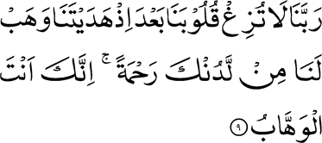
When divine communities progress, their detractors try their utmost to stop their progress by means of force
‘Our Lord, let not our hearts become perverse after Thou hast guided us; and bestow on us mercy from Thyself; surely, Thou alone art the Bestower.
Chapter 3 , Verse 9
We should pray for our belief because without God’s grace nothing can come to pass.
Prayers for Belief
Each Ahmadi should increase his or her religious knowledge and be aware of what he or she believes in and why he or she believes it so that they can respond to such covert enemies.
March 4th, 2011
Notes:
When divine communities progress, their detractors try their utmost to stop their progress by means of force or through the help of supporters whom they deem powerful. At times, they also surreptitiously and cunningly try to take those who have weak faith or who lack Tarbiyyat or adolescents away from the truth. This is why each Ahmadi should increase his or her religious knowledge and be aware of what he or she believes in and why he or she believes it so that they can respond to such covert enemies. In addition, and more importantly, we should pray for our belief because without God’s grace nothing can come to pass. For this, God has taught us a prayer: ‘Our Lord, let not our hearts become perverse after Thou hast guided us; and bestow on us mercy from Thyself; surely, Thou alone art the Bestower. (3:9). Thus one’s belief is safeguarded by God’s mercy alone and this is why a humble person is ever in need of His help, indeed, should be in need of His help. Hudhur said at times people write to him asking that if the prophethood aspect of the Promised Messiah (on whom be peace) is not mentioned in discussions etc. it lessens the hostility.

Slide 6
Hudhur said this was the open and clear claim of the Promised Messiah (on whom be peace)
This was in exact accordance with the prophecy of the Holy Prophet (PBUH)..
The Holy Prophet (PBUH) had said that there would be no Prophet between him and the Messiah, the Mahdi.
Hudhur ) aba quoted from the writings of the Promised Messiah (on whom be peace) where he said that one should not be afraid to assert heavenly matters and that it is not the practice of those who follow truth to be fearful. He said that it was his claim that he was a Prophet. He said whoever God has a dialogue with, which is a superior phenomenon than that of others and which includes prophecies in abundance, is called a Prophet. He said this definition fulfilled in his person and that he certainly was a Prophet. However, he said his prophethood was not law-bearing that would cancel Book of God and bring a new book, he said he considered such a claim as Kufr (unbelief).
Status of Promised Messiah (AS)
March 4th , 2011
Notes:
Explaining Hudhur quoted from the writings of the Promised Messiah (on whom be peace) where he said that one should not be afraid to assert heavenly matters and that it is not the practice of those who follow truth to be fearful. He said that it was his claim that he was a Prophet. He said whoever God has a dialogue with, which is a superior phenomenon than that of others and which includes prophecies in abundance, is called a Prophet. He said this definition fulfilled in his person and that he certainly was a Prophet. However, he said his prophethood was not law-bearing that would cancel Book of God and bring a new book, he said he considered such a claim as Kufr (unbelief). He said if he was not called a Prophet, then which other term would distinguish him from others who were recipients of Divine revelation. Hudhur said thus was the open and clear claim of the Promised Messiah (on whom be peace) which was in exact accordance with the prophecy of the Holy Prophet (peace and blessings of Allah be on him) who had said that there would be no Prophet between him and the Messiah, the Mahdi.

Slide 7
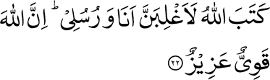
But the evil plot encompasses none but the authors thereof
. ‘Allah has decreed: ‘Most surely I will prevail, I and My Messengers.’ Verily, Allah is Powerful, Mighty.’
Chapter 35, Verse 44
Chapter 58, Verse 22
Times come when sacrifices are needed but the final triumph is of a Prophet and his people, this is the way of God and God’s way does not ever change, it will show us the bad ending of the enemy as it did before
Many a tyrannical ruler and their multitudes have contended but Godly communities continue to progress. Eventually God’s decree triumphs.
God’s decree triumphs.
March 4th , 2011
Hudhur said those who think that their throngs and the help of their worldly masters will give them success are in error. The ultimate triumph most certainly belongs to divine communities. No matter how sharp their intellect is in conspiring and making false plans, they cannot contend with God’s decree.
Notes:
Hudhur said opposition of divine communities always goes on. Many a tyrannical ruler and their multitudes have contended with them before but Godly communities continue to progress. Eventually all the multitudes are finished and God’s decree triumphs. ‘Allah has decreed: ‘Most surely I will prevail, I and My Messengers.’ Verily, Allah is Powerful, Mighty.’ (58:22). Hudhur said those who think that their throngs and the help of their worldly masters will give them success are in error. The ultimate triumph most certainly belongs to divine communities. No matter how sharp their intellect is in conspiring and making false plans, they cannot contend with God’s decree. And God has thus assured true believers: ‘…But the evil plot encompasses none but the authors thereof…’. Indeed, times come when sacrifices are needed but the final triumph is of a Prophet and his people, this is the way of God and God’s way does not ever change, it will show us the bad ending of the enemy as it did before, just as the verse cited before (35:44) states.

Slide 8
Indonesia, recent events
Hudhur said the recent barbaric happening in Indonesia gave the mullah and his coterie audacity to plan a huge rally calling for a complete ban on the Ahmadiyya Community as Muslims.
We are grateful to the Indonesian government because since then, with the exception of one or two ministers, the stance of the rulers has been good with us.
The plan was huge in scale , however God so willed that only an ordinary rally took place which finished earlier than it was planned to.
A few days earlier, government sponsored clergy had decided to hold a convention which was attended by the President of the country and thus God dismissed the other plans.
March 4th , 2011
Notes:
Hudhur said the recent barbaric happening in Indonesia gave the mullah and his coterie audacity to plan a huge rally calling for a complete ban on the Ahmadiyya Community as Muslims. They planned this rally to be hundreds of thousands strong and had made huge preparations. They said they would take their protest to the highest level in government and if not successful, they would remove the head of state from his office. The plan was huge in scale and had the Indonesian Jama’at concerned about the extremist element of it. However, God so willed that only an ordinary rally took place which finished earlier than it was planned to. A few days earlier, government sponsored clergy had decided to hold a convention which was attended by the President of the country and thus God dismissed the other plans. In any case, neither the government sponsored clergy nor the mullah are our friends. God so wills at times, that our opponent parties clash with each other. We are grateful to the Indonesian government because since then, with the exception of one or two ministers, the stance of the rulers has been good with us.

Slide 9
Hudhur said that just as after the Lahore martyrdoms we witnessed sincerity of faith emerge in Africa resulting in Bai’ats, similarly God has opened ways for pious-natured people after the Indonesian incident.
A murrabi sahib from Africa writes that he put the video clip at the start of a Tabligh session with local dignitaries and ulema. Hardly a minute of the footage had been seen when one of the imams stood up and announced that he was an Ahmadi.
He later said that he pledged that in recompose of the three martyrdoms he would bring three villages in the fold of Ahmadiyyat..
Bai’ats after Indonasian incidence
Hudhur prayed that may God enable him so
March 4th , 2011
Notes:
Hudhur said he wished to say that just as after the Lahore martyrdoms we witnessed sincerity of faith emerge in Africa resulting in Bai’ats, similarly God has opened ways for pious-natured people after the Indonesian incident. A murrabi sahib from Africa writes that after seeing video clip of the Indonesian incident he was in an emotional state. By chance a Tabligh session was planned the same day with some local dignitaries and ulema. He writes that he put the video clip on at the start of the session and explained the background of the barbaric attack. Hardly a minute of the footage had been seen when one of the imams stood up and started sobbing in the traditional African manner and said if these were Muslims carrying out barbarity in the name of the Holy Prophet (peace and blessings of Allah be on him), then he wished to forsake such Muslims and such an Islam and announced that he was an Ahmadi. Hudhur said the Tabligh session had yet to take place when God enabled one big imam to accept Ahmadiyyat. He later said that he pledged that in recompose of the three martyrdoms he would bring three villages in the fold of Ahmadiyyat. Hudhur prayed that may God enable him so.

Slide 10
God’s Decree Triumphs
Hudhur said whether the enemy plans against us overtly or covertly, their planning immediately opens the hearts of the pious-natured in favour of Ahmadiyyat
It is a warning from God that if people in earlier times came to a bad ending due to such opposition, today’s God is the same God and these are the promises of the very same All-Powerful God.
God addresses the arrogant and the conceited who are intoxicated in the conceit of their power that their arrogance will come to naught.
even today when earthquakes strike they are a cautionary sign for those who pay heed.
March 4th , 2011
Notes:
Hudhur said whether the enemy plans against us overtly or covertly, let alone frightening those of strong faith, their planning immediately opens the hearts of the pious-natured in favour of Ahmadiyyat and the task that cannot be done by our missionaries in a year is accomplished in a moment. Who indeed is there that can stop God’s work. It is God’s way that His decree triumphs and the oppressors are destroyed. It is a warning from God that if people in earlier times came to a bad ending due to such opposition, today’s God is the same God and these are the promises of the very same All-Powerful God. He says have you not seen the destruction of the earlier people? Hudhur said even today when earthquakes strike they are a cautionary sign for those who pay heed. By stating this in the Holy Qur’an, God enjoined Muslims to have sense. But unfortunately, they have forgotten this warning. God addresses the arrogant and the conceited who are intoxicated in the conceit of their power that their arrogance will come to naught.

Slide 11
And Allah is not such that anything in the heavens or the earth should frustrate His plans;’
Chapter 35 , Verse 45
And they were stronger than they in power
When looked from a worldly perspective, the powerful are right in assuming that they will overcome the others with their power.
When it comes to the Community of the Promised Messiah (on whom be peace) the contention becomes between Godly people and worldly people and here worldly principles do not work. Here the triumph will be of that side with which God’s support will be.
Godly People
God has told every Pharaoh-like person and his throngs that their power is nothing compared to God and though apparently weak, Godly people are given power by God.
March 4th , 2011
Notes:
When looked from a worldly perspective, the powerful are right in assuming that they will overcome the others with their power. Indeed, today the cunning and the powerful are the rulers around the world and they have a hold over those who are apparently called Muslims. However, here the contention is not between worldly people. When it comes to the Community of the Promised Messiah (on whom be peace) the contention becomes between Godly people and worldly people and here worldly principles do not work. Here the triumph will be of that side with which God’s support will be and God will state: ‘…And Allah is not such that anything in the heavens or the earth should frustrate His plans;’

Slide 12
Responsibility of Ahmadi Muslims
Try and make our worship of God, our prayers, our practices in line with the teachings of the Holy Prophet (peace and blessings of Allah be on him) which the Promised Messiah (on whom be peace) further unfolded for us.
Our detractors need to understand the signs of decree of God and reform themselves, otherwise, God’s decree will triumph and when His final decree comes to pass, everything is destroyed.
Huzur (aba) Hudhur said while this is glad-tiding for us in this age, it also draws attention to a responsibility: to truly connect with that Godly person and generate a special relationship with God.
If we truly inculcate this principle, then whether it is the powerful people of Pakistan, Indonesia, Bangladesh or some Arab nation, they have no standing against the All-Powerful God.
March 4th , 2011
Notes:
Hudhur said while this is glad-tiding for us in this age, it also draws attention to a responsibility: to truly connect with that Godly person and generate a special relationship with God. Try and make our worship of God, our prayers, our practices in line with the teachings of the Holy Prophet (peace and blessings of Allah be on him) which the Promised Messiah (on whom be peace) further unfolded for us. If we truly inculcate this principle, then whether it is the powerful people of Pakistan, Indonesia, Bangladesh or some Arab nation, they have no standing against the All-Powerful God. Our detractors need to understand the signs of decree of God and reform themselves, otherwise, God’s decree will triumph and when His final decree comes to pass, everything is destroyed.

Slide 13
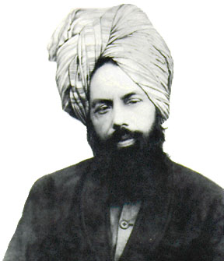
‘God will break the arrogance of the arrogant maulwis’ and ‘the truth of an especially loyal person of God reaches God in such abundance that the worldly blind cannot see it’.
‘O’ people, understand that I have that Hand in my hand which will be sincere to me till the very end.’
‘If you hide your testimony, then a time will soon come that stones will bear testimony for me.’
Sayings of Promised Messiah (as)
March 4th , 2011
Notes:
Next Hudhur read some extracts from the writings of the Promised Messiah (on whom be peace). These included the following: ‘God will break the arrogance of the arrogant maulwis’ and ‘the truth of an especially loyal person of God reaches God in such abundance that the worldly blind cannot see it’. ‘O’ people, understand that I have that Hand in my hand which be sincere to me till the very end.’ ‘If you hide your testimony, then a time will soon come that stones will bear testimony for me.’ ‘It is wrong to assume that the Promised Messiah will descend from the sky. Remember, no one will descend from the sky, all our opponents who are alive today will all die and none of them will witness Jesus, son of Mary descend from the sky. Then their surviving children will also die and none among them will witness Jesus, son of Mary descend from the sky. Then children of their children will die and they too will not witness son of Mary descend from the sky. This is when God will make their hearts anxious that the time of final triumph has passed, the world has changed but Mary’s son Jesus has not yet descended from the sky. This is when the intellectuals will be wary of this creed. And three centuries from this day would not have completed when those who await Jesus, be it Muslims or Christians, badly discouraged and dismayed, will abandon this false creed. And there will be only one religion in the world and one leader.’

Slide 14
‘It is wrong to assume that the Promised Messiah will descend from the sky. Remember, no one will descend from the sky, all our opponents who are alive today will all die and none of them will witness Jesus, son of Mary descend from the sky.
.Then their surviving children will also die and none among them will witness Jesus, son of Mary descend from the sky. Then children of their children will die and they too will not witness son of Mary descend from the sky . This is when God will make their hearts anxious that the time of final triumph has passed, the world has changed but Mary’s son Jesus has not yet descended from the sky.
This is when the intellectuals will be wary of this creed. And three centuries from this day would not have completed when those who await Jesus, be it Muslims or Christians, badly discouraged and dismayed, will abandon this false creed. And there will be only one religion in the world and one leader.’
S
March 4th , 2011
Notes:
Next Hudhur read some extracts from the writings of the Promised Messiah (on whom be peace). These included the following: ‘God will break the arrogance of the arrogant maulwis’ and ‘the truth of an especially loyal person of God reaches God in such abundance that the worldly blind cannot see it’. ‘O’ people, understand that I have that Hand in my hand which be sincere to me till the very end.’ ‘If you hide your testimony, then a time will soon come that stones will bear testimony for me.’ ‘It is wrong to assume that the Promised Messiah will descend from the sky. Remember, no one will descend from the sky, all our opponents who are alive today will all die and none of them will witness Jesus, son of Mary descend from the sky. Then their surviving children will also die and none among them will witness Jesus, son of Mary descend from the sky. Then children of their children will die and they too will not witness son of Mary descend from the sky. This is when God will make their hearts anxious that the time of final triumph has passed, the world has changed but Mary’s son Jesus has not yet descended from the sky. This is when the intellectuals will be wary of this creed. And three centuries from this day would not have completed when those who await Jesus, be it Muslims or Christians, badly discouraged and dismayed, will abandon this false creed. And there will be only one religion in the world and one leader.’

Slide 15
Great signs in favour of Ahmadiyyat
Hudhur said we thus witness the truthfulness of the words of the Promised Messiah (on whom be peace).
Today, in accordance with God’s promise Ahmadiyyat is blossoming in Asia, the islands, Europe, America and the fertile areas as well as far flung deserts of Africa.
Special attention to prayers is needed during these days, may God also cover our faults and may no act of ours be such that it deprives us of experiencing this progress.
Each sacrifice of every Ahmadi is becoming a means to attain new objectives. We should pray more than ever to partake a measure of God’s grace and for strengthening of our faith.
March 4th , 2011
Notes:
Hudhur said we thus witness the truthfulness of the words of the Promised Messiah (on whom be peace). Today, in accordance with God’s promise Ahmadiyyat is blossoming in Asia, the islands, Europe, America and the fertile areas as well as far flung deserts of Africa. Each sacrifice of every Ahmadi is becoming a means to attain new objectives. We should pray more than ever to partake a measure of God’s grace and for strengthening of our faith. World situation is fast changing, InshaAllah it will manifest great signs in favour of Ahmadiyyat. A lot of prayers are needed for this, self-reflection is needed for this. Special attention to prayers is needed during these days, may God also cover our faults and may no act of ours be such that it deprives us of experiencing this progress.

Slide 16
He took his Bai’at in 2002 and was a scholarly person.
He came into Ahmadiyyat after reading the Promised Messiah’s (on whom be peace) book ‘Ijazul Masih’.
He had a great bond with Khilafat and was in the process of handwriting the Holy Qur’an which he had said he would present to Hudhur.
He donated all his savings to the collection for Strasbourg mosque.
Hudhur (aba) lead his funeral prayers in absentia.
The sad news of demise of Imam sahib from Morocco.
May God forgive him and elevate his station in Paradise and may God open the hearts of his offspring and relatives who are not Ahmadis.
March 4th , 2011
Notes:
Next Hudhur announced the sad passing away of Imam sahib from Morroco. He took his Bai’at in 2002 and was a scholarly person. He came into Ahmadiyyat after reading the Promised Messiah’s (on whom be peace) book ‘Ijazul Masih’. He first met Hudhur at the 2003 Jalsa in France. When Hudhur visited Strasbourg last year he came to see Hudhur again. Due to his illness, he was quite frail at the time. He had a great bond with Khilafat and was in the process of handwriting the Holy Qur’an which he had said he would present to Hudhur. He donated all his savings to the collection for Strasbourg mosque. May God forgive him and elevate his station in Paradise and may God open the hearts of his offspring and relatives who are not Ahmadis.

Slide 17
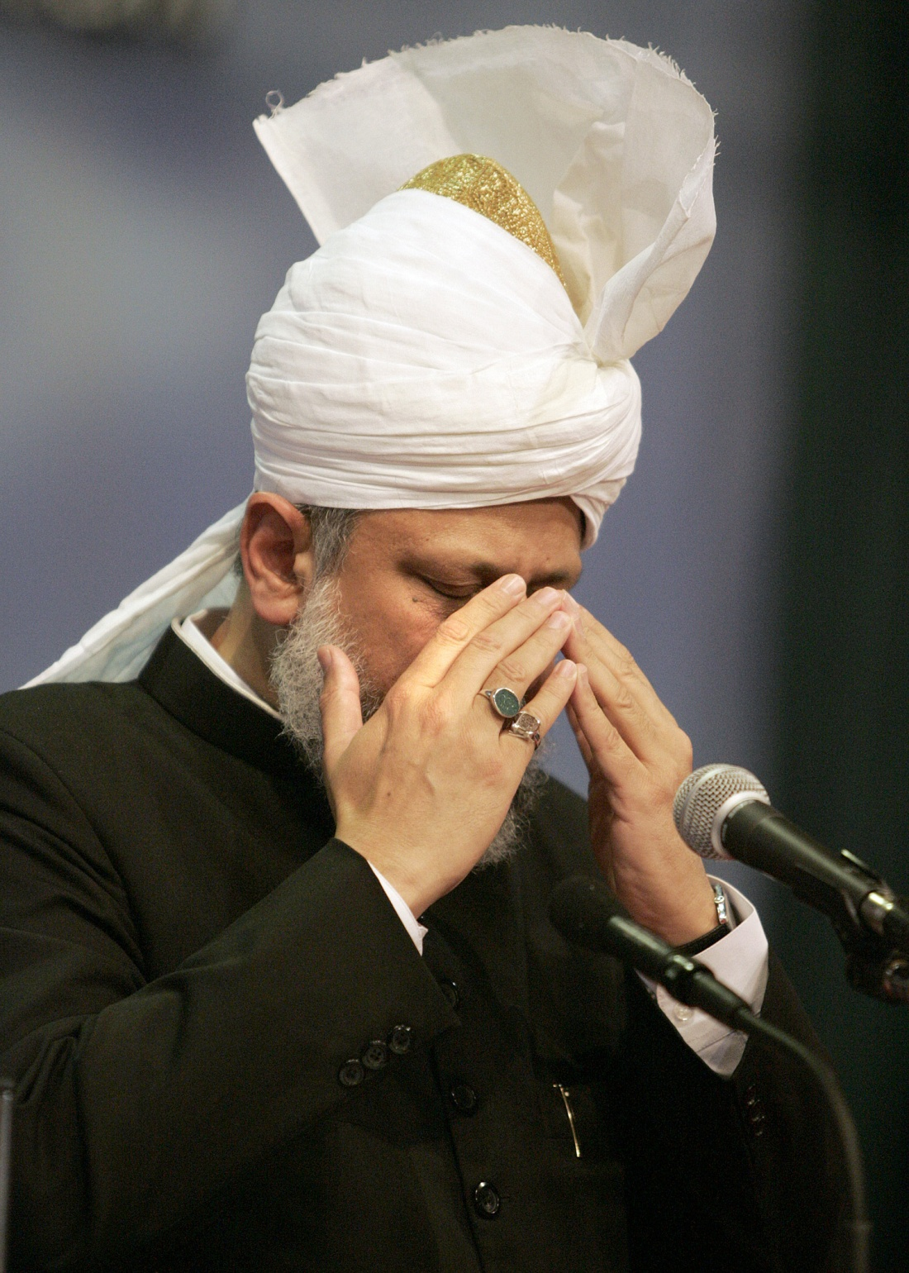
May God enable us to turn with sincerity to the one whom He has sent and to put God’s teaching in practice, to do His Tasbih in a correct manner, worship Him and take His message to others.
Hudhur asked for special prayers for the Ahmadis of Egypt where about a dozen of Ahmadis have been imprisoned. Prayers should be made for their speedy release.
Hudhur said prayers should also be made for Pakistan and the situation there.
May Allah keep everyone safe from every type of trouble and calamity and make them those who turn to Him.
Hudhur (aba) prayed
March 4th , 2011
Notes:
Hudhur prayed that may God enable us to turn with sincerity to the one whom He has sent and to put God’s teaching in practice, to do His Tasbih in a correct manner, worship Him and take His message to others.
Hudhur asked for special prayers for the Ahmadis of Egypt where a commotion has been raised against us and about a dozen of Ahmadis have been imprisoned. Prayers should be made for their speedy release. They probably think that by imprisoning the Ahmadis they can take their faith away. With the grace of God Ahmadis the world over are very strong in faith and this is what the Egyptian Ahmadis too are telling Hudhur. Initially, they held one Ahmadi lady as well but have now released her. Hudhur said prayers should also be made for Pakistan and the situation there. God has provided us with the means to take the message of the Promised Messiah (on whom be peace) to the world, it is the task of man to avail of it. May God keep everyone safe from every type of trouble and calamity and make them those who turn to Him.

