Slide 1
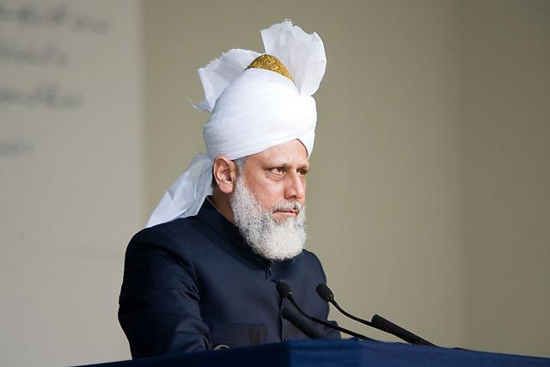
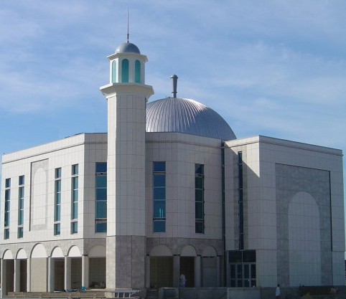
Friday Sermon Slides August 7th, 2009

Slide 2
Summary
Huzur (aba) gave a discourse on the Divine signs to distinguish the lofty station of the Promised Messiah (on whom be peace).
Huzur (aba) emphasised the status of the Promised Messiah (on whom be peace) based on his divine revelations.
Huzur (aba) explained the blessings of Allah shown to the Promised Messiah (on whom be peace) after the prophecy of Abdullah Atham came true
Huzur (aba) mentioned more martyrs in Pakistan and led their Janaza prayers
Huzur (aba) urged fervent prayers for Pakistan and Pakistani Ahmadies

Slide 3
Huzur (aba) gave a discourse on the Divine signs to distinguish the lofty station of the Promised Messiah (on whom be peace).
رَفِيْعُ الدَّرَجٰتِ ذُوْ الْعَرْشِ‌ۚ يُلْقِىْ الرُّوْحَ مِنْ اَمْرِهٖ عَلٰى مَنْ يَّشَآءُ مِنْ عِبَادِهٖ لِيُنْذِرَ يَوْمَ التَّلَاقِۙ
‏﻿﻿
‘The Exalter of ranks, the Lord of the Throne. He causes the spirit to descend with His command to whomsoever of His servants He pleases, that He may give warning of the Day of Meeting Him,’
(40:16)

Slide 4
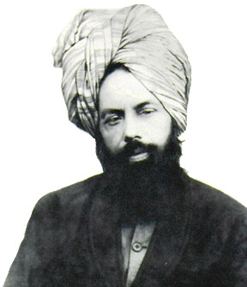
The Rafi-ud-darajaat God (Exalter of ranks) has sent the Promised Messiah (on whom be peace).
Allah sends His chosen people to revive the spiritually ailing. Just as God has sent His Prophets to each nation in each era, in the current age, He sent the Promised Messiah.
This advent was in accordance with the prophecy of the Holy Prophet (peace and blessings of Allah be on him) and borne out of his ardent love for the Prophet.
The Holy Prophet (peace and blessings of Allah be on him) had said that the Mahdi would be guided by God and will come to put right the troubled world of Islam, guiding people to the straight path.

Slide 5
Allah the Exalted revealed to the Promised Messiah (on whom be peace) that he was the chosen one

Slide 6
The Promised Messiah (on whom be peace) received many revelations from God
He sends down the Spirit on whomsoever He wills from among His servants.’
(Tadhkirah, 2007, p.764).
‘You are to Me like My Spirit.’
(Tadhkirah, 2007, p.883).

Slide 7
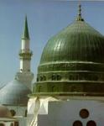
In this age, The Wise, All-Knowing God sent Hadhrat Mirza Ghulam Ahmad Qadiani.
His advent has been cited in the Holy Qur’an with reference to latter days and ahadith speak of him as a significant sign for the Ummah as they are urged to accept him.
Huzur (aba) said if the Muslims read this message with sincerity of heart there is no way they would not accept the Promised Messiah (on whom be peace).
Indeed, the Holy Prophet (peace and blessings of Allah be on him) had said that whoever lives in the age of the Mahdi should take my greetings to him.
Convey my message of peace to Mehdi (salam)
Notes:
In order to carry out His spiritual system God sends Prophets and saints. His knowledge determines who should be sent with the special message. In this age, The Wise, All-Knowing God sent Hadhrat Mirza Ghulam Ahmad Qadiani. His advent has been cited in the Holy Qur’an with reference to latter days and ahadith speak of him as a significant sign for the Ummah as they are urged to accept him. Huzur said if the Muslims read this message with sincerity of heart there is no way they would not accept the Promised Messiah (on whom be peace). Indeed, the Holy Prophet (peace and blessings of Allah be on him) had said that whoever lives in the age of the Mahdi should take my greetings to him. In one tradition related by the grandson of Hadhrat Imam Hussein, the Holy Prophet (peace and blessings of Allah be on him) said, ‘for our Mahdi two signs, the like of which have never appeared before will be evident’. The reference is of course to the solar and lunar eclipses. Huzur said while the mention of the extraordinary signs here signifies the station of the Messiah and Mahdi, the use of the term ‘our Mahdi’ by the Holy Prophet (peace and blessings of Allah be on him) signifies the love and high regard he had for him.

Slide 8
In one tradition related by the grandson of Hadhrat Imam Hussein, the Holy Prophet (peace and blessings of Allah be on him) said, ‘for our Mahdi two signs, the like of which have never appeared before will be evident’.
The reference is of course to the solar and lunar eclipses.
Huzur (aba) said while the mention of the extraordinary signs here signifies the station of the Messiah and Mahdi, the use of the term ‘our Mahdi’ by the Holy Prophet (peace and blessings of Allah be on him) signifies the love and high regard he had for him.
The unique celestial sign for the Mahdi

Slide 9
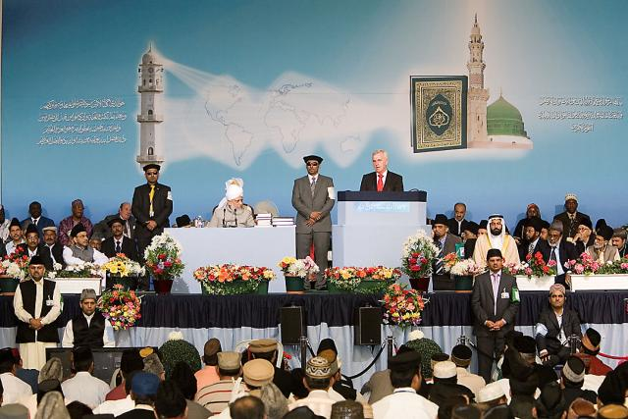
God had promised to exhibit His signs of corroboration and to exalt the Mahdi.
This promise was fulfilled when the Promised Messiah (on whom be peace) made his claim and indeed is still being fulfilled.
Prophets of God are always opposed and so was the Promised Messiah (on whom be peace). His opposition continues to this day.
He was granted a lofty station by God then Who continues to exalt him to this day.
Mahdi is destined to be successful

Slide 10
God revealed to the Promised Messiah (on whom be peace)
‘Also, ‘Allah will support thee, Allah will help thee. Allah has raised the argument of Islam. There is the beauty of Allah. He it is Who has purified you in every situation. The mysteries of the friends of Allah are without count.’
(Tadhkirah, edition ’07, p.127).
Mercy flows from thy lips, ‘O Ahmad. You are under Our care. Allah will exalt thy name and perfect His bounty upon thee in this world and the hereafter.’
(Tadhkirah, edition ’07, p. 72).

Slide 11
The elevated status of the Promised Messiah (on whom be peace)

Slide 12
God states in the Holy Qur’an in Surah Al Inshirah: ‘And removed from thee thy burden, Which had well nigh broken thy back, And We exalted thy name?’ (94:3-5)
Can anyone who associates falsehood to God, be successful?
God revealed to the Promised Messiah (on whom be peace)
Huzur (aba) said the purpose of mentioning the revelations of the Promised Messiah (on whom be peace) here is that as God consoled him through these revelations
‘O Servant of the One Who exalts, I shall raise thee towards Me. I shall bestow honour on thee. None can stop that which I bestow.’
(Tadhkirah, edition ’07, p.159)
‘I am with you, O Imam of high esteem.’
(Tadhkirah, edition ’07, p.624)

Slide 13
‘end is for the God-fearing’ (11:50) A number of aspects of a divine prophecy were the source of honour for the Promised Messiah (on whom be peace)
The Promised Messiah (on whom be peace) has mentioned a few of these signs in his book ‘Anjam e Atham’; a book that he wrote at the death of Abdullah Atham.
Atham was a Christian priest who died as fulfilment of the challenge of Mubahalah (spiritual/prayer duel). His death was a sign of the splendour of Islam and the Holy Prophet (peace and blessings of Allah be on him).
Many religious scholars and ‘custodians of shrines’ did not accept his death as a sign of the truthfulness of the Promised Messiah (on whom be peace).
The Promised Messiah (on whom be peace), therefore, wrote a book of two hundred pages, followed by an appendix and also a footnote.
In the detailed footnote he mentioned the 10 signs of the Divine support and honour bestowed on him after the Mubahalah.

Slide 14
Ten Blessings of Allah
1. Allah has restored my honour by fulfilling a seemingly impossible prophecy
2. Eloquent Arabic books were written by the Promised Messiah (on whom be peace) and remained unchallenged
3. Dramatic increase in the number of followers of Promised Messiah (on whom be peace) took place
4. The advent of the celestial signs took place
5. Highly advanced comprehension of the Holy Quran was demonstrated by the Promised Messiah (on whom be peace)

Slide 15
Ten Blessings of Allah
6. A prophesied son was born to the Promised Messiah (on whom be peace) and not his opponent as he predicted.
7. The sincere and enhanced dedication of the followers of the Promised Messiah (on whom be peace) was seen with a major increase in donations by followers, who regarded this an honour to give money to this movement.

Slide 16
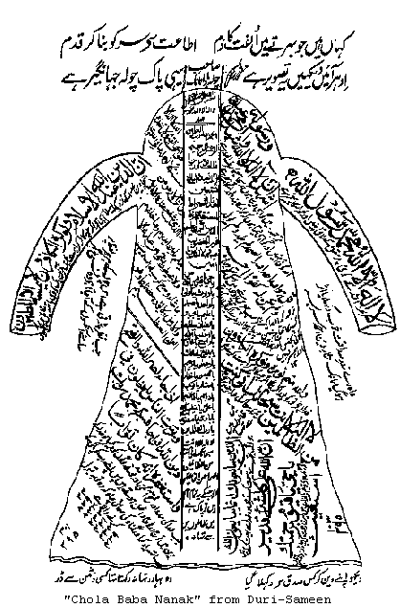
Ten Blessings of Allah
Huzur (aba) said he wished to say to people who are associated to these areas that they should always remember the sincerity of their ancestors.
8. The writing of book Satt Batchun with the special grace of Allah, the truth about the chola Baba Guru Nanak was shown to the whole world
9. Eight thousand followers entered the Ahmadiyya movement from Lahore, Sialkot, Amritsar and Kapurthala. These people excelled in their abilities and righteousness

Slide 17
Ten Blessings of Allah
10. Tenthly, the source of honour for the Promised Messiah (on whom be peace), after the Mubahalah, was the ‘Conference of Great World Religions’ in Lahore. Here, his treatise ‘Philosophy of the Teachings of Islam’ was read out by Maulvi Abdul Karim (RA). This was extremely well-received and left a profound impact on all. It was stated that it saved the day for Islam.
The Promised Messiah (on whom be peace) said how could God put such sweetness and blessing into the words of an [alleged] disbeliever?.

Slide 18
Signs of the success of the Promised Messiah

Slide 19
The Promised Messiah (on whom be peace) said that Allah the Exalted has Granted him more then 300,000 signs
Allah the Exalted has saved me from my enemies
Allah the Exalted has met all my needs
Allah the Exalted has granted me success in court cases
My prayers were accepted for my friends, and family
Righteous people were given guidance in true dreams to follow me
Pious people were told about my advent even before I was born ( Nimatullah Wali and Gulab Shah)

Slide 20
Signs for the truthfulness of the Promised Messiah (on whom be peace) after the prophecy of Abdullah Atham
When the Promised Messiah (on whom be peace) went to Jehlum in 1904 for Karam Deen court case, a dedicated crowd of 10,000 followers turned up
The increase in spiritual and physical progeny as prophesied in the Baraheen e Ahmadiyya has come true for all to see

Slide 21
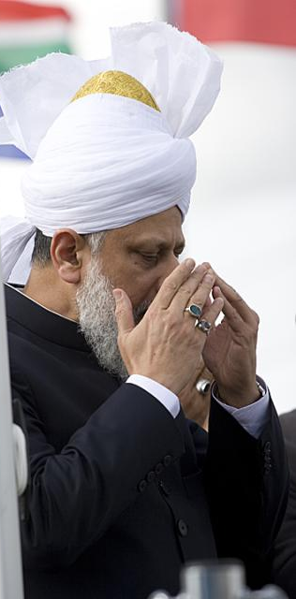
Huzur (aba) urged to pray
For safety and security of Pakistan and Pakistani Ahmadies
Allah the Exalted Saves every Ahmadi from every trouble
The forgiveness and elevated station of all the deceased including recent martyr in Multan and steadfastness for the bereaved. Aameen

